Slide 1
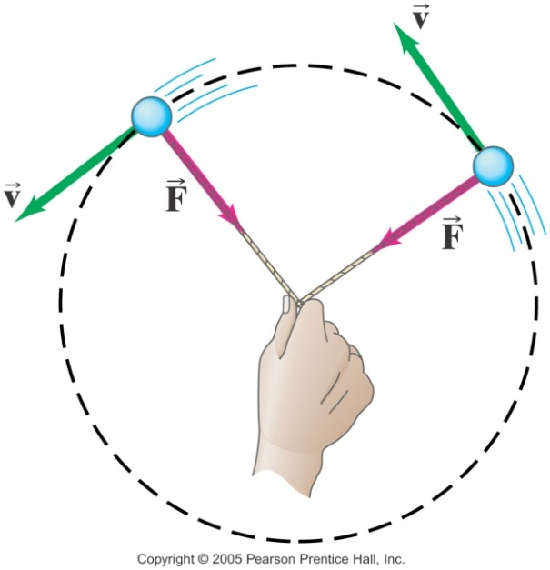
Uniform Circular Motion
UCM – motion in a circle of a
constant radius at a constant speed
Like projectile motion, it’s a
combo of 2 separate causes:
an attempt at constant speed in a straight line
(we’ll learn v is always tangent to the circle)
so that’s like PM’s horizontal v…
with a centripetal force acting – like PM’s F_{g}…
Centripetal Force – any (combination of) force(s) that make(s) an object move in a circle.
While a in linear motion is due to changing speed,
a in circular motion is due to changing direction.

Slide 2
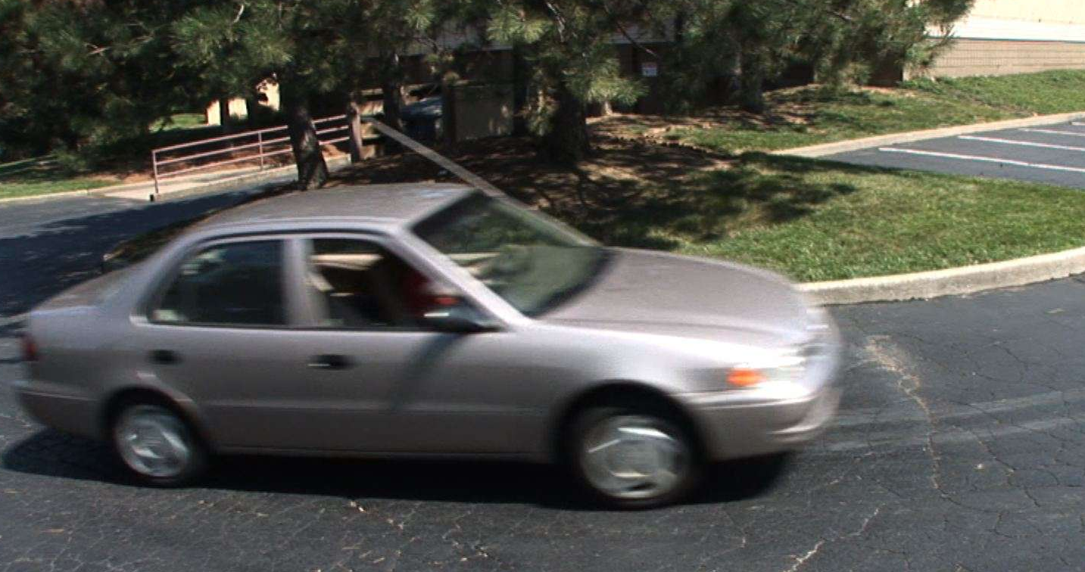
Uniform Circular Motion
Recall a time that you’ve moved in a turn or circle-
what is it that you feel?
Like you’re being thrown out of the circle!
That feeling is referred to as centrifugal force
but it’s just a feeling, not a real force –
it’s an example of a fictitious force...

Slide 3
Aside: Fictitious Forces
They arise any time an object is accelerated –
in any non-inertial frame of reference.
Like our heads feel thrown forward when a car stops suddenly
or pushed back when the car starts out
There is no force making the head move like that-
When accelerating in a car, our head is simply trying to maintain its state of motion in a non-inertia reference frame. (So N1stL doesn’t apply!)
So in UCM, our body feels like it’s being thrown out, but really it isn’t – there’s no outward force!
But since the feeling can last as long as we are turning or moving in a circle, we gave it a name: centrifugal (“center fleeing”) force.

Slide 4
So if the centrifugal (outward) force is not real, why does an object released from a circular path, fly off?
It does, but NOT straight out from the center!
It flies off tangent to the circular path!
Without the centripetal (inward) force to keep it moving in a circle, it gets to do what it’s been trying to do all along –
move in a straight line, tangent to the circle.

Slide 5
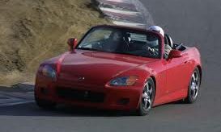
(back to) Uniform Circular Motion
An object making a turn
is changing its direction,
which means,
even if it’s traveling at a constant speed, its velocity is changing,
which means it’s accelerating,
which means, according to N2ndL,
there must be a net force acting on it,
in the direction it’s accelerating.

Slide 6
Uniform Circular Motion
So then what if it
doesn’t just make a
single turn,
but keeps
turning continually?
Then that should result in the object moving in a circle – as a circle requires a constant rate of change of direction.
And that means its got a constant acceleration.
And that means its got to have a constant net force acting on it to cause that.

Slide 7
Uniform Circular Motion
But constant acceleration and constant net force insinuate that both should have a constant value in a constant direction…
How could that be possible when the object itself has a velocity that is constantly changing direction???
Recall, physics has never claimed that an object’s velocity is in the same direction as its acceleration…
What it does state, is that an object’s change in velocity is always in the same direction as its acceleration, as well as the net force that causes that acceleration.

Slide 8
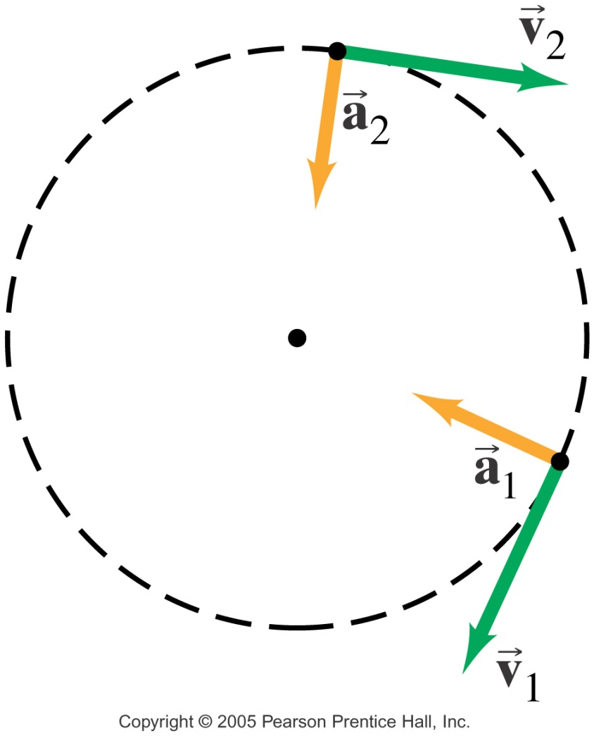
So what is the direction of Δv?
As is turns out, it’s directly along the radius, pointed toward the center of the circle.
So acceleration must be too!
called radial: a_{R} or centripetal (center-seeking): a_{C}

Slide 9
Math of Uniform Circular Motion
1st, let’s define 2 new terms:
period (T) – the time it takes an object to complete one full cycle of its repetitive motion; units: sec
frequency (f) – the number of full cycles an object can complete with a second;
units: 1/sec = hertz (Hz) or rpm
Ex: pendulum bob swinging back & forth (p296)
So mathematically, period & frequency are reciprocals of each other:
T = 1/f or f = 1/T

Slide 10
Now, as derived on p 110 in your textbook,
a_{C} = v²/r (mag only!)
where v is the linear speed of the object as it travels in the circle
and r is the radius of the circle
Does the equation make sense?
As the object goes faster around the circle, it has to change direction faster, so that should make a_{C} be larger
(directly proportional … actually power)
And if the size of the circle it travels around is larger, it doesn’t have to change direction as quickly, so that should make a_{C} be smaller
(inversely proportional)

Slide 11
Math of Uniform Circular Motion
If v in a_{C} = v²/r is the linear speed of the object as it travels in the circle,
Recall linear speed: v = Δx/Δt,
But for an object going in a circle,
Δx can be the circumference → 2πr
Δt can be the period of that trip → T
So now v = 2πr/T or v = 2πrf

Slide 12
Math of Uniform Circular Motion
And now apply N2ndL:
ΣF = ma
to UCM, and we get:
ΣF_{C} = ma_{C} = mv²/r, _____
where ΣF_{C} is the Centripetal Force
the (vector sum of all the) force(s) that makes an object move in a circle
following Δv and a_{C}, its direction is always toward the center of the circle
its what makes objects feel like they’re being thrown radially outward, as they try to go tangent, following N1st L!

Slide 13
Centripetal force (ΣF_{c}) is not a new force, it’s simply the label we give to any force that makes an object move in a circle. (The same way ΣF_{(net)} worked.)
Examples of objects under the influence of ΣF_{c}:
Anything in orbit: F_{c} from F_{G}
Electrons around nucleus: F_{c} from F_{e (electric)}
Object on Nearly Horizontal String: F_{c} from F_{T}
As long as m is small, then Φ ≈ 0 and F_{T} >> F_{g}, so that we don’t need to find F_{T} components

Slide 14
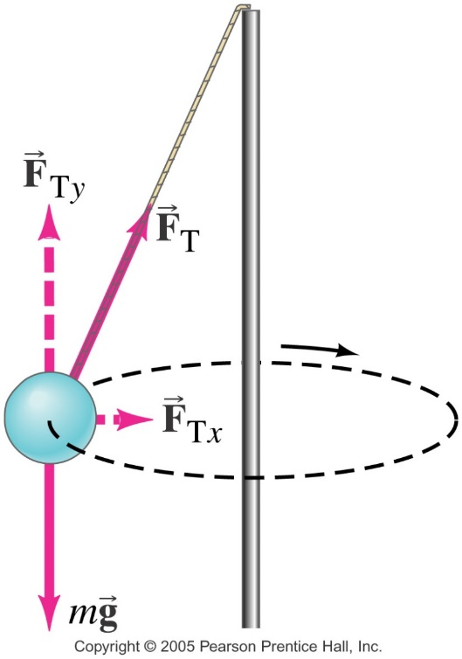
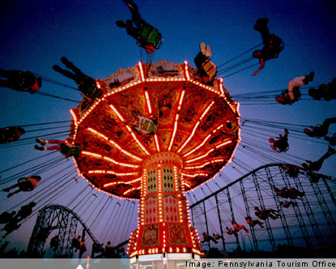
4. Object on Angled String
Ex: The Wave Swinger
Φ is larger, so need to find components of F_{T} … F_{c} from F_{Tll.}
Note, they aren’t push outward! At the start of the ride, they move along a tangential path, at the edge of the circle, until tension increases its horizontal component enough to then acts as the F_{c} to move the rider in a circle. Cool!

Slide 15
5. An Object on a Level Surface
Examples:
spin masses on pink lazy-susan
child on playground merry-go-round
F_{c} from F_{fs} between object and surface
So what happens when an object doesn’t or can’t make it around the turn or a circle?
Is it being moved out by centrifugal force?
No! No such thing!
There’s simply not enough F_{c} present to maintain the circular path, so the object begins to move tangent to the circle, or perhaps just spiraling outward into a larger radius circle that requires less F_{C} to maintain.

Slide 16
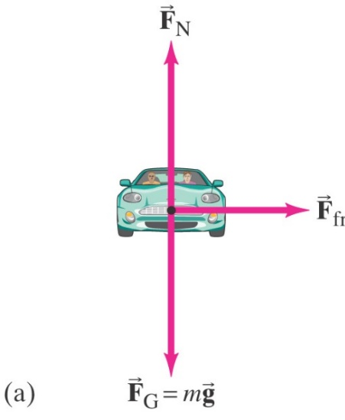
Another example of 5.: Car Turning on Level Road
F_{c} from F_{fs} between road & tires
For the passenger in the car,
F_{c} from F_{fs} between seat & clothes + F_{N}, if they end up leaned against the inside of door.
FBD of car,
top view:
FBD of car,
front view:
FBD of passenger in car:

Slide 17
But for this example of Car Turning on Level Road
why is it static friction, when the car is moving?
& why is it pointed toward the center of the curve, and not opposing the direction in which the car is moving?
Answer:
There are actually 2 forces of friction acting…
Rolling Friction - along the direction the car is moving/pointed
This is what allows the tires to push back on ground, so that ground can push forward on tires… and move the car forward.
Static Friction - which is opposing the tires sliding tangentially out of the circle and continuing in the straight line path they had before you turned the wheel.

Slide 18
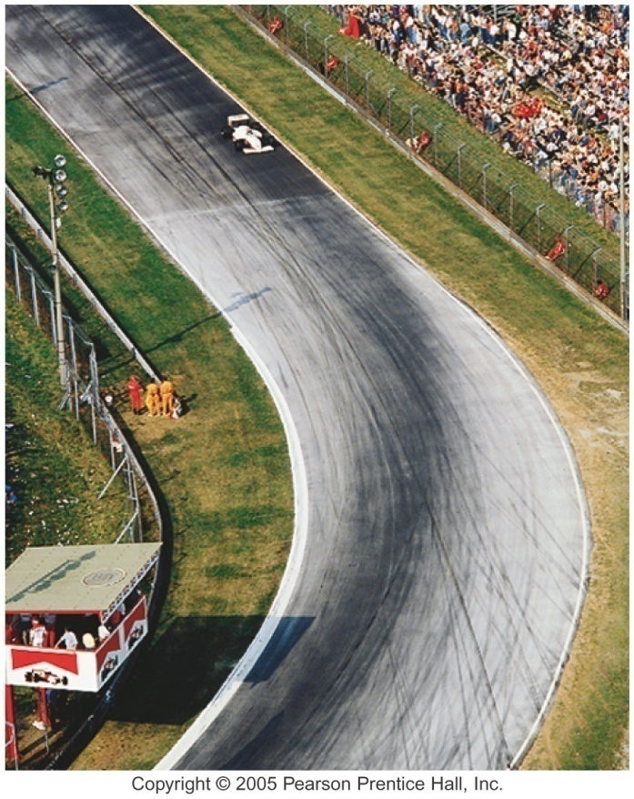
And what if the car doesn’t
make the turn; if it skids
off the road?
Since F_{c} is from F_{fs}, there
just may not be enough
F_{fs}, if it’s icy, snow covered or even just wet.
Or, since F_{c} = F_{fs} = mv²/r,
then less of F_{c} is needed for
lower speeds
larger radii
Ex: reason for lower speed
limits on highway exit ramps
Or, if it can’t be done with low
enough v or large enough r…

Slide 19
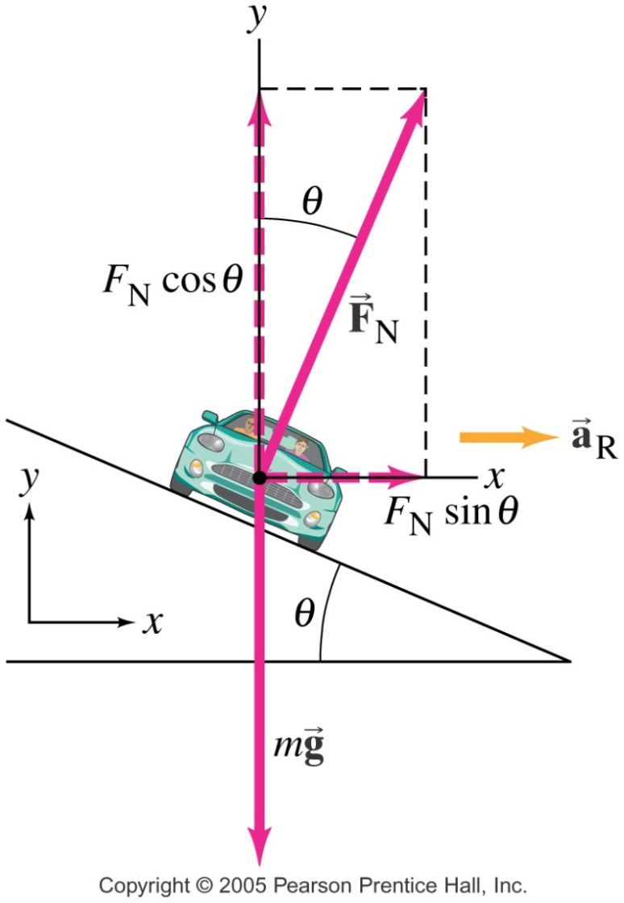
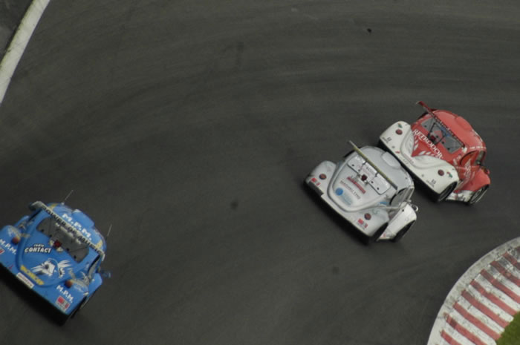
6. Object on an Inclined Surface
Ex: the banked curve
For every θ, there is one speed, v_{crit}, at which no F_{f} is required to maintain the car’s position,
For this critical case, F_{c} from ll component of F_{N}

Slide 20
Otherwise, it needs friction, and the
direction of F_{f} depends on speed:
If v > v_{crit},
then the car will attempt to slide
into a larger radius circle,
so up the incline… therefore
F_{f} acts down the incline.
If v < v_{crit},
then the car will attempt to slide
into a smaller radius circle,
so down the incline… therefore
F_{f} acts up the incline.
And either way:
ΣF_{c} = F_{Nll} + F_{fll}

Slide 21
Penn State’s
indoor track is
banked!
(courtesy of Bailey O’Malley, 2019,
& there’s a video in Ed. emails
3.18.19)

Slide 22
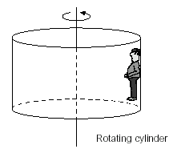
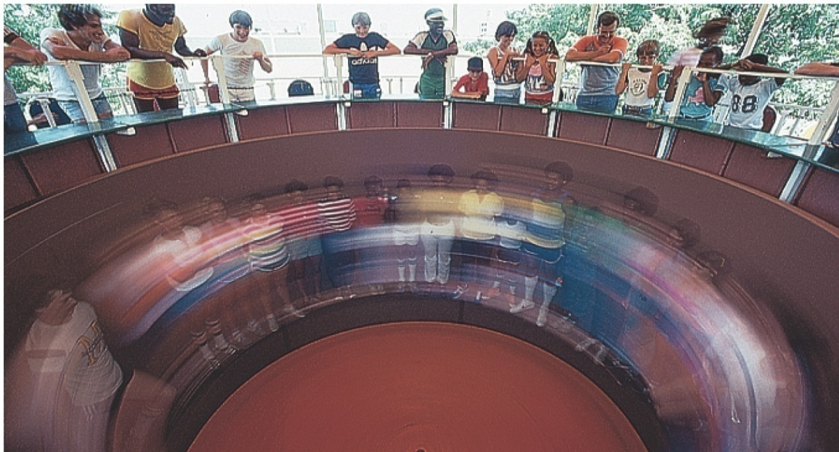
7. Object on a Vertical Surface, in a Horizontal Circle Example: the Rotor
F_{c} from F_{N} by wall

Slide 23
Another Example: Clothes in spin cycle
F_{c} from F_{N} by inner wall
But what about the water during the spin cycle?
Water drops separate from clothes thru holes in washer drum during spin cycle.
Does it go radial outward?
No – tangential outward!

Slide 24
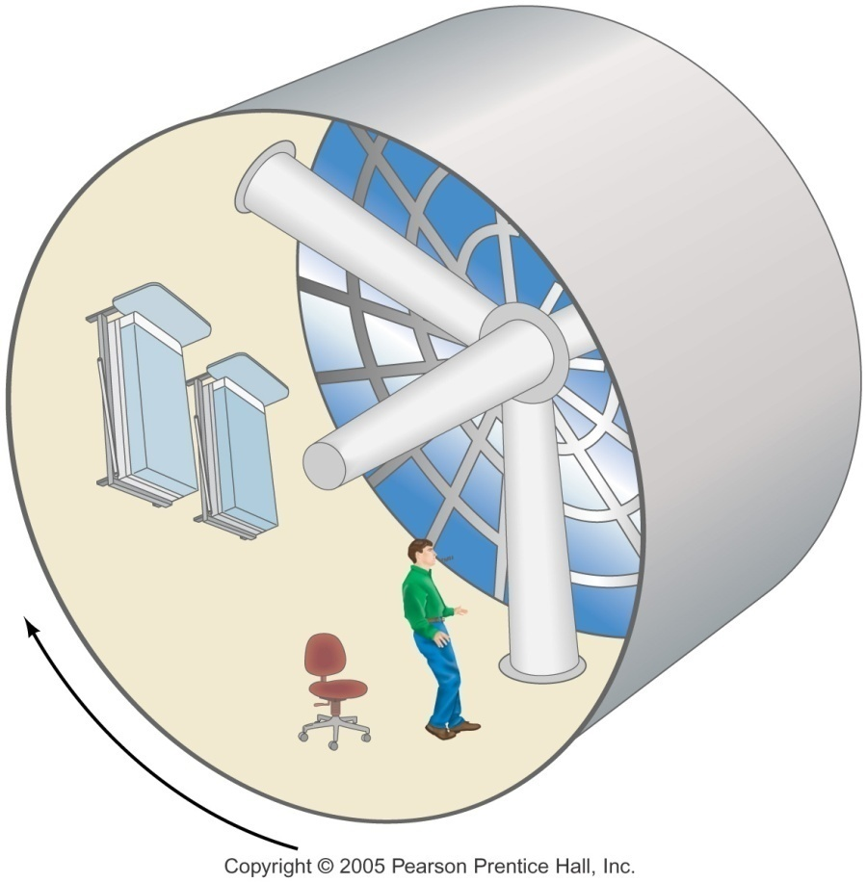
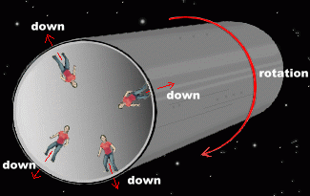
Another (maybe not so) crazy application of this:
Simulated gravity space stations!
F_{c} from F_{N} of the “floor”
(inner surface of outside wall) up on the bottom of your feet

Slide 26
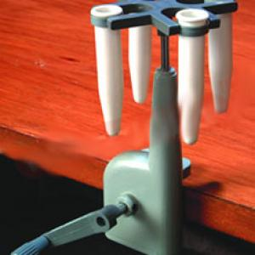
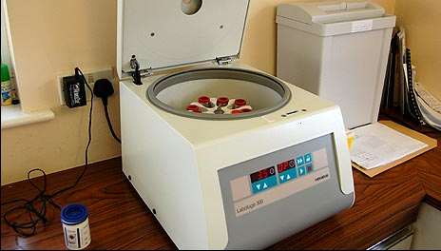
Centrifugation
A practical application… aka Artificial Sedimentation:
When a non uniform substance is rotated in horizontal UCM at high speeds (up to 10⁴ rpm!) using a centrifuge, the varying densities of the particles in the substance are easily separated from each other as each particular density (think mass…) material finds its appropriate radius of spin for the particular F_{c}, provided by the viscosity of the “rest” of the substance acting upon it.

Slide 27
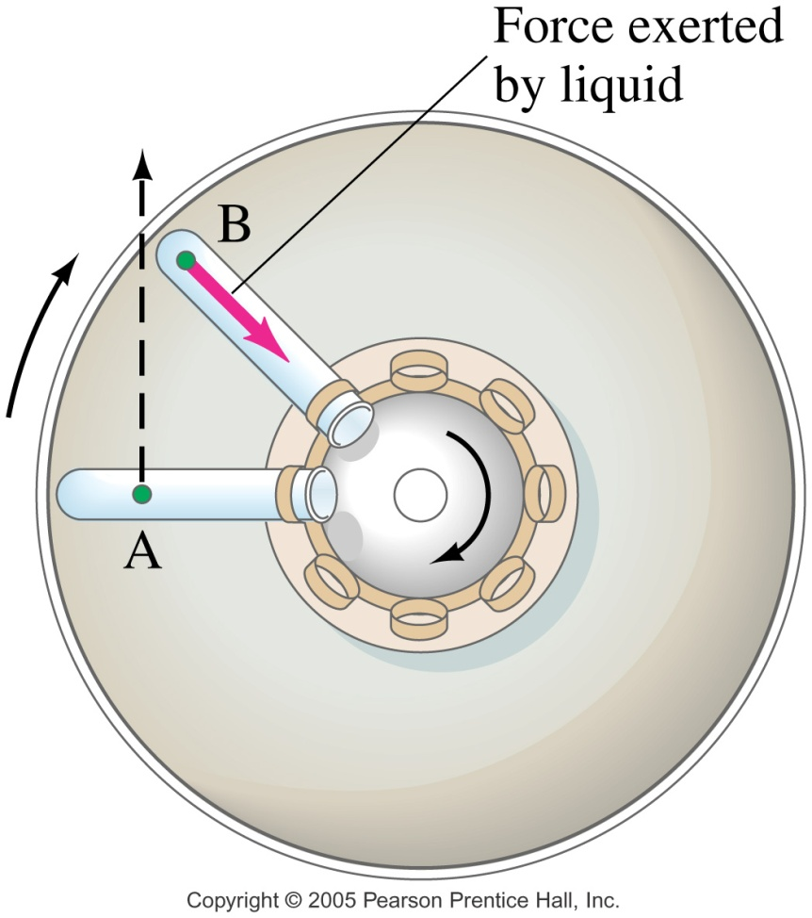
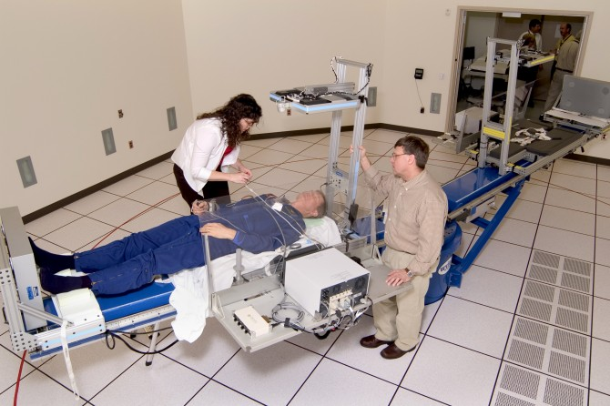
Centrifugation
Also, the heaviest particles eventually make it to the bottom of the tube, since the resistance of the rest of the substance does not provide enough Fc to move them in a circle, so they move tangent until they reach the bottom of the test tube, which then provides the necessary Fc to push on them toward the center.

Slide 28
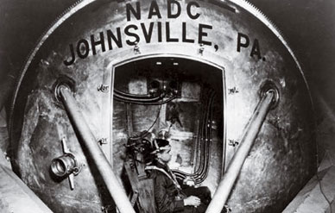
Centrifugation
Famous Human Centrifuge
Located at Johnsville Naval Base in Warmister, Pa
Used from 1950 – 1996
To test, train, experiment with military pilots and astronauts, as well as instrumentation & equipment
Could produce up to 40 g’s of acceleration!
For the Mercury, Gemini, and Apollo astronauts, the “wheel” was both a rite of passage and an invaluable training tool. “Whirling around at the end of that long arm, I was acting as a guinea pig for what a human being might encounter being launched into space or reentering the atmosphere,” Glenn recalled in John Glenn: A Memoir. “You were straining every muscle of your body to the maximum…if you even thought of easing up, your vision would narrow like a set of blinders and you’d start to black out.”

Slide 29
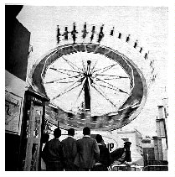
What about Vertical Circular Motion:
Note: If an object is being moved in a vert circle by a non-rigid body (ex rope), to be considered UCM,
the ΣF_{c} must be >> F_{g}.
A Ferris Wheel
The Volcano
The Round Up…
Do you feel heavier at the bottom or at the top?
Why?

Slide 30
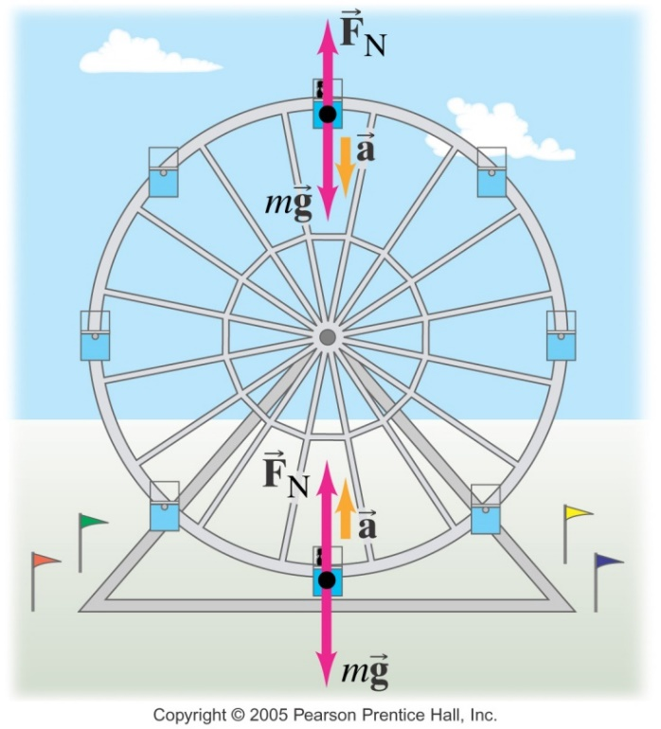
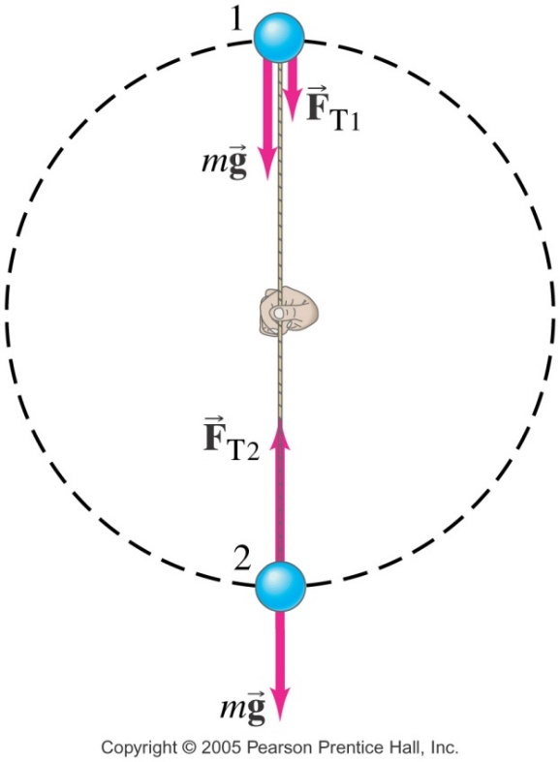
8. The Vertical Circle: F_{c} from more than 1 force?
Bottom: ΣF_{c} = F_{N/T} + F_{g} , where F_{g} pulling down & out of circle: so “-”; so F_{N/T} is large to compensate
so you feel heaviest or the string will break.
Top: ΣF_{c} = F_{N/T} + F_{g} , where F_{g} pulling down & now into circle: so “+”; now F_{N/T} is small … even 0!
so you feel light, even weightless, like in free fall.

Slide 31
Ex: The Laser Loop
So what if they build it without the top section of track? Would you ride it??

Slide 32
Non-Uniform Circular Motion
Not all circular motion is uniform – if an object speeds up or slows down, while traveling in a circle, then it will have to have an acceleration acting tangent to the circle, as well as one acting toward the center, to cause this.
Where the net acceleration, and net force, is the vector sum of these 2 and no longer acts toward the center.
If F_{tan} acts to increase v, it will spiral outward.
If F_{tan} acts to decrease v, it will spiral inward.

