Slide 1
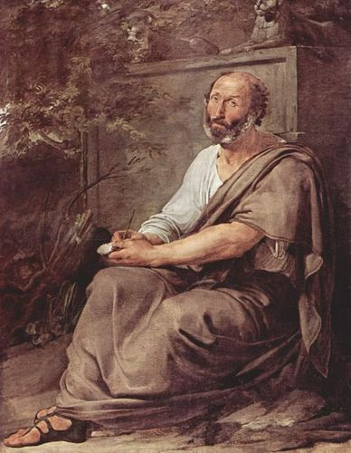
Mechanics
Kinematics – how things move
vs Dynamics – why things move
one reason: forces.
And now for a bit of history…
Around 350 BC – Aristotle
described 2 types of motion

Slide 2
Aristotle’s 2 Types of Motion
Natural – things that just naturally moved the way they do
  heavy objects fall – the heavier, the faster
  light materials rise
  heavenly bodies circle
  and, most commonly, objects come to or stay at rest, their “natural” state, including Earth – it wasn’t moving.
Violent – any motion that required a force to make it occur
  most notable, any object that keeps moving, would require a force to make it so

Slide 3
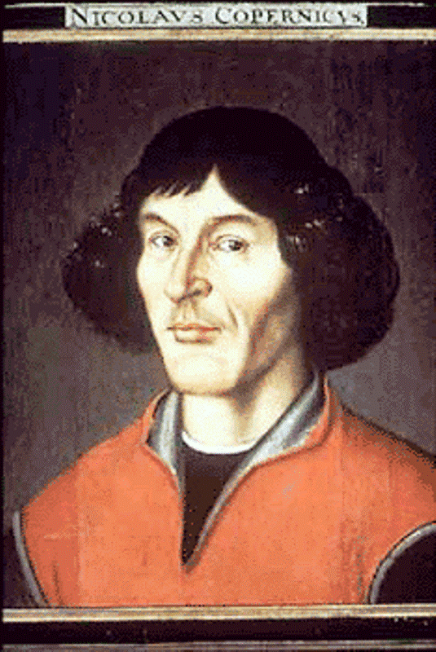
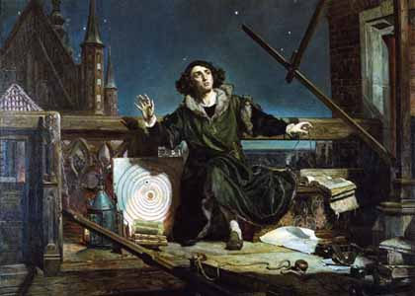
But now we know better!
Nicolaus Copernicus worked through the early 1500’s to try to explain that it was actually the Earth that moved around the sun, but fear of persecution by The Church, meant he kept this a secret

Slide 4
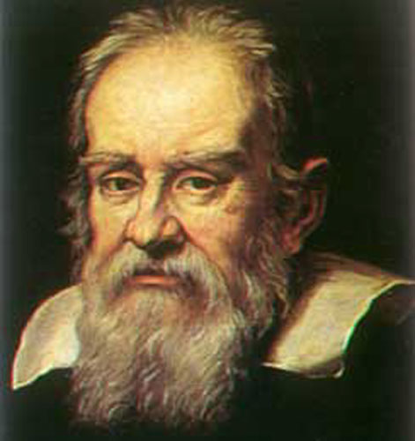
Until Galileo Galilei, in the late 1500’s and early 1600’s, not only publicly supported Copernicus, but had a few ideas of his own that would shatter our 2000 year old understanding of why things move…

Slide 5
He demolished the notion that a force is necessary to keep an object in motion, by defining and explaining friction.
1st: a force is a push or a pull
2nd: friction is a force that acts between 2 touching surfaces as they try to move relative to each other. It opposes this relative motion, slowing the objects down.
3rd: he was able to envision a world without friction – then once an object was pushed or pulled, it would move forever without any additional forces acting

Slide 6
Aristotilean View
Newtonian Mechanics
“Natural” motion does not require a force
Heavy things fall
Light things rise
Heavenly bodies circle
Moving things slow to rest
ex: no force needed to slow an object to rest
“Violent” motion – anything other than natural – requires a force
ex: a force is required to keep an object moving
Constant motion does not require a force
at rest
moving with constant velocity
No need to distinguish between these inertial frames of reference
ex: no force needed to maintain an object’s motion
Accelerated (non-inertial) motion requires a force
ex: a force is needed to slow an object to rest…
called…
friction!

Slide 7
Galileo did this by considering
    What happens when a ball is rolled up or down a ramp – then what if there was no ramp, only a horizontal plane?
      then it will roll forever
    What happens on the double sided ramp – if the ball tries to reach its original height, then what if the other side of the ramp was flat?
      then it will roll forever
    Galileo defined a new natural state as whatever the object was already doing, that’s what it would continue to do unless a force acted to change it.
Since then, we named this idea…
inertia – the tendency of an object to resist a change in its state of motion…
but there’s a better way to define this…

Slide 8
Do all objects have the same amount of inertia?
Does a wadded up ball of paper have the same tendency to resist a change in its state of motion as an 18 wheeler truck?
No. The more mass an object has, the harder it is to get it going if it is stopped and stopped if it is going – the more inertia.
  Mass – the amount of matter in an object
  Inertia – the property of an object to resist a change in its state of motion
As it turns out, (and it took about 200 years for scientist to figure this out!) mass and inertia are 2 different ways to describe the exact same property of an object

Slide 9
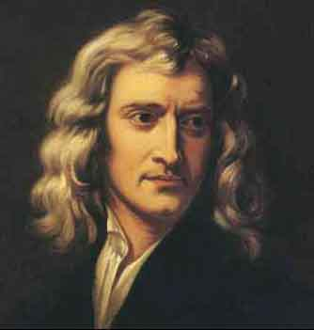
Back to some history:
Newton was born the very same year that Galileo died, and within 25 years (1667), he was the next scientist to carry on the torch of enlightenment in England at a time when the public was much more receptive to these ideas, so this time, they stuck…

Slide 10
Newton’s First Law of Motion; aka Law of Inertia (official): Every object continues in its state of rest , or of uniform velocity (straight line & constant speed) unless it is compelled to change that state by a net force.
Put simply, N1stL: objects will do whatever they’re already doing (unless acted upon by a net force)
Net Force – the vector sum of all the forces acting on an object
If net force = 0, then the object is said to be in a state of equilibrium – continuing to do whatever it was already doing

Slide 11
The idea in N1stL & the term “inertia” are often used interchangeably, and they’re not interchangeable!
So what’s the difference?
Inertia is the mass of an object… plain and simple.
And mass determines how much change in motion (aka acceleration) an object will experience if a net force is applied.
Whereas N1stL tells us that as long as no net force is applied to an object’s mass (inertia), it will continue to do whatever it was already doing.
Let’s try some…

Slide 12
Good or Bad uses of “inertia”?
The large inertia of the box made it harder to start sliding across the floor.
The large inertia of the box made it slow down and stop.
The inertia of the box, released in space, made it move forever.
The small inertia of the bike made it more likely that we could stop it and not be run over by it.

Slide 13
2 Types of Reference Frames
Recall: a frame of reference is the background by which we judge or measure an object’s motion.
Inertial reference frames are not accelerating
  can be moving, just not changing how they’re moving
Noninertial reference frames are accelerating
  Newton’s 1st & 2nd laws don’t hold true
  Objects can have motion in these that would seem to require a force, but upon closer examination, we see no such force exists!
    feeling pushed forward when driver brakes
    feeling thrown back when driver steps on gas
    feeling thrown into passenger door when driver turns left

Slide 14
Mass vs Weight
Mass - m – amount of matter in an object
  what provides the object’s inertia,
  a constant no matter where it is measured
  Units: grams – standard in chemistry – think paperclip
      kg – standard in physics – think textbook
Volume - V – amount of space object takes up
Units: liter, ml, cm³, m³
Recall Density = m/V it is the mass to volume ratio
Weight - F_{g} – the force of gravity on an object
  it’s how much gravity pulls on the mass of the object
  so depending on what the gravity is in your location, your weight will vary
  Units: Newton
So while m ≠ F_{g}
    m α F_{g} if measured in the same location.

Slide 15
The Math of Mass vs Weight
eq’n: F_{g} = mg where on Earth, g = 9.8 m/s², down
units: N = kg m/s²
  So a Newton is a derived unit, just like m/s or m/s² . derived unit – any unit which is a combination of any of the 7 fundamental units (see p. 10)
  but unlike m/s, it was a bit cumbersome to say, so we gave it a nickname, that honored Issac Newton.
  Note: 1 kg ≠ 9.8 N
  (since a kg should never be set = to a N)
  so it is bad form to use this as a conversion factor to get from m to F_{g}

Slide 16
Table of Units for Mass vs Force
System of Measurement: version | mass | force ex: weight
metric: mks (SI) | kilogram (kg) or amu (u) | Newton (N)
metric: cgs | gram (g) | dyne
British Engineering | slug | pound (lb)
Where
1 slug = 14.6 kg
1 atomic mass unit = 1.6605 x 10⁻²⁷ kg from ¹²C = 12 u
1 lb = 4.45 N = 4.45 x 10⁵ dynes
and since F = ma
1 N = 1 kg • 1 m/s²
1 lb = 1/32 slug • 32 ft/s²
Also, 1 kg has a weight of 2.20 lb where g = 9.8 m/s²
  (But 1kg ≠ 2.20 lbs!)

Slide 17
Tools to Measure Mass vs Weight
Spring scales – contain a spring that extends or compresses depending upon how much push or pull is applied – so they’re location ___________ - so they’re good to measure ____
  Ex:
Balances – compare the amount of material in one object with the amount in another – so they’re location ___________ - so they’re good to measure _____
  Ex:
But whether you’re measuring mass or weight is very confusing to keep straight and often messed up in real life – even by people of science!
  Ex: “scale” at dr’s office … in lbs
    “weigh” your sample of ____ in grams in chemistry

Slide 18
Newton’s Second Law
“ Forces do not cause motion. Forces cause accelerations”

Slide 19
Newton’s 2nd Law
Recall
acceleration is the rate of change of velocity – either speed or direction
net force – ΣF – is the vector sum of all the forces acting on an object (Σ is Greek letter sigma; means “sum of”)
  it is not the name of any one particular force.
  Therefore, you can’t apply a net force to an object, you can only apply a force that may result in a net force.
  If ΣF = 0, then the object is in a state of equilibrium
    it is not changing its state of motion – not accelerating
    the case for Newton’s 1st Law…
  If ΣF ≠ 0, then we say there is a net force acting on an object, and so it will accelerate.

Slide 20
Newton’s 2nd Law
Newton’s 2nd Law (official): The acceleration of an object is directly proportional to the net force acting on it, and is inversely proportional to its mass. The direction of the acceleration is in the direction of the net force acting on the object.
Put simply: a net force causes a mass to accelerate!
  to change its state of motion
  to do something different than it’s already doing
A constant (consistent amount of) net force causes a constant acceleration
Any size net force, no matter how small, causes any size mass, no matter how big, to accelerate.

Slide 21
  The Math of Newton’s 2nd Law…
  a α ΣF (direct) so, for the same mass,
  as ΣF changes, the a changes by the same multiple
  Ex: If ΣF = 3 N causes a = 8 m/s²,
  then if ΣF = 9 N on the same m, the a = _____
  a α 1/m (inverse) so, for the same ΣF,
  as m changes, the a changes by the inverse multiple
  Ex: If m = 10 kg has an a = 4 m/s²,
  then if m = 5 kg with same ΣF, the a = _____
  But we can combine these 2 proportions to get
  a α ΣF / m
  where the constant to make the proportion an equation has a value of 1, so
  a = (1) ΣF / m
  or just a = ΣF / m
  or more commonly, ΣF = ma

Slide 22
  Units of the ΣF = ma equation:
  1 Newton = 1 kg•1 m/s²
    so then if a = ΣF / m
    the units are: = N / kg
  = kg•m/s²
  kg
  = m/s² , which makes sense for a
  or if m = ΣF / a
    the units are: = N / m/s²
  = kg•m/s²
  m/s²
  = kg , which makes sense for m
  All of this applies to F_{g} = mg too! See it ?!?!?
  ΣF = ma is a more generic form, good for any force, whereas F_{g} = mg is only appropriate to determine the force of weight using the acceleration due to gravity.

Slide 23
In regards to the Skateboard lab, recall: 1) kg ≠ Newton
2) Any size net force, no matter how small, will make any size mass, no matter how big, accelerate.
A force can be applied to a skateboarder and cause no motion, if the skateboarder’s inertia is greater than the other forces acting on it. ______
If the mass, or inertia, of an object is at rest, then it wants to remain at rest, so a force applied to it may not be enough to overcome its inertia. _______
There is a way that a force can be applied to an object and no motion occurs with that specific force if the inertia is big enough to resist the force. ______
When an object has a greater mass, it has a greater inertia, which means a greater force is needed to move the object. So if the force is not great enough to overcome the inertia, the object will stay at rest. _____

Slide 24
Newton’s 3rd Law of Motion
The 3rd law focuses on 2 interacting objects – different than either the 1st or 2nd law, which focus on one object.
The new info we get about forces from the 3rd law is that they arise in pairs – always, no exceptions. There is no such thing as a singular force.
Action / Reaction (A/R) Forces – terms used to refer to the pairs of forces described in the 3rd law – they’re always:
  equal in magnitude
  opposite in direction
  occur simultaneously
  act on 2 different objects - the interacting objects

Slide 25
How to ID the A/R forces in an interaction:
  1st ID the 2 objects that are interacting as A & B
  where A is thought of as the instigator force
  2nd state the action as: “A exerts force on B”
  then state the reaction as “B exerts force on A”
  Since A/R forces are equal & opposite to each other, do they cancel each other out?
  NO!!
  Because they act on 2 different objects.
  See how “on A” & “on B” (from above) indicates 2 different objects! Only forces acting on the same object can cancel each other’s effect on the object,
  so A/R forces never cancel each other out!!

Slide 26
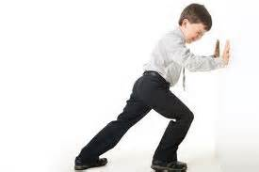
How do inanimate objects exert a force?
And how is the amount of force varied??
All materials have a degree of elasticity – a “springiness” – that allows them to stretch, if pulled upon; or compress, it pushed upon.
But when a material’s internal, atomic/molecular structure is out of its normal position, there are forces within that structure that resist the change, by pulling or pushing back. And the more the standard structure is affected, the greater the forces grow to resist the change.

Slide 27
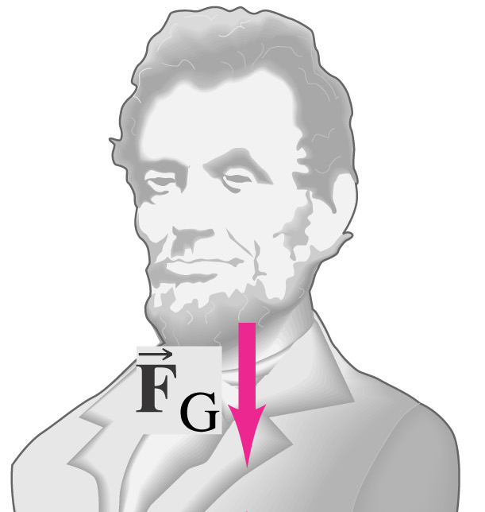
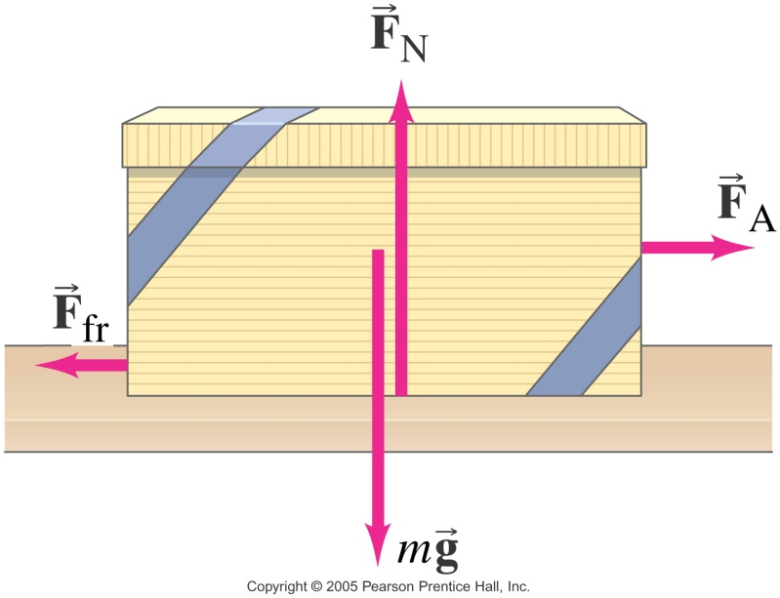
Common Forces in N2L Problems
Weight - F_{g} (or F_{G}) – the force of gravity acting on the mass of an object
Recall F_{g}= mg
Applied Force - F_{a} (or F_{P}) – the push or pull applied to an object, usually by a person or other living thing

Slide 28
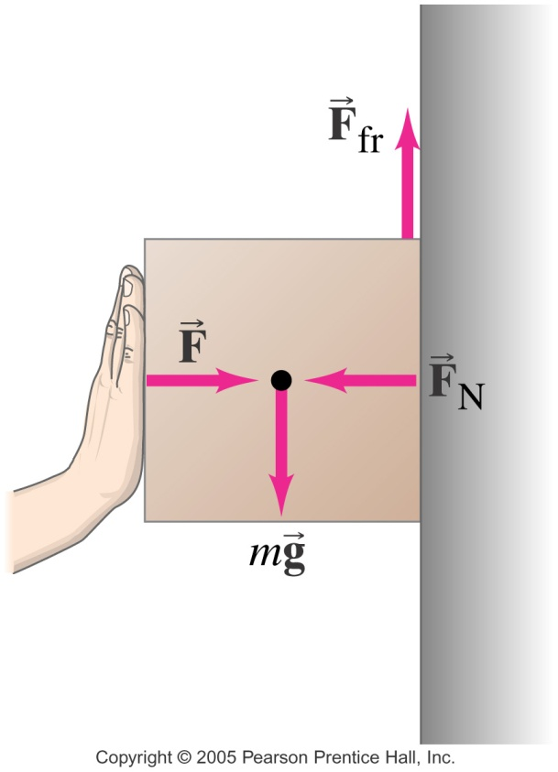
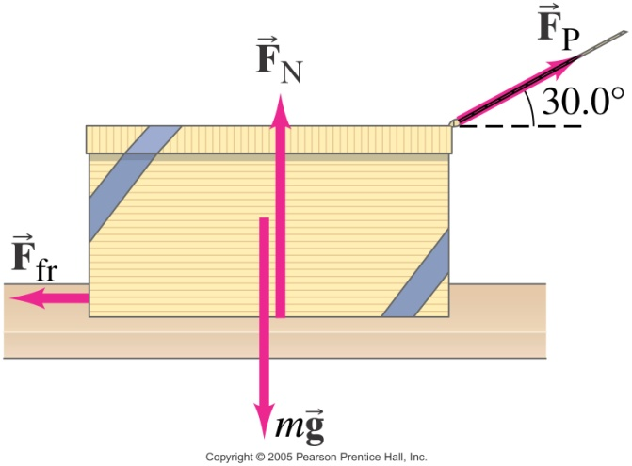
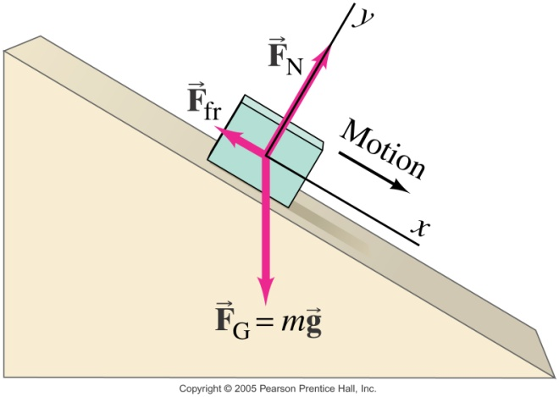
Normal Force - F_{N} – the force of support an object gets from the surface on which it rests – it always act perpendicular (normal) to the surface, so
vertical
surface
Horizontal surface
inclined
surface

Slide 29
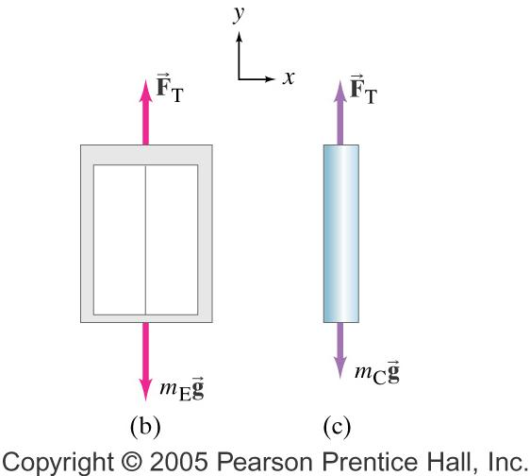
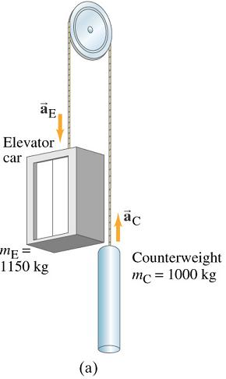
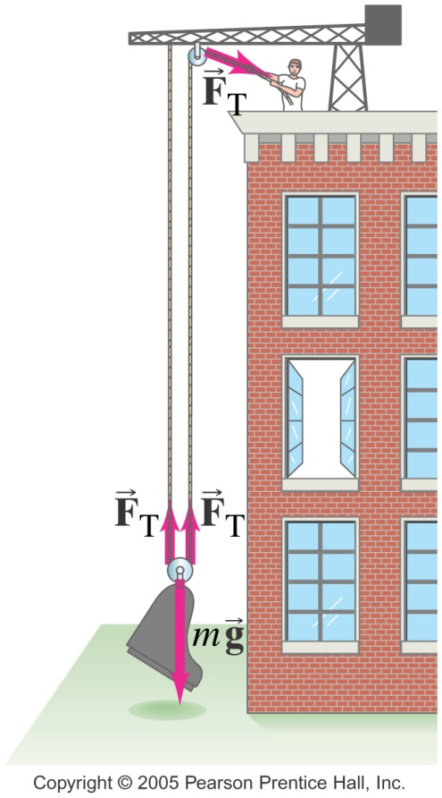
Tension - F_{T} – another supporting force applied to an object through a long, stringy thing like
  cord, string, cable, chain, even an arm…

Slide 30
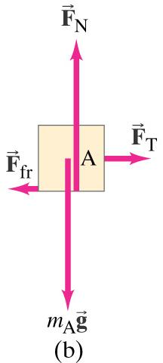
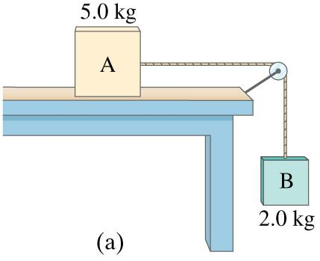
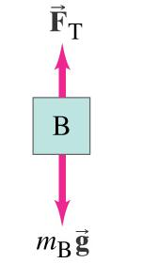
Copyright © 2005 Pearson Prentice Hall, Inc.

Slide 31
Force of Friction – F_{f}
acts between any 2 touching substances
parallel to the surfaces in contact
opposite the direction of (attempted) motion
vertical
surface
horizontal surface
inclined
surface

Slide 32
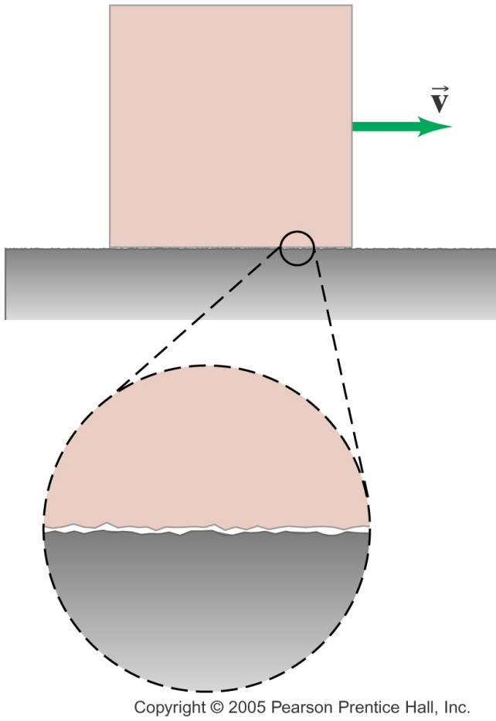
The Cause of Friction??
On a rough surface, the cause of friction is obvious – a surface gets caught on the other’s protrusions or irregularities.
But even very smooth surfaces can have a great deal of friction between them, depending on how the atoms in one surface react to being so close to the atoms in the other. If these atoms from different surfaces actually try to connect, then the surfaces will seem stuck, and can be considered “rough”, at least at the submicroscopic level.

Slide 33
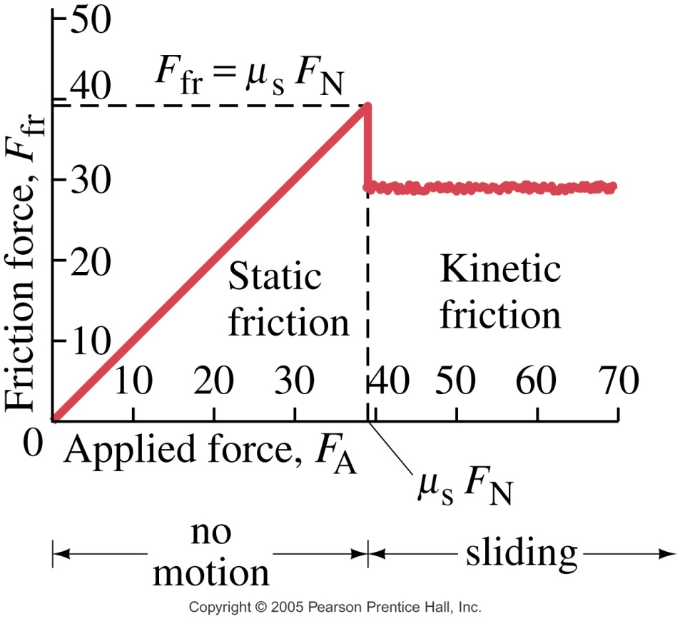
4 Types of Friction
Static - F_{fs} – opposes the start of motion
    has a range of 0 < F_{fs} < max, once motion begins
Sliding (kinetic) - F_{fk} – opposes actual motion
    has a constant value for any 2 given surfaces
Rolling – like with a ball or a car tire – more in Ch 8
Fluid – when a gas or liquid is one of the substances
Graph of F_{f} vs F_{A} (p 91)
F_{fs} increases as the applied force increases, until it reaches its maximum. Then the object starts to move, and F_{fk} takes over – notice its less than F_{fs}.

Slide 34
Determining Friction
the eq’ns: F_{fk} = μ_{k}F_{N} or F_{fs} ≤ μ_{s}F_{N}
  Note: these are magnitude only equations – they only determine the size of F_{f}. Its direction is always oppo motion, but no +/- signs belong in this equation.
So the amount of friction depends on 2 things:
the nature of the 2 surfaces in contact
  are they rough relative to each other?
  either physically or at the atomic level?
  called coefficient of friction – μ (Greek letter mu)
  it has no units: μ = F_{f} / F_{N} would cancel the only units of Newton/Newton (slope on previous graph)
  its value is determined experimentally by the 2 materials in contact (see chart)

Slide 35
Coefficients of Friction (approximate!)
2 Surfaces in Contact | μ_{s} | μ_{k}
Wood on wood | ≤ .4 | .2
Ice on ice | ≤ .1 | .03
Lubricated steel on steel | ≤ .15 | .07
Dry steel on steel | ≤ .7 | .6
Rubber on dry concrete | ≤ 1.2 | .8
Rubber on wet concrete | ≤ .8 | .5
Rubber on dry asphalt | ≤.7 | .5
Rubber on wet asphalt | ≤ .6 | .25
Teflon on Teflon | ≤ .04 | .04
  Note: usually μ_{s} > μ_{k} for any 2 surfaces
  because the atoms on the different surfaces connect in some way…
  And if they’re at rest, there’s more of a chance to connect than if they’re moving relative to each other…
  This explains why it’s harder to get an object moving than it is to keep it moving! Not due to inertia! Not due to Newton’s 1st Law! Recall, any size net force makes any size mass accelerate! If an object is at rest, it takes more force to create a net force since F_{s} > F_{k}.

Slide 36
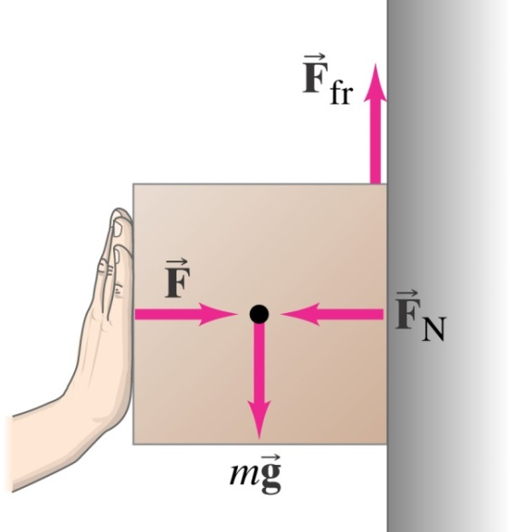

(Determining Friction – 2nd thing)
the normal force – F_{N}
  recall this is the perpendicular supporting force of a surface on an object
  depends on how much the 2 surfaces are pressed together as they try to move relative to each other
  so while F_{N} is not the weight, the weight will often, but not always, play a role in its magnitude

Slide 37
More Friction Facts…
Contrary to popular belief, friction between solid surfaces does NOT depend on
  Amount of surface area touching
  Relative speed between the 2 surfaces
And since it’s defined as acting between any 2 touching substances, it not only occurs between solids,
  but with fluids as well
fluids – anything that flows
liquids and gases are both fluids
  Ex: Air resistance, which is what causes an object in the real world, as opposed to ideal “Physicsland”, to reach terminal velocity when in falls…

Slide 38
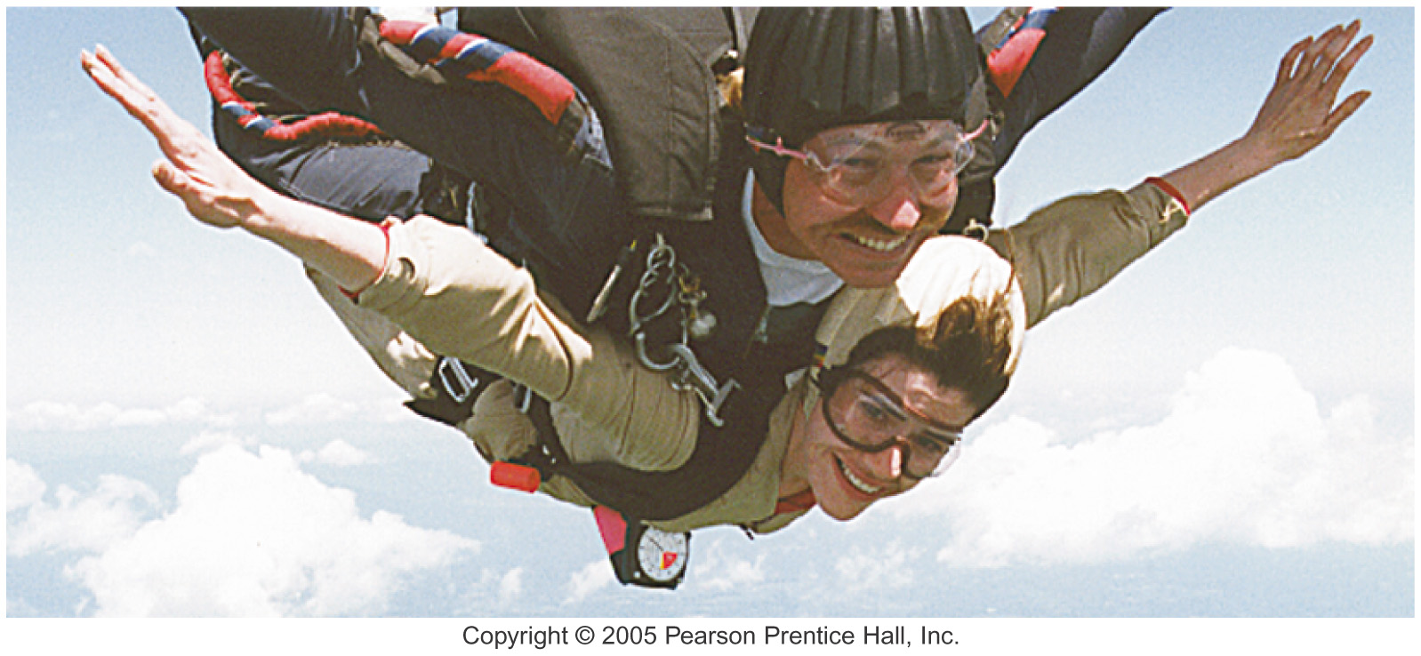
Skydiving at Terminal Velocity

Slide 39
Free Body Diagrams
Free Body Diagram (FBD) – a diagram used to indicate all the forces acting upon an object (or a system of objects) for a given snapshot in time
  may include the object, but drawn simply, like a square, rectangle or circle
  draw force vectors, in the appropriate direction, arising from a center point,
  may indicate relative (not scaled) length, but often not known, so nice but not necessary
  it can be helpful to indicate direction of motion, if known, using a snaked arrow, not touching the basic object
  if multiple objects are connected by rope, you should include all on same diagram

Slide 40
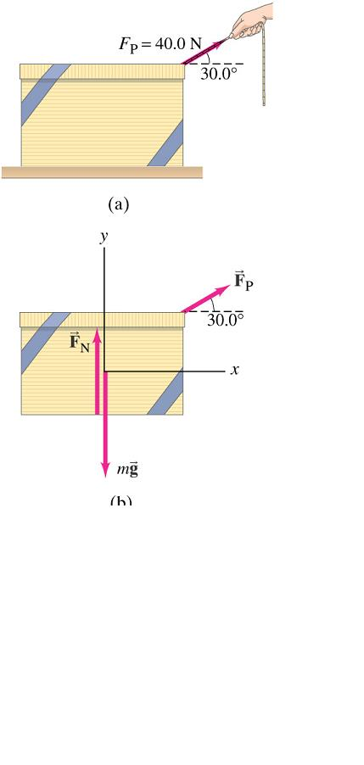
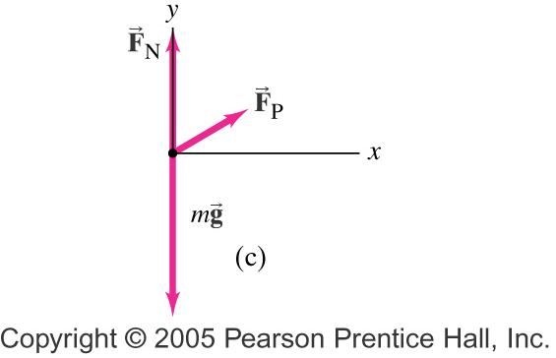
Figure 4-21
Pulling a Box p 86
FBD:
Notes:
(a) Pulling the box, Example 4-11; (b) is the free-body diagram for the box, and (c) is the free-body diagram considering all the forces to act at a point (translational motion only, which is what we have here).

Slide 41
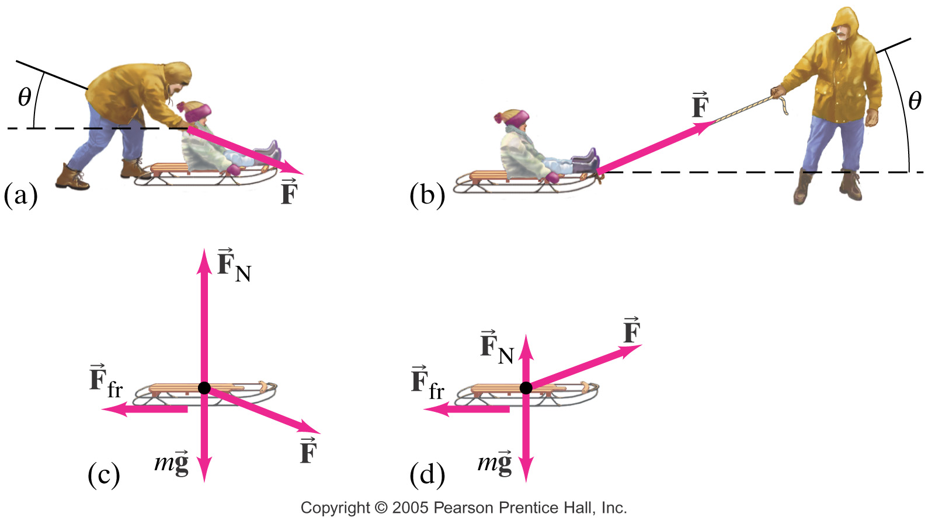
Figure 4-30
Pushing / Pulling a Sled p 92
FBD:
FBD:

Slide 42
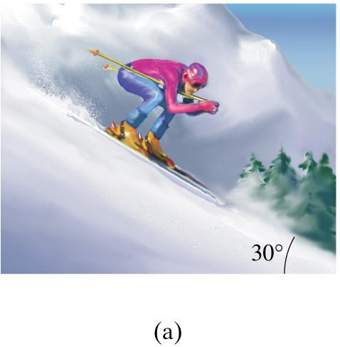
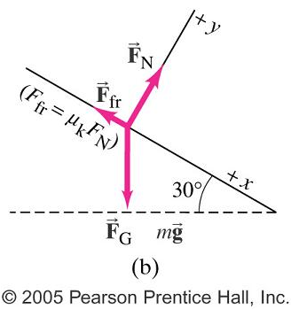
Figure 4-34
A skier descending a slope p 94
FBD:
Notes:
Example 4-21. A skier descending a slope; F_{G} = mg is the force of gravity (weight) on the skier.

Slide 43
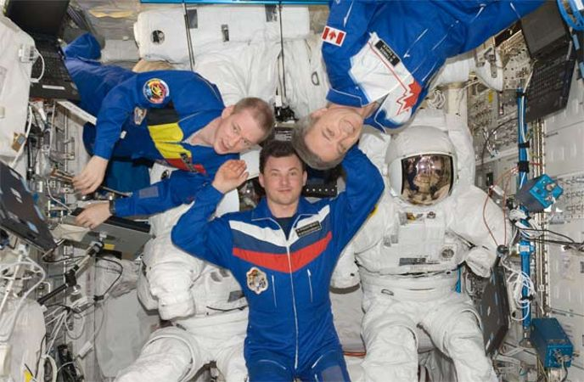
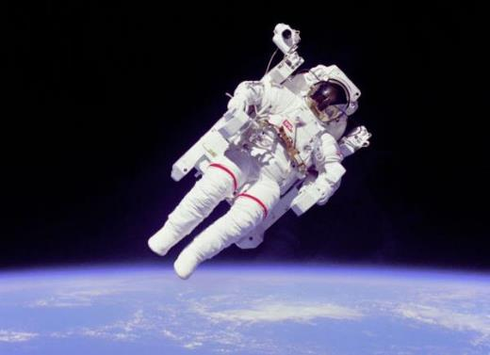
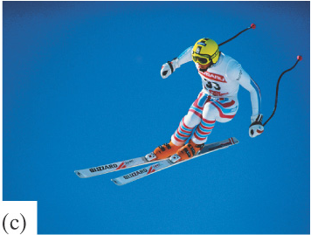
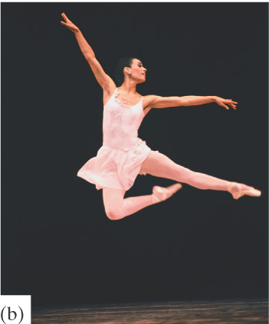
Apparent Weight
If weight is F_{g} = mg, apparent weight is how heavy you feel…
Notes:
Example 4-21. A skier descending a slope; F_{G} = mg is the force of gravity (weight) on the skier.

Slide 44
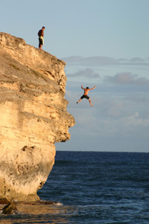
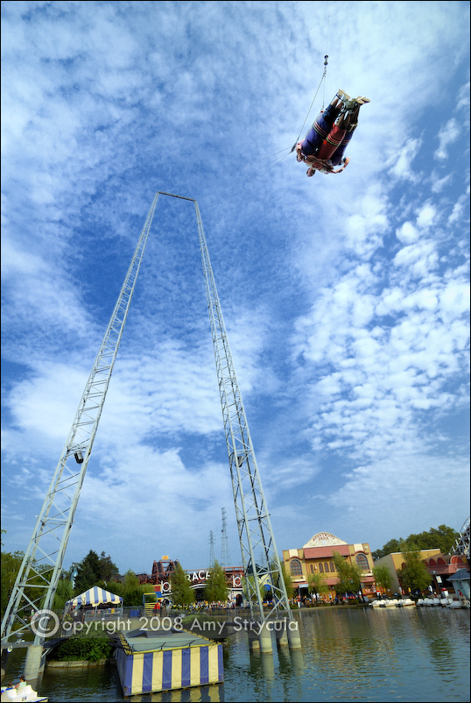
Apparent Weight
So these people might feel weightless, but it’s not because there’s no force of gravity, it’s because they have no force acting to counter gravity, like…
    F_{N}, since they’re not supported by a surface
    F_{T}, since they’re not supported by a cable, etc
Notes:
Example 4-21. A skier descending a slope; F_{G} = mg is the force of gravity (weight) on the skier.

Slide 45
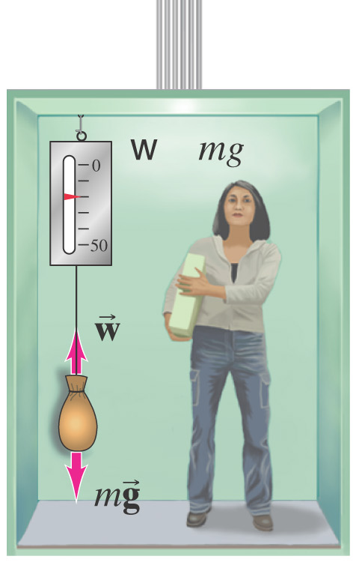
Apparent Weight
But you don’t have to feel completely weightless…
Like riding in an elevator
If you’re not accelerating, then you feel like
your normal weight.
But if you’re accelerating upward, it must
be due to a net force acting upward,
so you’ll feel heavier…
F_{N} > F_{g} (or F_{T} > F_{g} for the bag)
  Recall that could happen 2 ways
  if up is chosen as the + direction
    It could speed up, as it moves up
    It could slow down, as it moves down
Notes:
Example 4-21. A skier descending a slope; F_{G} = mg is the force of gravity (weight) on the skier.

Slide 46
Apparent Weight
But if you’re accelerating down, it must
be due to a net force acting downward,
so you feel lighter
F_{N} < F_{g} (or F_{T} < F_{g} for the bag)
  And again, that could happen 2 ways
    It could slow down, as it moves up
    It could speed up, as it moves down
Notes:
Example 4-21. A skier descending a slope; F_{G} = mg is the force of gravity (weight) on the skier.

Slide 47
  Since force is a vector quantity, it is important to clarify that perpendicular forces do no affect each other.
  So when determining ΣF, the N2L equation can be more specifically written as
  ΣF_{ll} = ma for forces acting parallel to the direction of motion
  ΣF⊥ = 0 for forces acting perpendicular to the direction of motion
  Note: it is not necessary to use these subscripts if the problem is entirely 1D.

Slide 48
Approach to Newton’s 2nd Law Math Problems
1st ID the givens and the unknown
2nd Draw a FBD with a directional key that indicates ll/⊥ and +/-
3rd Use accepted equations/definitions to connect your unknown to your givens – this will often be a multi-step process
ΣF_{ll} = ma & ΣF⊥ = 0
F_{f} = μF_{N}
  Remember: no direction – magnitude only
  Don’t get hung up on static vs kinetic – you’ll only work with one at a time, and both use same eq’n since in math problems, we’re always concerned with the max static friction – if static then note that a_{ll} = 0
Notes:
If your hand pushes against the edge of a desk (the force vector is shown in red), the desk pushes back against your hand (this force vector is shown in a different color, violet, to remind us that this force acts on a different object).

Slide 49
(Approach to Newton’s 2nd Law Math Problems)
F_{g} = mg
Any of the 5 constant acceleration equations
Any known trig function or identity
  F_{component opposite θ} = F_{original} sin θ
  F_{component adjacent θ} = F_{original} cos θ
  tan θ = sin θ/ cos θ
Strings (etc) are massless, stretchless & have consistent tension throughout
Pulleys are massless and frictionless

Slide 50

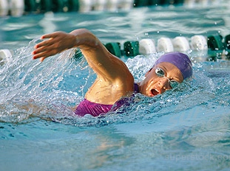
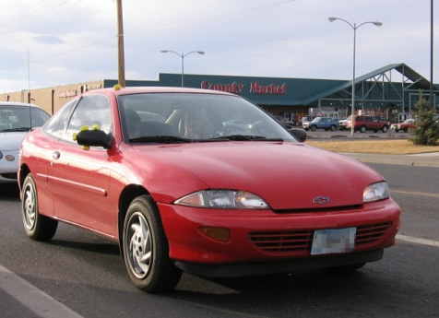

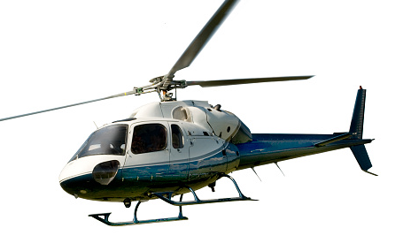
Now let’s use Newton’s 3rd Law to explain
  – A: you push down & back on ground,
  R: the ground pushes up & forward on you
  – A: you push backward on the water,
  R: the water pushes forward on you
  – A: the tires push back against road,
  R: the road pushes forward on the tires
  – A: the bird pushes its wings down on air,
  R: the air pushes up on bird’s wings
  – A: the main prop spins to push down on air,
  R: Air pushes up on the main prop
Notice friction can play a role here. Without friction, it can be impossible to initiate the action force, therefore no reaction force will exist either.
walking
swimming
a moving car
a bird taking off
a helicopter

Slide 51
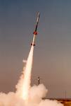

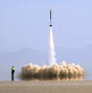
Now let’s use Newton’s 3rd Law to explain the motion of a rocket ship – what are the A/R forces?
Action: Rocket pushes fuel out the back
Reaction: Fuel pushes rocket forward
Nothing to do with the ground or surrounding air – if so, then how could it move in space??

Slide 52
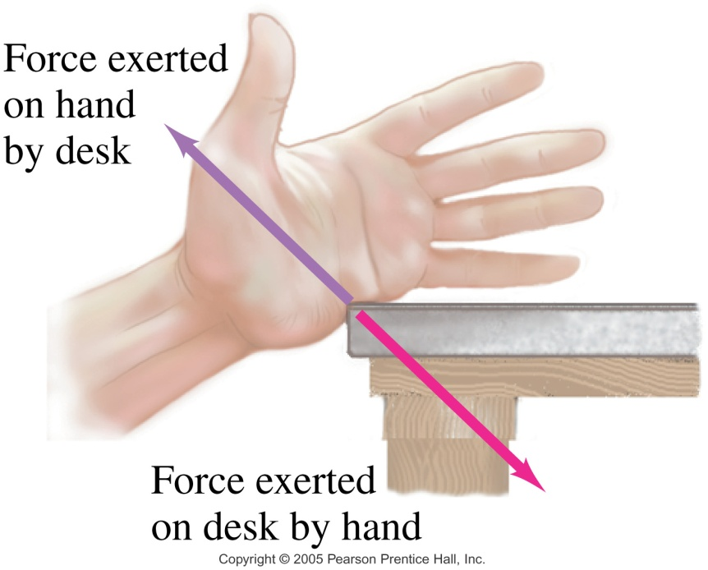
Revisiting Newton’s 3rd Law
What are the A/R forces if you push on a table?
With how much force does it push on you?
What if you pushed harder?
What determines whether or not it will accelerate?
Note that the 1st 3 questions are answered by the 3rd law, but the last one is not…
Notes:
If your hand pushes against the edge of a desk (the force vector is shown in red), the desk pushes back against your hand (this force vector is shown in a different color, violet, to remind us that this force acts on a different object).

Slide 53
  When you push on a table,
  Application of 3rd Law:
  you apply a force to the table, so it applies an = & oppo force back on you, where those A/R forces never cancel since they act on different objects.
  Application of the 1st/2nd Law:
  Whether or not the table is accelerated by your push on it depends on if your applied force to the table is enough to unbalance other forces on the table (friction) to create a net force, to cause acceleration.
  [Not!!: too much mass or too much inertia…
  Recall: any size net F, no matter how small, will make any size mass, no matter how big, accelerate!]

Slide 54
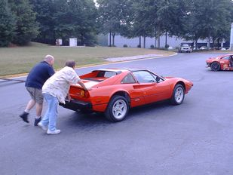
Have you ever personally move a car around??

Slide 55
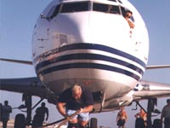
  Have you ever heard of the strong man competition, where the guys do things like pull a 747 jumbo jet with a rope? How do they do this, when the jet is far more massive than them?

Slide 56
  In terms of overcoming your opponent, it’s not about who’s more massive or stronger, it’s about who can create a net force on the other one.
  The forces they apply to each other are = & oppo, but don’t cancel, since they act on different objects.
  But if one’s force on the other object can create a net force on it, then it will cause that object to accelerate! This most likely happens when the “winner” has more friction then the “loser”.

Slide 57
  Consider any example of 2 interacting objects where one of the objects gets accelerated by the other one’s push/pull.
  What if you push on someone who’s standing on a skateboard?
  At the moment when the acceleration begins, are they still pushing/pulling on you with as much force as you’re pushing/pulling on them (are the F’s still = & oppo) ?
  Sure – there are no exceptions to the 3rd law – forces always arise in equal and opposite pairs.
  It’s just that at some point, the force you apply could be big enough to create a net force on the other object and cause it to accelerate, at which time, it would be difficult, if not impossible for you to continue applying a stronger force.

Slide 58
  What if you push on a wall made of paper?
  What if your tug-of-war match was with 1 little girl?
So while you may be stronger than the other object involved (paper wall, little girl) you simply don’t get to use all your strength in a situation like that.
Nothing can pull/push harder than the interacting object can pull/push back.
And even when you’ve gotten an object to accelerate, you have not applied more force to it then it applied back on you – that would be impossible – it would violate N3rdL!

Slide 59


  Other examples where we can try to explain how the 3rd law applies:
  What happens when you punch a wall or even a person across the jaw?
  Which way should you hold onto a fire hose?
  Which sail will move the fan cart?
  Who wins a tug-of-war match?
  Not necessarily the bigger, stronger team, but the one who can create a F_{net} on the other. Whomever has more friction, has the best shot to win.

Slide 60

Consider a ball at rest on the table.
Are F_{N} and F_{g} A/R forces?
  Both forces act on the same object – the ball
  They don’t even have to be = or oppo; what if someone pushed down on the ball? then F_{N} ≠ F_{g}
  They don’t even have to act simultaneously – consider the ball in free fall – there is no F_{N} at all.
So then what are the A/R force pairs?
  if F_{N} is the action, put it in “A on B” format:
  the table pushing up on the ball,
  then the reaction is ball pushing down on the table
  & if F_{g} is another action, put it in “A on B” format:
  the Earth pulling down on the ball,
  then the reaction is the ball pulling up on the Earth
NO!!

Slide 61
If the ball really pulls up on the Earth, does that make the Earth accelerate towards the ball?
No, because so unlikely to be an unbalanced force due to all the other interactions – walking, driving, objects falling or bouncing - taking place on the Earth’s surface at any point in time… so some other force(s) balances it out and therefore it’s not creating a net force.
OR Yes, if it somehow manages to create a net force…
but consider, if these are equal forces applying to both objects, then their accelerations will vary by the inverse of their masses (N2L).
  The mass of the Earth is 6 x 10²⁴ kg, so compared to a 0.1 kg ball, it’s billions and billions of times larger than our ball, so the ball’s acceleration, which is at most 9.8 m/s², must be billions and billions of times larger than the Earth’s acceleration toward the ball!!

Slide 62
Various Cases of Equilibrum (Statics):
1st A Block Hung from 2 Vertical Strings
What are the forces acting on it?
The Earth pulls down – force of gravity – F_{g}
The strings pull up – 2 forces of tension – F_{T1} & F_{T2}
The block is in equilibrium, so
ΣF = F_{T1} + F_{T2} + F_{g} = 0
which means F_{T1} + F_{T2} = - F_{g}
Are F_{T1} & F_{T2} equal to each other?
Most likely yes in this situation, but always?
Not necessarily – depends on how / where they’re attached to the object and if the object is made of a uniform material or not.

Slide 63
2nd A Block Hung from 2 Angled Strings
Both string’s tensions/scale’s readings get greater as the angles get wider, but why?
Since the tensions are angled, only the vertical component of each actually pulls straight up to support the weight of the object. Now these 2 components, F_{T1V} & F_{T2V}, take on the values that the scales had when they simply hung vertically.
And the more horizontal the strings/scales are, the more tension has to be put into the strings/scales along the hypotenuse to keep the vertical component of it big enough to continue balancing the weight of the block, downward.

Slide 64
The horizontal components don’t help to support the weight at all, and in fact always cancel each other out:
F_{T1H} = - F_{T2H}
Therefore, the resultant forces, F_{T1} + F_{T2}, would have to be larger than either of their components,
  and bigger than when they were simply pulling straight up, as in 1st situation.
F_{T1} = F_{T2} (the readings on the scales), & F_{T1v} = F_{T2v} (their vertical components) ONLY IF:
the supports are at equal angles
and the object is uniform, etc.

Slide 65
3rd A Block Hung from 2 Unequally Angled Strings
  The more vertical string/scale has the greater tension… but why?
  the more vertical support has the larger vertical component and therefore does more to support the weight
but the vertical components will still add to equal the weight of the object :
F_{T1V} + F_{T2V} = - F_{g}
and the horizontal components will still be equal but opposite to each other:
F_{T1H} = - F_{T2H}
Note: the string’s length DOES NOT determine the amount of tension in it!

Slide 66
4th A Block Hung from 2 Tandem Scales
Both scales read the entire weight of the object they hold, with the top one reading just a bit more, as it is holding up the 2nd scale, as well as the object.

Slide 67
Demos of Newton’s 1st Law
Little Green Truck & Blue Guy
  When you stop quickly, you FEEL thrown forward…
  But you’re not!! (There’s NO forward force acting!)
  Instead, you’re moving, so you’ll keep moving,
  but the force of the seat belt (hopefully!) pushes you backward so you slow down and stay with the vehicle.
  When you start quickly, you FEEL thrown back…
  But you’re not!! There’s NO backward force acting!)
  Instead, you’re at rest, so you’ll stay at rest,
  but the force of the seat back (& headrest) pushes on you forward to start you into motion.
    Whiplash was the common injury that used to result from a rear end collision before headrests.

Slide 68
Demos of Newton’s 1st Law
Cup, Card & Coin
  When you flick the card straight or pull it quickly,
      The coin is at rest, so its going to stay at rest,
      so the card moves right out from under it.
      The heavier coin, the better… more inertia!
  Tablecloth trick
    Same as the coin on the notecard…
      The dishes/glasses/food are at rest, so they’ll stay at rest,
      as long as…
      The dishes are heavy
      The cloth & dishes are smooth
      You pull quickly,
      You pull straight,
      You have enough room to pull it all the way out!

Slide 69
Demos of Newton’s 1st Law
Protecting the Cups from Nailing into Wood
  The books provide a large inertia, between the pounding and the cups.
  They are at rest, and have a lot of inertia to stay at rest,
  and if they don’t move, then the cups won’t be affected.
  Without the inertia of the books, the cups feel the force of pounding, and it causes them to change their state of motion (ie crumple & crush).
  Similar example: street performers that use a sledgehammer to smash something soft on top of a concrete block sitting atop someone’s chest.
  Sometimes it involves a bed of nails too… more later:)

Slide 70
Demos of Newton’s 1st Law
Break the Board with Newspaper???
  The column of air on top of the sheet of newspaper actually has a lot of inertia
  It’s at rest, and has a lot of inertia to stay at rest,
  So the board snaps before the paper will be moved.
Important Note: All of these examples only work with forces being applied over very quick/short periods of time.
This goes back to our study of acceleration.
If you take a long time to change an object’s velocity, then that will require less acceleration by the object that you’re messing with, which in turn requires less force. (N2ndL)
So the little bit of force that might be there to get the object to change its motion, in a more gentler way, will likely work, and you won’t see the dramatic effects like we did in the demos!

