Slide 1
Graphical Analysis of Motion
2 ways to solve motion problems:
Mathematically
Graphically – we’re going to 1st focus here for a while…
2 ways to create a graph:
“Plot”: means to follow all standard graphing requirements & techniques, & use of exact numbering –
a pain, but necessary at times
“Sketch”:
only requires a basic title (y vs x)
variable labels & units on axiis (if you know them)
general shape of the curve to indicate the relationship

Slide 2
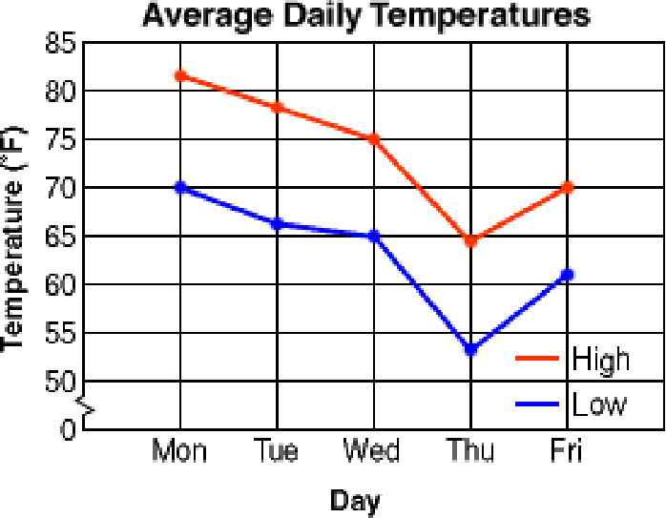
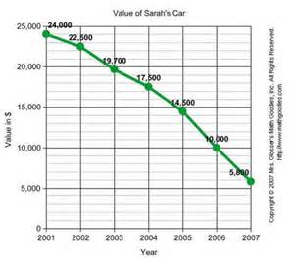
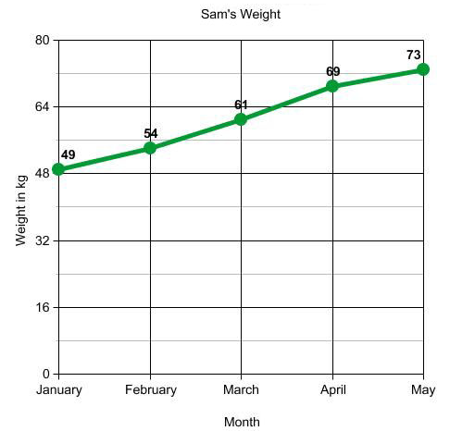
3 Ways We Gain Information from a Graph:
1. Read the x or y axis value

Slide 3
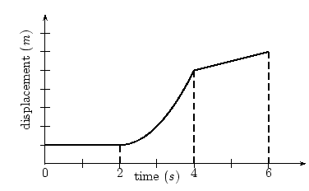
2. Slope
Be able to describe it in 2 words. Choose one from each:
1) 0 or + or −
0 for horizontal; +/- for slanted (up/down)
2) constant or increasing or decreasing
constant for a line; inc/dec for curves
Note the graphs we study will be of objects that have different types of motion during a single trip, so within each “section” there should be a single relationship (type of motion) represented, but expect that there will be multiple sections.

Slide 4
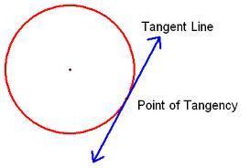
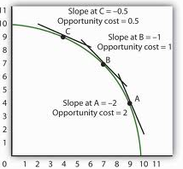
Also need to be able to determine the value of the slope.
But what if the graph presents an inverse or power relationship, where the shape is not a straight line?
Then draw a tangent to curve and find the slope of that line.
a line that touches
a circle at just one
point
Theoretically one right answer for each point, so select placement carefully and draw with straight edge & sharp point on your pencil.
Our motion graphs will have curves from different circles, so it’s ok if a tangent from one curve runs into a different curve on the graph.

Slide 5
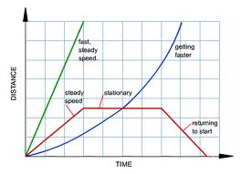
3. Determine area under the curve –
“under” means between curve & x-axis…
so if curve in 3rd quadrant, then “under” is really “over”:

Slide 6
How this will apply to the 3 motion graphs we work with:
x vs Δt v vs Δt a vs Δt
Δx = A _{v vs Δt} Δv = A _{a vs Δt}
position
m _{x vs Δt} = v m _{v vs Δt} = a
So to
summarize:
Info from | x vs t | v vs t | a vs t
y axis
slope
area

Slide 7
Notice where the slope of your graph begins to do something different, this indicate where the object changed to a different type of motion during its trip, and where you should expect a different look on the corresponding graphs as well.

