Slide 1
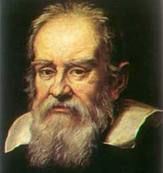
Galileo Galilei (1564-1642)
"You must read the book of Nature... In other words, observe and do experiments. This is against the medieval idea of scholasticism--that all wisdom and knowledge are best found in ancient authorities."
"Truth cannot be found in the book of Aristotle but in the book of Nature; and the book of Nature is written in the language of mathematics.“

Slide 2
Galileo creatively thought to idealize real life by simplifying the situation of a falling object
-- by removing the effects of air resistance .
If so, then he predicted a mathematical relationship for distance fallen as a function of time:
y α t²
This is a perfect parabolic relationship, which means a graph of position vs time would result in a parabola, so the rate of change of the slope of its curve is constant!
That means the rate of change of velocity would be constant!!
That means the acceleration is a constant!!!
This was caused by the force of gravity!!!!, although we didn’t have that term until Newton’s day (1642-1727)

Slide 3
This was a big deal! Up until this time, thanks to the Greek scholar, Aristotle (384-322 BC), objects weren’t known to accelerate when they fall, nor was it ever conceived that the rate of fall could be similar for different mass objects.
The rule for falling objects in ancient Greece, was that heavier objects fall faster than lighter ones.
This makes perfect common sense, until you test it a few different ways…

Slide 4
Free Fall
Free Fall - a state of motion where an object has a constant acceleration because it is only affected by force of gravity
- so there can be no air resistance
So to conduct an experiment about free fall, involving an object in a room filled with air…
we need to minimize the affects of air by using an object with
maximum mass
minimal surface area (& smooth)
short drop distance

Slide 5
In free fall, the object is only affected by one thing – gravity.
But where does gravity come from?
from the mass of an object
the more massive, the more gravity
So Earth vs moon vs Jupiter…
Where the value of acceleration caused by gravity here on Earth is:
g ≈ 10 m/s², to center of Earth
or more exactly, for math problems…
g = 9.80 m/s², to center of Earth (down)
(always include the end “0” in labs, for correct sig figs)

Slide 6
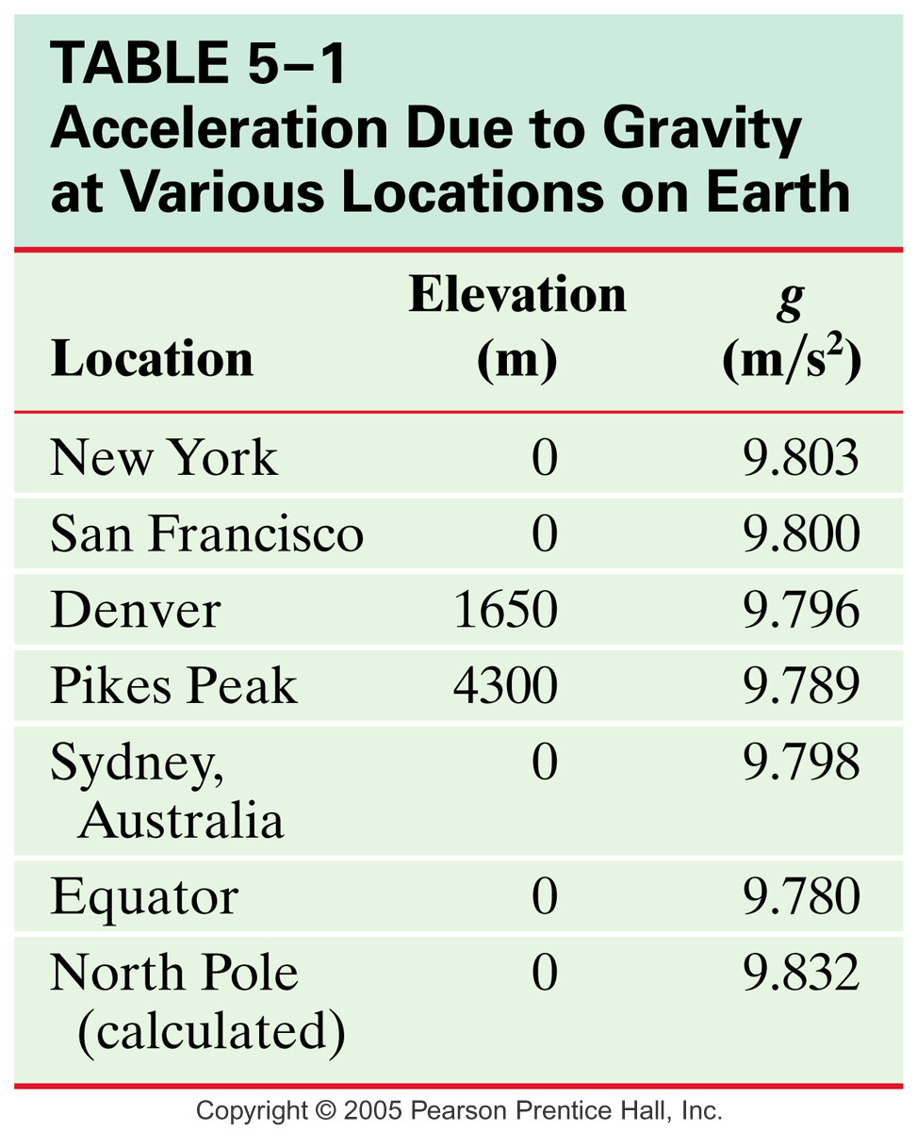
The Value of g
g is a measured quantity, so it varies from place to place.
Depends on
Latitude
Elevation

Slide 7
Since gravity always pulls down on things, the direction “down” accounts for both
Losing speed as it goes up
Gaining speed as it goes down
So here we see a another great example of where velocity and acceleration can be in different directions!
That means an object in free fall will
gain 9.8 m/s every second as it falls
lose 9.8 m/s every second as it rises
& maintains 9.8 m/s² at the tip top, where v = 0
g gets object to keep changing its v, resulting in a change of direction, so it comes back down
Otherwise, it would just stay there… weird…

Slide 8
So what if air is an issue???
Then the a ≠ 9.8 m/s²
nor is it even a set, constant value -
(we’ll learn more about this later…)
Characteristics of an object that affect how it falls when air is present
mass
shape / surface area
Note we never deal with these in free fall situations, as they don’t matter -- everything falls identically in free fall!
But sometimes these characteristics provide unexpected results, as we saw earlier… So thank goodness for Galileo’s idea to simplify the world we live in – that’s the difference between physics and engineering/real life!

Slide 9
The Constant Acceleration Equations for Free Fall
Displacement will be vertical, so use y instead of x
Acceleration is due to gravity, so use a = 9.80 m/s², downward
v_{f} = v_{i} + aΔt
Δy = v_{i} Δt + ½aΔt²
Δy = v_{f} Δt - ½aΔt²
v_{f}² = v_{i}² + 2aΔy
Δy = (v_{i} + v_{f}) Δt
2

Slide 10
Solving Free Fall Problems
For direction, usually down is – & up is +
but either way will work as long as you’re consistent throughout that problem.
Always ID your choice with a directional key.
Pre-empting some confusion:
Velocity starting an “up” trip can’t be 0
Velocity ending a “down” trip can’t be 0
If you’re thinking it can, your including more of the trip than just its free fall part.
Remember free fall means gravity is the only force acting, so you can’t include the part where something (a person, a gun, a trampoline) applies a force to make it go up, nor can you include the part where something (the ground, the floor, a person) applies a force to make it stop once it comes back down.
Velocity = 0 at the top

Slide 11
Ex 3. A ball is thrown straight up, reaching a maximum height of 71 m. How long does this take?
3.81 s

