Slide 1
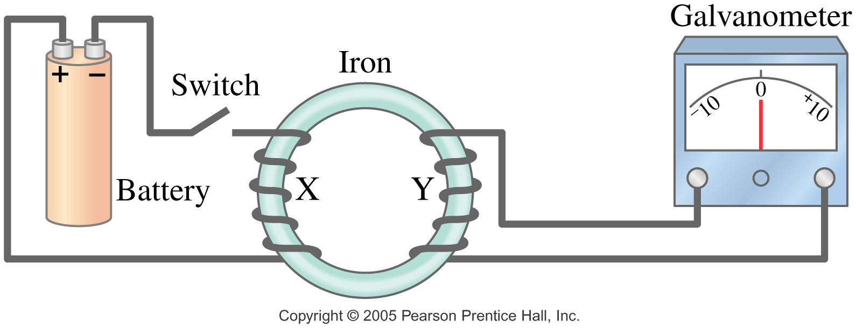
Electromagnetic Induction: the next huge discovery!
If a current can create a magnetic field,
can a magnetic field create a current??
Yes! Electromagnetic induction – a changing magnetic field induces an emf – known as Faraday’s law…
Discovered by Michael Faraday in England, using a set up as pictured below, and Joseph Henry in US in 1831 (10 years after Oersted)

Slide 2
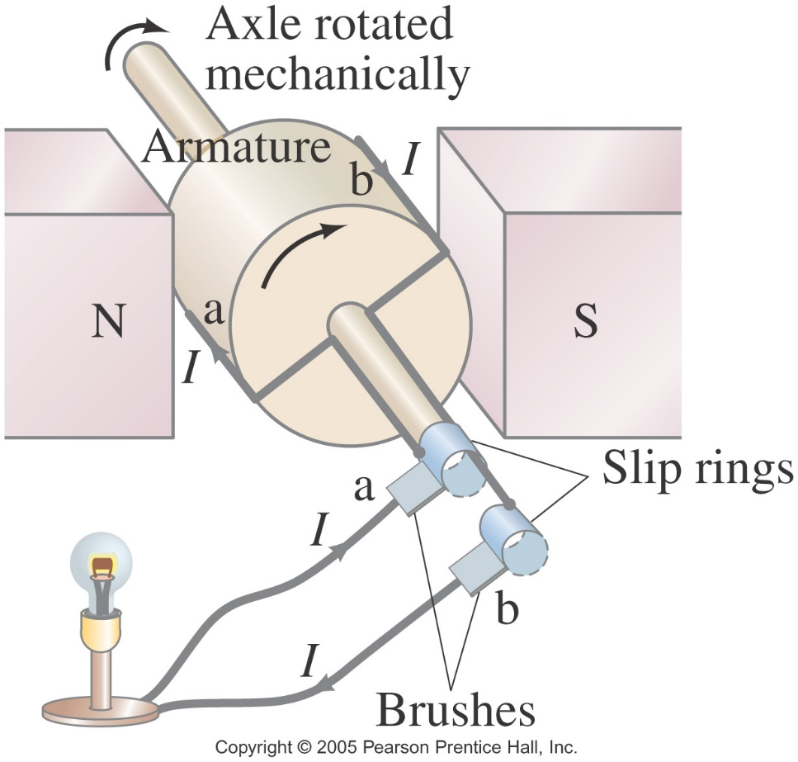
So now the 2nd connection between E & M:
If you supply relative movement to a wire & a nearby magnetic field,
current will flow!
The key is in the relative
motion… no motion, no I.
If the wire is looped,
then current is created in
switching directions –
called alternating current:
that’s a generator!!
Now plug whatever into it…
Refrigerator
TV
Cell phone charger

Slide 3
So to recap…
Electromagnetism is the basis for a motor:
Put a voltage across looped wire, creating an electromagnet, that’s in a magnetic field so that the loop feels torque and is spun.
Or more basically:
motors turn electric PE (voltage) into KE (motion).
Electromagnetic induction is the basis for a generator:
Supply relative motion to a magnet & looped wire so that a current is induced in the wire.
Or more basically:
generators turn KE (motion) into electric PE (voltage).
Then motors & generators are essentially the same device in construction, just opposites of each other in use!

Slide 4
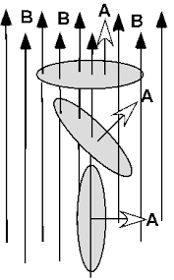
New Term: Flux & New Vector: Area
Flux, Φ – a scalar quantity that connects the strength of a field (g, E, B) to a closed area that contains it.
So for magnetic flux: Φ_{B} = B • A = BAcosθ … a dot product!
SI units: weber (Wb) = T⋅ m² (or cgs: maxwell)
Where we need to define a new vector, A, for Area:
The vector, A, is defined as pointing perpendicular to the plane of the actual area, so it works like this:
1. 1. If B ⊥ area,
then B II A,
2. so θ = 0⁰,
& Φ_{B} = max.
3. 3. If B II area, then B ⊥ A,
so θ = 90⁰, & Φ_{B} = 0.
2. If B is angled to A, use the cos between tails of A & B,
which will equal the sin ∠ of tilt between B & area,
because cos θ = sin (90⁰ - θ).

Slide 5
Faraday’s Law
Faraday found that to increase the emf produced
Use a stronger magnetic field
Use more coils of wire
Move at a greater relative* speed
*It doesn’t matter if it’s the wire or magnet that moves.
Eq’n for Faraday’s Law of Induction:
$ℰ=−N\frac{ΔΦ_{B}}{Δt}$ ($ℰ$ is emf or Voltage)
[Or using calculus, #3 of Maxwell’s Eq’ns:
$\oint{E dl=−\frac{dΦ_{B}}{dt} }$ where E is electric field]
There are 3 ways to create ΔΦ_{B} , since Φ_{B} = BAcosθ
Change B
Change A
Change θ
But why the negative sign?? …

Slide 6
Lenz’s Law
Again, $ℰ=−N\frac{ΔΦ_{B}}{Δt}$
Lenz’s Law gives it the “−”: I produced by an induced E moves in a direction so that its B opposes the original ΔΦ_{B}.
This is a result of Law of Conservation of Energy…
Nature never creates something out of nothing!
Note: we’re dealing with 2 different magnetic fields…
The original B that’s changing, that induces I
The B that’s created by the I that’s induced
When solving Faraday’s law problems, if induced E ends up
+? Indicates the original ΔΦ_{B} was a loss, so the induced E produces I whose B will create a gain in its Φ_{B} (+ΔΦ_{B}).
-? Indicates the original ΔΦ_{B} was a gain, so the induced E produces I whose B will create a loss in its Φ_{B} (-ΔΦ_{B}).

Slide 7
How to Explain Your Choice for the Direction of Induced I in Faraday/Lenz’s Law Problems
1st: The change in magnetic flux causes the original B (location) ______________ to in/decrease (direction) _____________,
2nd: so the induced B of the _________ is created __________ (direction so negates the 1st change) to compensate,
3rd: which means the induced current should flow (direction) __________________.
Let’s try some… Pg 594, Fig 21-8.
(a) The ΔΦ_{B} causes B inside the loop to decrease out of the page,
so the B of the loop is created out of the page to compensate,
which means the I should flow CCW.
(c) The ΔΦ_{B} causes B inside the loop to increase into the page,
so the B of the loop is created out of the page to compensate,
which means the I should flow CCW.

Slide 8
Let’s try some more…
Change B:
The ΔΦ_{B} causes B inside the wire loop to
increase directly up,
so the B of the loop is created
down to compensate,
which means the I should flow to the
left across the front piece of wire. CW
The ΔΦ_{B} causes B inside the wire loop to
decrease in the up direction,
so the B of the loop is created
up to compensate,
which means the I should flow to the
right across the front piece of wire. CCW

Slide 9
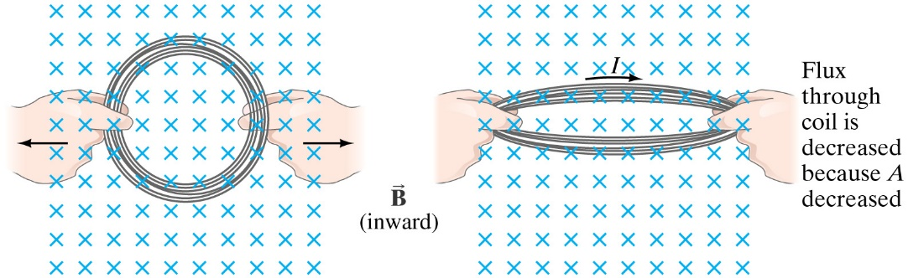
And another…
Change A:
The ΔΦ_{B} causes B inside the wire loop to
decrease into the page,
so the B of the loop should
be created into the page to compensate,
which means the I should flow
CW.

Slide 10
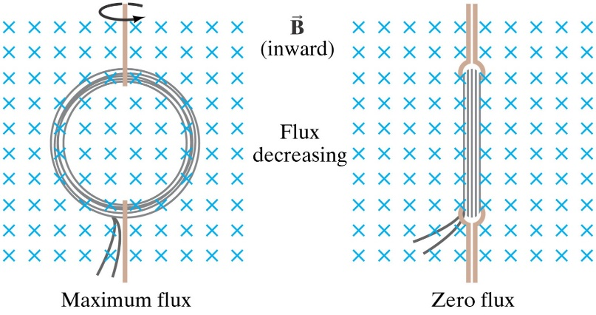
Last one…
Change θ:
The ΔΦ_{B} causes B inside the wire loop to
decrease into the page,
so the B of the loop should
be created into the page to compensate,
which means the I should flow CW.

Slide 11
Faraday’s Law Applied to a Moving Conductor
Very common EM Induction problem: Picture a U-shaped conductor with a movable conducting rod resting on its open end and place perpendicularly in a magnetic field…
How can we use Faraday’s law here? pg 596
An expression for ΔA = $l∆x$,
then (mag only): $ℰ=\frac{ΔΦ_{B}}{Δt}$
$ℰ$ = $\frac{BΔA}{Δt}$
$ℰ$ = $\frac{BlΔx}{Δt}$
$ℰ$ = $Blv$
where all 3 are assumed ꓕ to each other for max $ℰ$.
Note, while this is a derived eq’n for a specific situation, it’s used so commonly, you’ll find it on your AP eq’n sheet.

Slide 12
The Ultimate Connection between E & M!!
If a changing magnetic flux, $ΔΦ_{B}$, induces an emf,
and therefore induces a current,
then it should also induce an electric field…
Or more directly, if a changing magnetic field induces a changing electric field, and a changing electric field induce a changing magnetic field, then it’s a
self-perpetuating process…
And mathematically, for a small charge in a moving conductor, $E= \frac{F}{q}= \frac{qvB}{q}=vB$
or $v= \frac{E}{B}$ (We saw this before with mass spectrometers)
As it turned out, this $v$ equaled the speed of light, $c$… more on that later…!!!

Slide 13
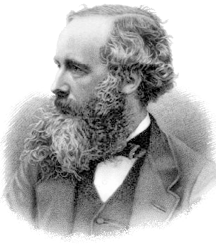
Maxwell’s Contribution to Physics
James Clerk Maxwell- Scottish (1831-1879)
discovered the connection between
E & B fields in the early 1860’s
(Actually, his original equations to handle the
connection numbered 20, with as many variables!
It was Oliver Heaviside, in 1881, that reduced
them to the 4 well-known “Maxwell’s equations”.)
figured out that these interacting fields create a wave that could travel through space (or at least the luminiferous ether) at about the same speed as light (because that speed was only roughly known at that time), so maybe that’s what light was made of?!?!
He called them electromagnetic waves… more to come…
Maxwell’s accomplishments in E&M are considered equivalent to, if not surpassing Newton’s work in mechanics! He unified all parts of electricity and magnetism into a single cause, as well as connected it to light waves. Wow!!

Slide 14
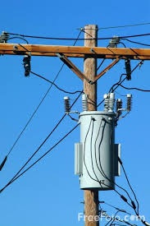
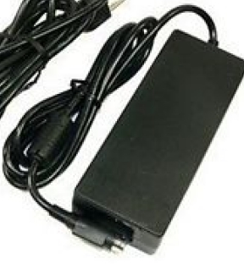
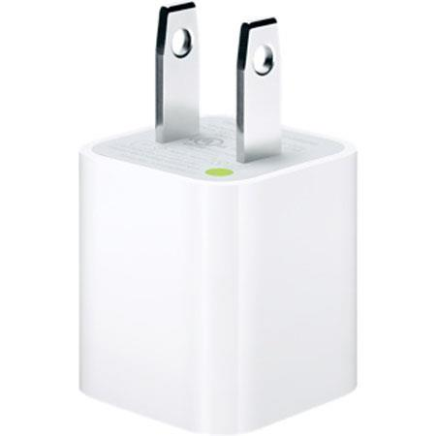
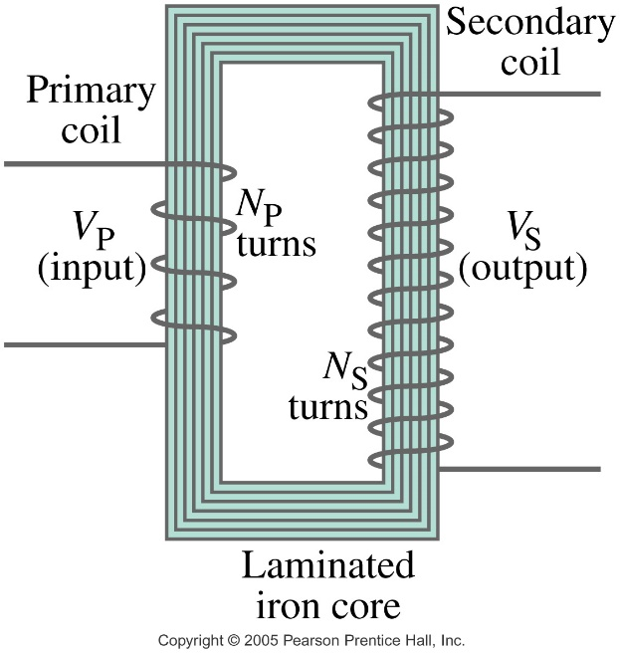
Transformers
Used to change the amount of ac voltage:
Big grey cylinders on telephone poles
Bulky box on laptop cord
Cube plug for phone charger
Consists of 2 separate coils of wire, usually looped around opposite sides of an iron rectangular-shaped core.
Primary – associated with input voltage
Secondary – associated with output voltage

Slide 15
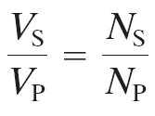
Math of Transformers Transmission of Power
The constantly changing direction of AC means there’s always magnetic flux around the primary coil, which then induces a magnetic flux around secondary coil...
If rates of chg in magnetic flux equal in both coils (ideal):
$\frac{ΔΦ_{Bp}}{Δt}$ $=\frac{ΔΦ_{Bs}}{Δt}$
Then by Faraday’s law of induction,
where: $V=N\frac{ΔΦ_{B}}{Δt}$
We’re left with only V $∝$ N
So then known as the
Transformer equation
Step Up Transformer: N_{S} > N_{P} so it increases voltage
Step Down Transformer: N_{P} > N_{S} it decreases voltage

Slide 16
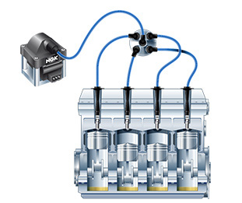
DC Transformers?
To have magnetic flux, something must change…
Since DC is constant,
it doesn’t work in transformers…
(Why AC (Nikola Tesla) beat DC (Edison) back in 1890’s!)
Except when the switch is flipped to turn current on or off in the primary coil – so only for a very short time…
Which works well to start a car…
the spike of high voltage is used to create a spark in the spark plug that then ignites the gas
and starts the engine. This transformer
is called the ignition coil and takes the
12V input from the battery to 30kV
because of all the turns in the
secondary coil.

Slide 17
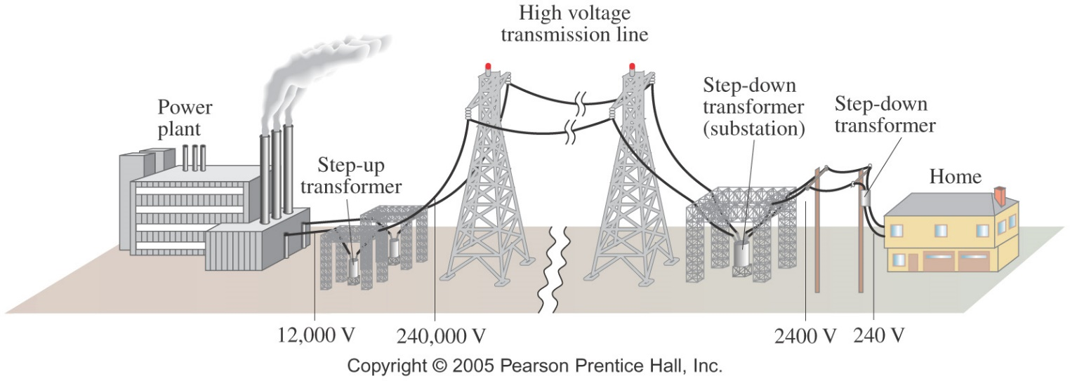
Transformers & Transmission of Power
They’re really important for getting electric power from where it’s produced - the power plant, to the place it’s used - a home.
Recall power losses through a wire are determined by P = I²R,
so for high current, there’s LOTS of power lost to heat.
Also recall P = IV, so we can get the same amount of power, by delivering it with little current, but high voltage.
[Side note: for an ideal transformer, P_{in} = P_{out}, so V (&∴N) α 1/I]
The problem is, we don’t have (and don’t want to have to make – more expensive) device that require high voltage,
so we step it up to deliver it, and step it back down to use it.

Slide 18
Aside: Where does the KE (motion) come from to run the generator?
Traditionally from turning turbines in power plants,
because steam from boiling water is rising into them,
which is heated by
burning coal
burning natural gas
burning gasoline (in personal generators)
a controlled nuclear reaction
But there are also “renewable” options
water guided through turbines in a dam
wind turning windmills, not turbines
geothermal – place turbine directly above Earth’s natural vents that release steam
solar power using photovoltaic cells

Slide 19
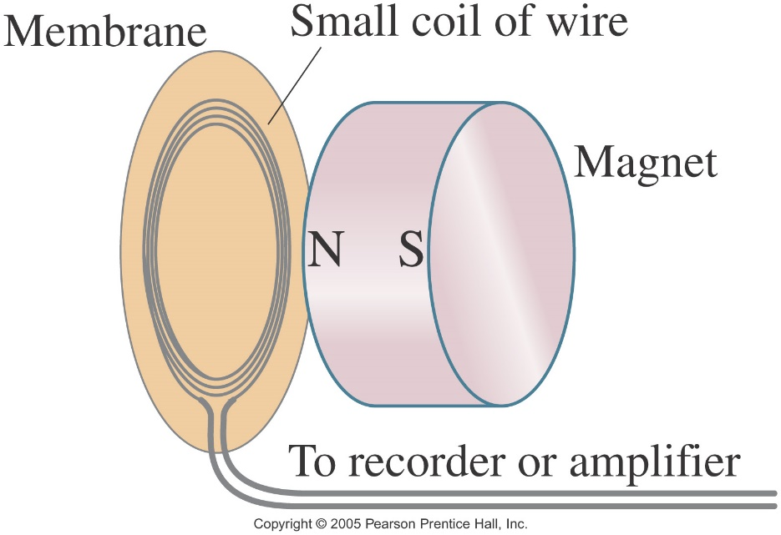
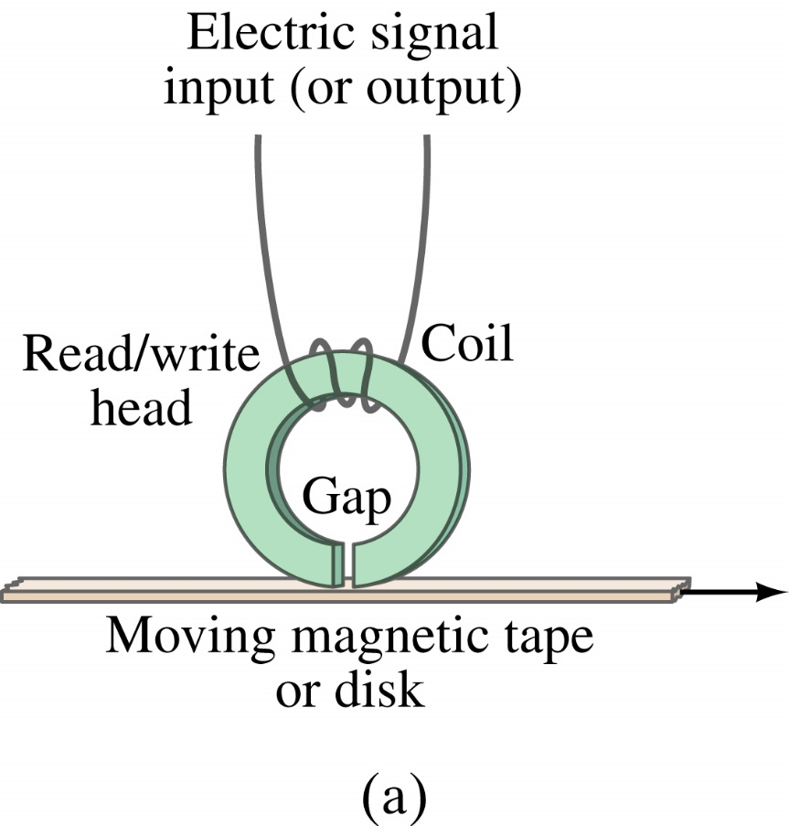
Applications of EM Induction
Sound Systems:
This microphone works by induction; the vibrating membrane induces an emf in the coil.
Computer Memory:
Differently magnetized areas on an audio tape or disk induce signals in the read/write heads.

Slide 20
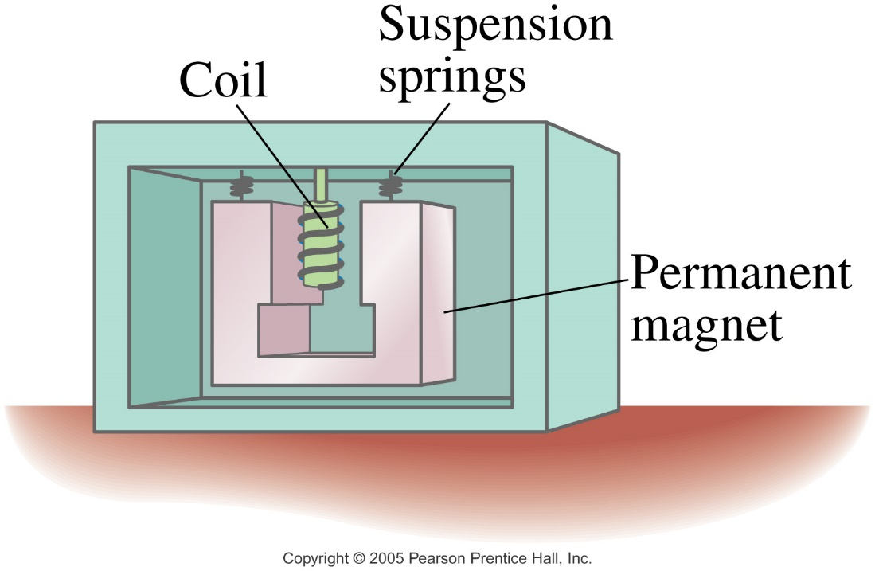
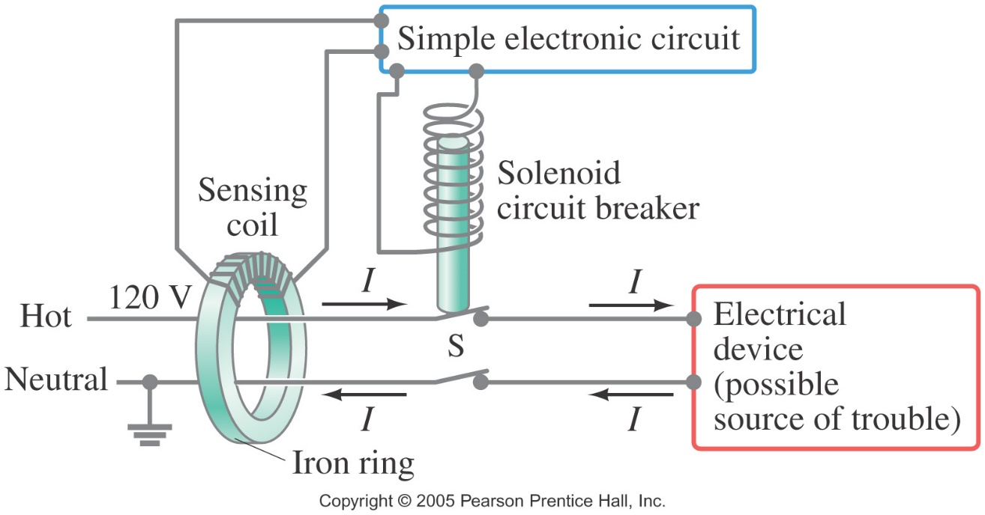
Applications of EM Induction
Seismograph:
It a fixed coil and a magnet hung on a spring (or vice versa), and records the current induced when the earth shakes.
GFCI:
A ground fault circuit interrupter will interrupt the current to a circuit that has shorted out in a very short time, preventing electrocution.

