Slide 1
Magnets and Magnetism
History
First magnets were lodestones – rock with iron ore
Found in Magnesia, Greece about 2000 years ago
Chinese used for navigation in 12th century
Possible (common) shapes:
bar, horseshoe, disk, flat, really anything
Poles
all have 2, a North & South pole
likes repel, opposites attract
can’t be isolated - no “magnetic monopole” ever found - because of the very nature from which all magnetism originates ...

Slide 2
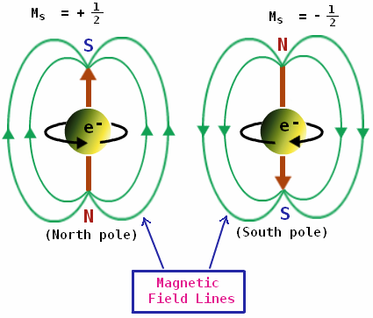
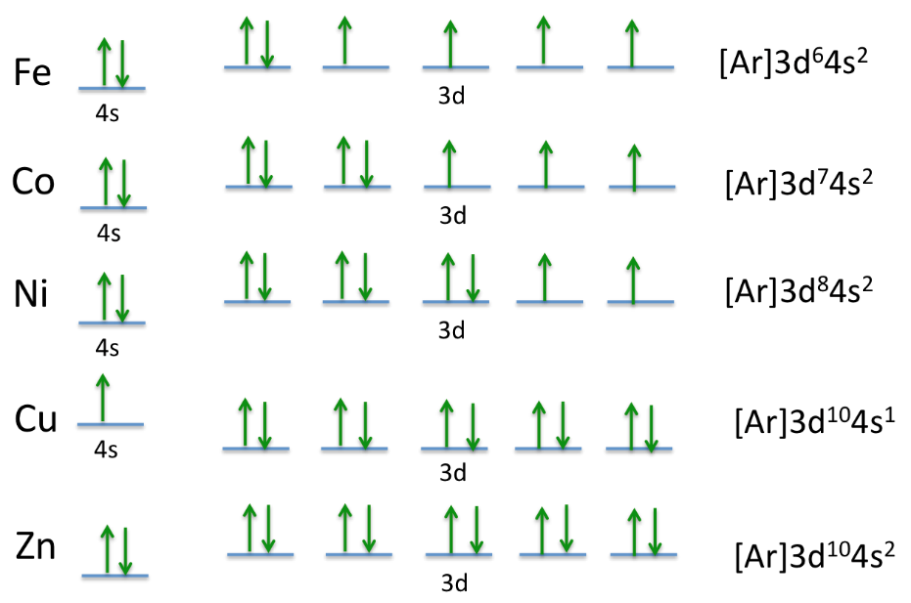
Cause of Magnetism
Spinning e-’s… a single spinning e- is the tiniest magnet, complete with a N & S pole
In most substances, e-’s come in pairs that spin in opposite directions, so they cancel each other’s magnetic effect
If e-’s spin in same direction, then magnetic affect is apparent
Called ferromagnetic materials, after iron or ferrum in Latin
Fe has 4 unpaired e-’s that can all be made to spin the same way… Co has 3… Ni has 2… Al has 1…
But most have none, so no chance of being magnetic.

Slide 3
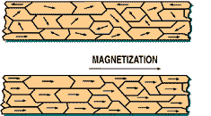
Magnetic Domains
In materials with multiple e-’s spinning the same way, neighboring atoms pair up to form large groups of atoms whose spins are aligned – called domains.
1 domain ≈ 10¹⁵ atoms
If the domains are aligned, then you’ve got a magnet;
not aligned – just plain metal:
aligned - so a magnet:

Slide 4
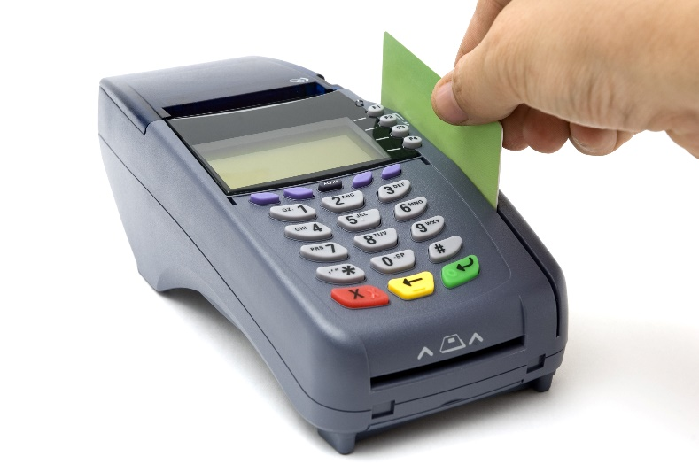
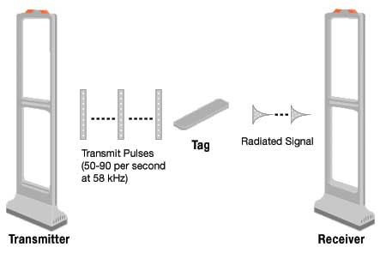
Uses of Magnetic Domains
Credit/debit cards
VHS & cassette tapes
3.5” floppy disks for computers
security tags on clothing, electronics

Slide 5
Types of Magnets
1. Permanent
Made of strong ferromagnetic materials - those whose domains are easy to align and stay aligned
Ferrite – mixed with ceramics, like iron oxides
or plastics – flat magnets 5 mT
Alnico – mostly iron, then aluminum, nickel, cobalt
Rare earth – ex: neodymium 1.25 T
Not exactly “permanent” – can jostle the domains out of alignment
dropping it or banging it
heating it to Curie temperature (768°C for Fe)
place near strong but opposite magnetic field
Can be re-magnetized using an electromagnet

Slide 6
2. Temporary
Made of weak ferromagnetic materials – those whose domains only stay aligned in the presences of a magnetic field
Nails and a construction hammer
Paperclips in a kitchen junk drawer with fridge magnets
Even steel food cans in pantry – what’s the magnetic field nearby??
Around the wiring in the walls of a house… a perfect lead into the 3rd type of magnet!

Slide 7
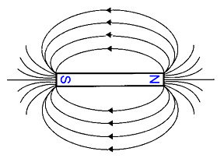
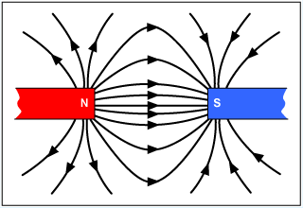
Magnetic Fields
The idea of force at a distance again like…
gravitational & electric fields.
Use magnetic field lines (arrows) to represent the strength and direction
Fields are strongest near poles, shown by higher concentration of lines.
Convention for direction is from north to south pole.
Closed loops since the field continues through magnet and both N & S are always present.
(Origin of Maxwell’s
2nd Eq’n: $\oint{B dA=0}$)
Use B to represent it in math equations.
Measured in units of tesla(T) or gauss(G)…more to come
Can permeate any non-ferromagnetic material…watch!

Slide 8
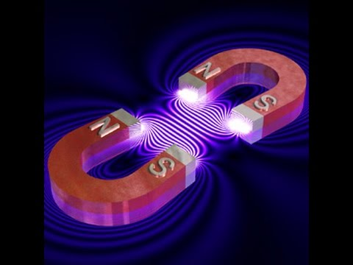
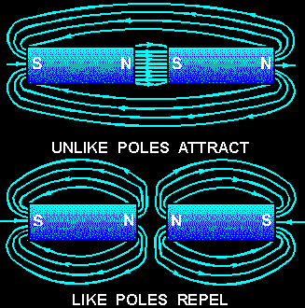

Slide 9
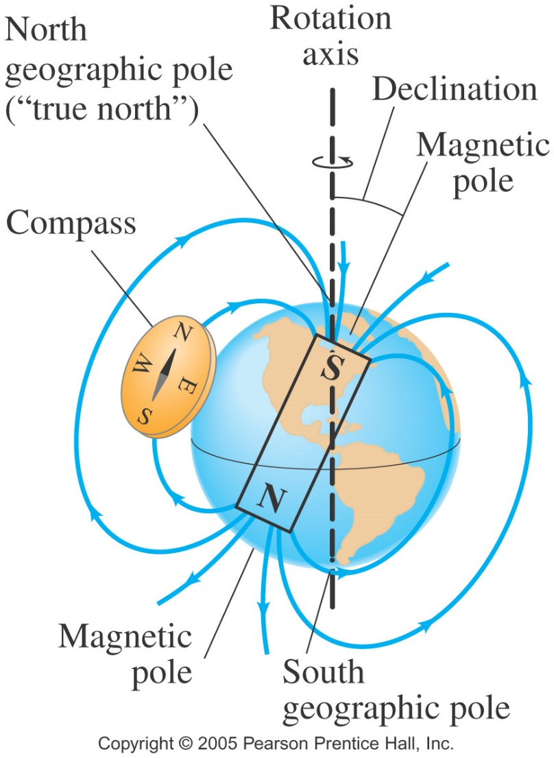
Earth’s Magnetic Field
As if a bar magnet stretches along the rotational axis…
but not exactly: the difference between “true north” and magnetic north is called magnetic declination – 0° to 20° difference in USA
And it wanders…
up to 15 km in a year
Strength: B_{Earth}≈ 5 x 10⁻⁵ T,
Angle of dip: angle between field & horizontal surface of Earth

Slide 10
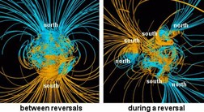
Earth’s Magnetic Field
Probable cause is motion of molten iron in Earth’s core
Not constant!: it’s changed more than 1000x’s in our 5 million year history and creates long periods where it’s zero then it reverses and grows – its weakening now
The lines represent magnetic field lines, blue when the field points towards the center and yellow when away. The dense clusters of lines are within the Earth's core.[

Slide 11
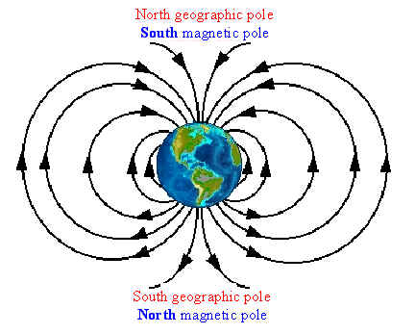
Earth’s Magnetic Field
On a magnet like in a compass,
N indicates the pole that attracts to geographic North pole,
which is actually the Earth’s magnetic South pole… otherwise they wouldn’t be attracted… (provable by using RHR on an electromagnet… more to come…)
So B_{E} points to magnetic S, as all B’s do,
but that matches Earth’s geographic North.
(Fyi: This can be confusing when determining directions in upcoming math problems.)

Slide 12
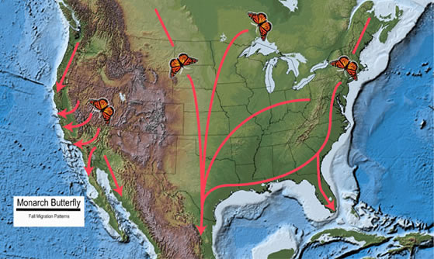
Uses of Earth’s Magnetic Field
Compass
Homing pigeons – records of more than 1000 miles, but typically less than 100 mi. For mail, messages during war.
Migratory birds – NY Times article 4/26/12
Salmon – use smell to find river where they spawned, but magnetism to make their way in ocean currents
Monarch butterflies – a generation flies South – as many as 3000 miles in the early Fall! They winter in Mexico then head North in Spring. It
takes 3 to 4 generations to
make it all the way North
by end of Summer, then
that generation heads
South again – crazy!

Slide 13
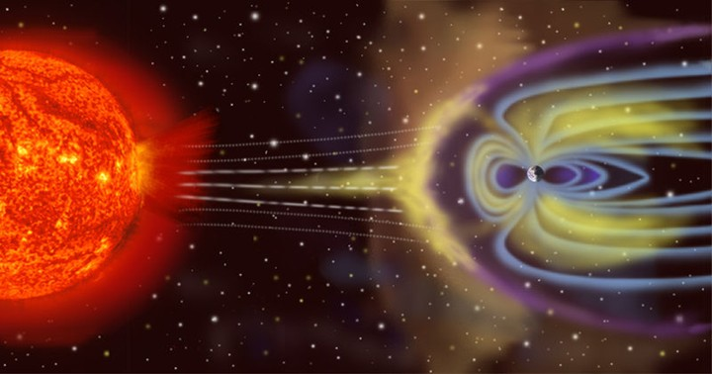
Uses of Earth’s Magnetic Field
The magnetosphere is the region above the ionosphere that is defined by the extent of the Earth's magnetic field in space.
It extends several tens of thousands of kilometers into space.
Protects the Earth from the charged particles of the solar wind and cosmic rays that would otherwise strip away the upper atmosphere, including the ozone layer, that protects the Earth from harmful ultraviolet radiation.

Slide 14
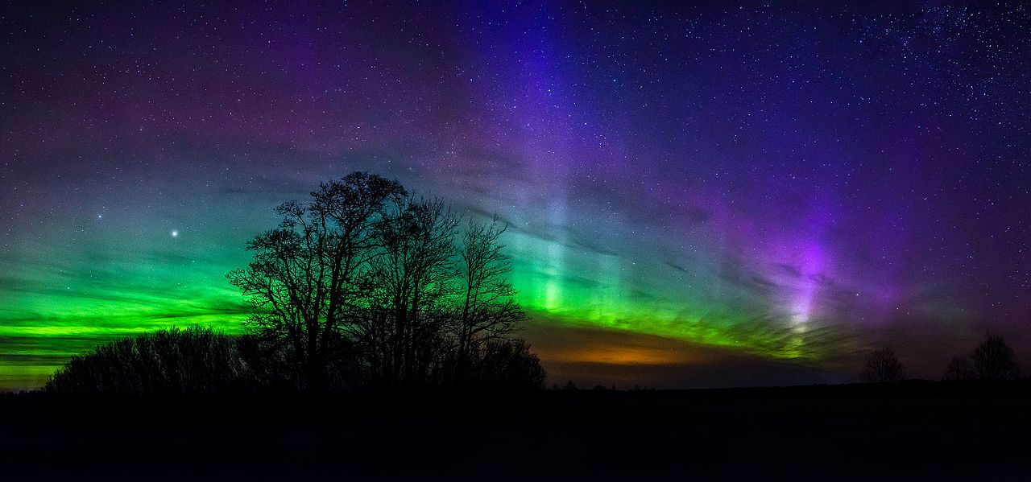
Uses of Earth’s Magnetic Field
Creates the Auroras
When charged particles from the sun run into Earth’s magnetic field, they transfer their energy.
More likely to happen/be seen where field is strongest, so near the poles: aurora borealis (northern lights); aurora australis (southern lights)
The colors of the lights are determined by the concentration and ionization levels of primarily oxygen and nitrogen. Greens are more common than blues and reds.

Slide 15
3. Electromagnets
A magnetic field is created around moving charges… current
Discovered by Hans Christan Oersted in 1820
To make it stronger
Use more current
Wrap more loops of wire
Add solid ferromagnetic core
Uses
scrap metal yards
MRI machines – very strong, 3-10 T
Our re-magnetizer

Slide 16
So the 1st connection between E and M?
An electromagnet!
Here’s how we figured to use it:
If you supply a potential difference across a wire,
so that a current flows,
a magnetic field is then created around the wire.
Then place it in another magnetic field,
the 2 magnetic fields interact with (apply forces to) each other,
making the wire begin to move !!!

Slide 17
And then, to make use of that motion:
If the wire is formed into a loop
then current flows in both directions within the magnetic field
so different sides of the loop will feel a force in opposite directions (torque…more to come later…)
making the coil of wire spin –
that’s a motor!
Now, attach “whatever” to it:
Fan blades
Blender blades
Hair dryer
Lawn mower blades
Drive shaft → axel → wheels of car

Slide 18
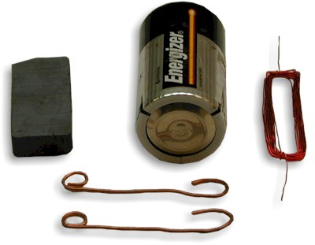
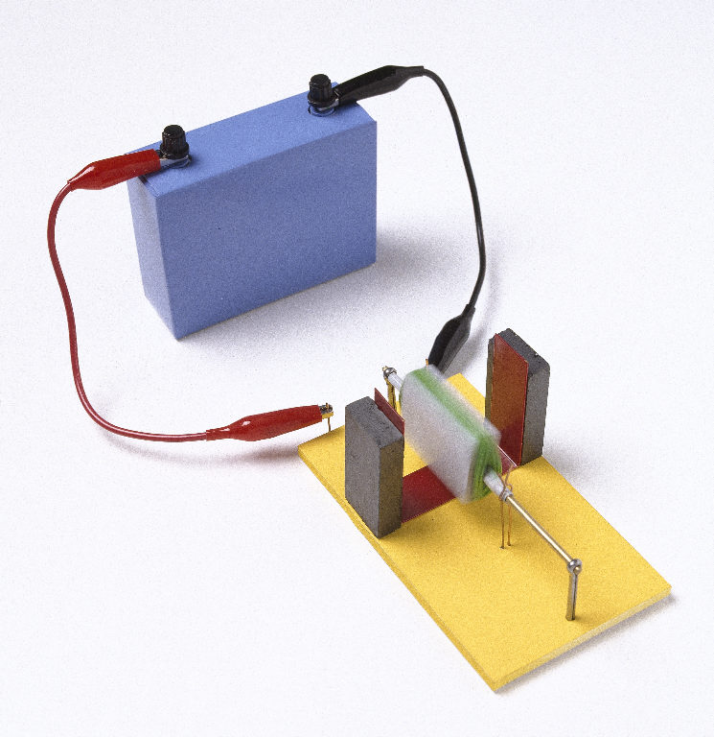
Basic components of a motor
A very basic motor

Slide 19
Math of E&M (20.4)
Eq’n: F_{B} = l I x B
finds (Laplace) force F_{B}, on a wire of length l, carrying current I, in a uniform magnetic field B
I x B is cross product of 2 vectors, so F_{B} = l IBsinθ,
where θ is the angle between I & B’s tails.
So 0 force if I & B are parallel; max F if perpendicular
Units: newtons = meter⋅amp⋅tesla
Eq’n: F_{B} = qv x B
finds (Lorentz) force F_{B} on a charge q, moving at v in a uniform magnetic field B – if not moving, then no F!
v x B is cross product of 2 vectors, so F_{B} = qvBsinθ,
where θ is the angle between v & B’s tails.
Units: newtons = coulomb⋅(meter/sec)⋅tesla
where a coulomb/sec = amps… so same as above.
Eq’ns find magnitude (no sign on q!); RHRs find directions

Slide 20
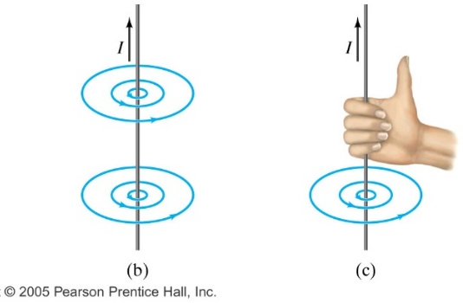
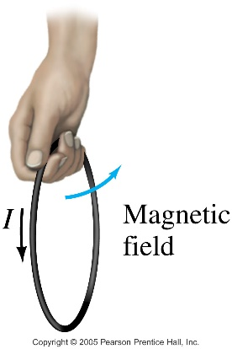
Right Hand Rules for E&M (20.3)
1st RHR: deals with only two vector quantities: I & B.
If the wire is straight,
point thumb in direction of current, I and your fingers will curl in the direction of (north) magnetic field, B.
So answer will be CW or CCW,
unless a particular location is specified.
If the wire is looped,
Run thumb along the loop in direction of I, and fingers will curl around loop to show B…
but if want B’s direction in a particular location around the loop, must stop finger tips from wrapping at that location. OR
curl the fingers in the direction of I, and your thumb will show direction of B inside the loop.

Slide 21
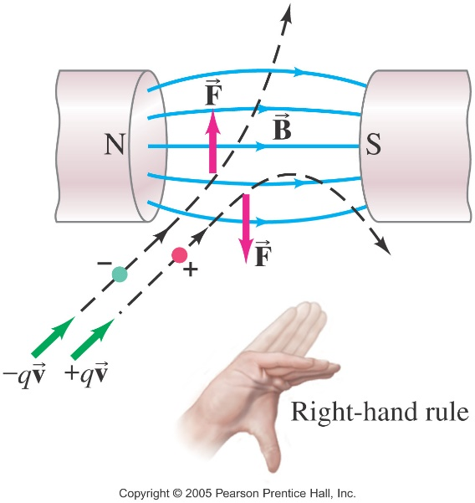
Right Hand Rules for E&M (20.3)
2nd RHR: deals with 3 vectors: I (or v of q), B & F.
index finger points in direction of I or positive q,
middle/rest of fingers point in direction of B
thumb points in direction of F.
Note, use LHR if q is negative!
Also, you can choose to use your
left hand for I and +q’s out of convenience, but then all your answers will be opposite what you’re hand tells you!!

Slide 22
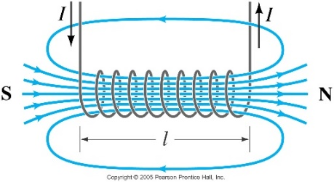
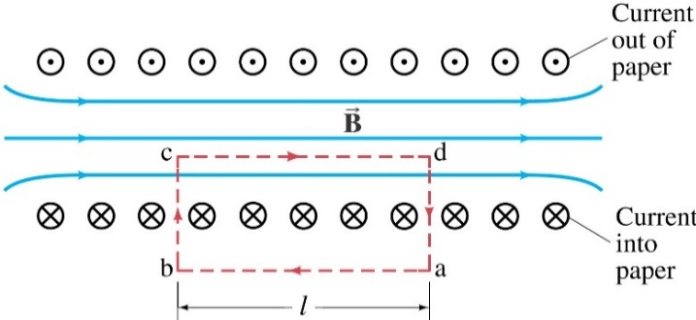
Note new notation: to indicate a vector in 3D – into/out of page: use ☉ for up/out of page, like you’re seeing the arrow tip come at you. And ⊗ for down/into page, like you’re looking at the arrow’s tail going away from you.
So this would look like
Here’s what a 3D directional key will look like:
Let’s learn how to use this on P1 & 3 from homework…

Slide 23
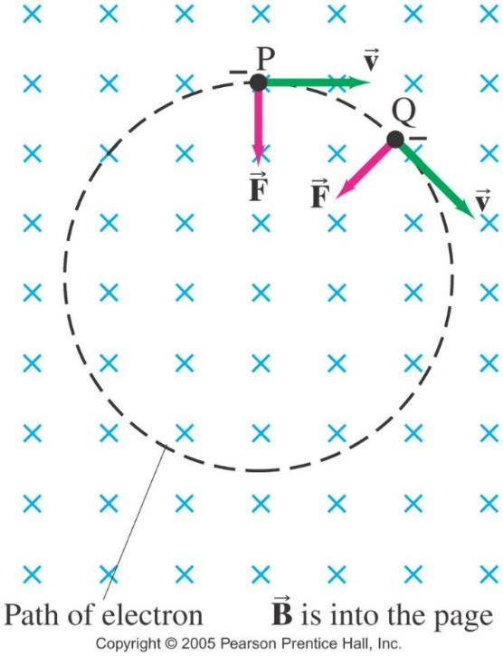
Cool & Practical Result of RHR:
If a charged particle is moving perpendicular to a uniform magnetic field, its path will be a circle!
Using ΣF_{C} = ma_{C}
then F_{B} = mv²/r
and qvB = mv²/r

Slide 24
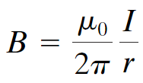
Magnetic Field Due to a Long Straight Wire (20.5)
← Circumference of the circle B makes around the wire.
Notice the field is directly proportional to current in wire, and inversely proportional to the distance from the wire.
Recall:
Variable | Name | Value for Vacuum (free space) | Relationship
μ_{m} | Magnetic permeability (think “permeate”) |  | B α μ_{m} *
$$ε_{e}$$ | Electric permittivity (think “permit”) |  | E α 1/$ε_{e}$ α k **
*μ_{m} indicates how well a medium helps to strengthen B.
**$ε_{e}$indicates how easy it is for E to exist in the medium.
Recall these fundamental constants are related by: $c^{2}= \frac{1}{ε_{0}μ_{0}}$
(Read Definition of Ampere & Coulomb section in text pg 572!)

Slide 25
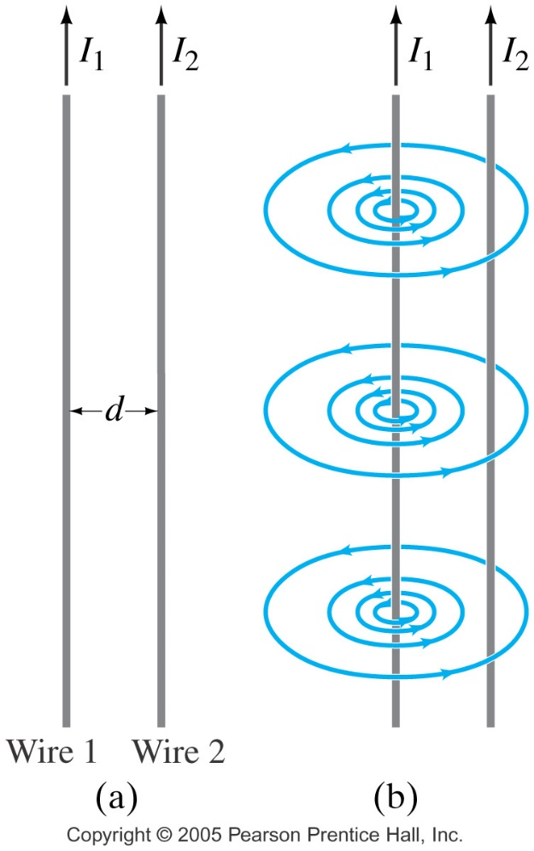
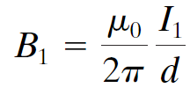
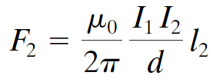
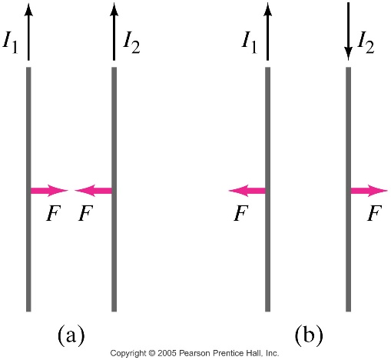
Force between Two Parallel Wires (20.6)
The magnetic field produced at position of wire 2 due to the current in wire 1 is:
If perpendicular, the force this field exerts on a length l₂ of wire 2 is:
since F_{B} = l I x B and sin 90° = 1
Where due to RHR, parallel currents attract; antiparallel currents repel.

Slide 26
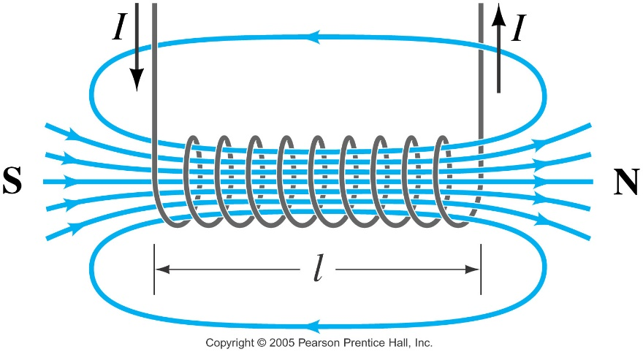
Solenoids and Electromagnets (20.7)
A solenoid is a long coil of wire. If it is tightly wrapped, the magnetic field in its interior is almost uniform, so it essentially creates a bar magnet with a field strength of:
If a piece of iron is inserted in the solenoid, the magnetic field strength is magnified.
Such electromagnets have many practical applications:
Door bells
Car starters
GFCIs

Slide 27
More on Magnetic Fields
2 ways to express the Intensity of a Magnetic Field
Magnetic field strength, H
Corresponds to the density of the field lines,
created by magnet or current carrying wire.
Units of amperes per meter (A/m).
Magnetic flux density, B
The effect of magnetic field strength on a given material.
For example…
a solenoid produces magnetic field strength H,
which only depends on amount of current & # of loops.
Whereas flux density varies by the material used inside the hollow solenoid,
so if ferromagnetic material used, flux is high; if not, flux is low,
using eq’n B = μ_{m}H, where μ_{m} is determined by nature of the core material (permeability of material, instead of free space).

Slide 28
(More) Units for magnetic flux density
cgs: gauss (G) = 10⁻⁴ T
mks: tesla (T) = N/A⋅m
Also T = J/A⋅m² = N/C⋅m/s = kg/C⋅s = kg/A⋅s²
Recall, the units for E are N/C (from E = F/q)
whereas units for B are N/C⋅m/s (from B = F/qv)
which again emphasizes difference between E & B:
E is not dependent on q’s motion, but B is!
Other examples of magnetic strength:
8 T – magnets in LHC (Large Hadron Collider in Cern)
16 T – required to levitate a frog (via diamagnetic levitation of the water in its body tissues) according to the 2000 Ig Nobel Prize in Physics (parody of real ones:)
27 T – maximum field strengths of super conducting magnets at cryogenic temperatures
10⁸ - 10¹¹ T – magnetic strength of the average magnetar!!

Slide 29
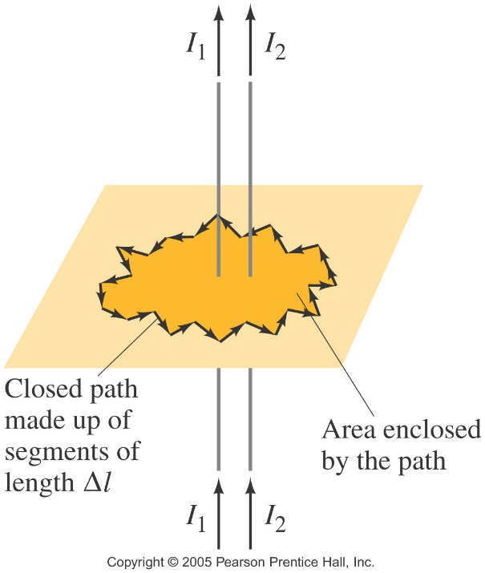
Ampère’s Law: B is produced by I (20.8)
We can use to determine the magnetic field around a perfectly straight wire, but is there a general relationship between current in the wire of any shape and the magnetic field around it?
Ampère’s law, from French scientist Andre’ Marie Ampère in the early 1820’s, relates the magnetic field around a closed loop to the total current flowing through the loop:
Or using basic calculus:
$\oint{B dl= μ_{0}I_{encl} }$ (#4 of Maxwell’s eq’ns)

Slide 30
Torque on Current Loop; Magnetic Moment (20.9)
The forces on opposite sides of a symmetrical loop of current carrying wire in a uniform B field will be equal and opposite,
which means you’d expect them to cancel, but since they act
on the loop on opposite sides of its CM/axis of rot, they will
actually create a net torque which will make the loop spin.
The magnitude of the torque is given by:
where the quantity NIA is called
the magnetic dipole moment, m. So m = NIA
Then there’s the magnetization field or M-field, which can be defined according to the following equation: $m= \iiint{M dV}$
Where the M-field is the distribution of magnetic moments in the region concerned, and m is an ordinary magnetic dipole moment and the triple integral denotes integration over a volume.

Slide 31
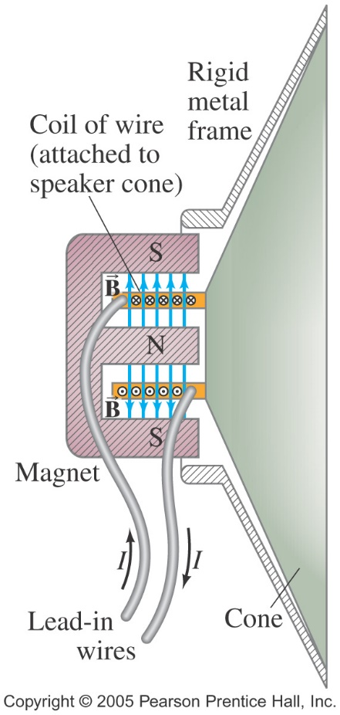
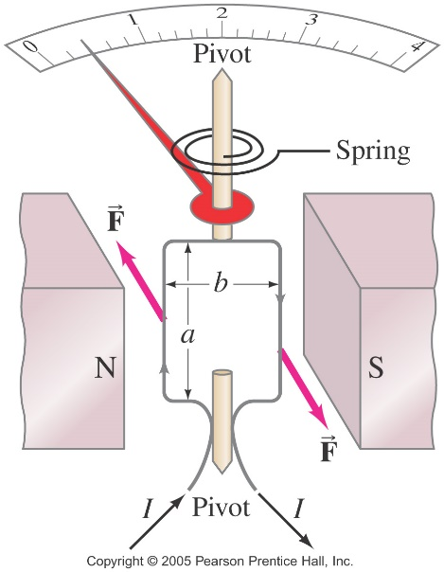
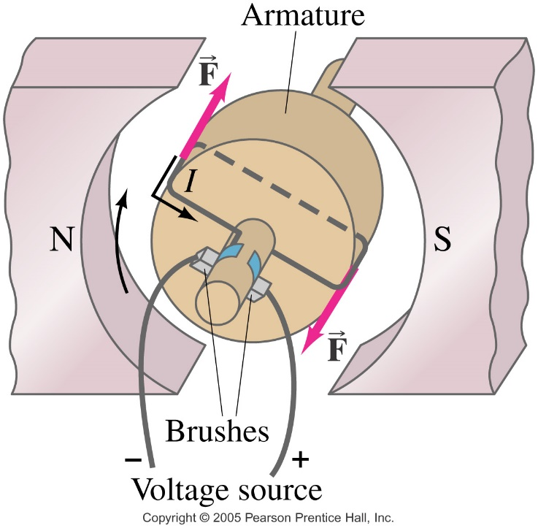
Applications of Torque on Current Carrying Loops (20.10)
A galvanometer’s loop is turned by torque which increases as I increases.
Speakers convert electrical signals into mechanical vibrations, producing sound.
An electric motor changes electrical energy to mechanical energy.

Slide 32
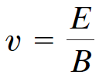
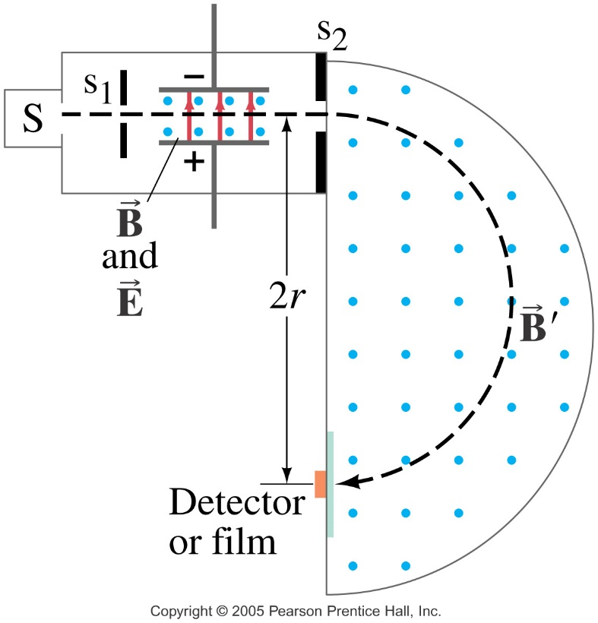
Another Application: Mass Spectrometer (20.11)
A mass spectrometer measures the masses of atoms. If a charged particle is moving through perpendicular electric and magnetic fields, there is a particular speed at which it will not be deflected:
All the atoms reaching the second magnetic field will have the same speed, which means their radius of curvature will depend on their mass.

