Slide 1
Electrical Circuits
Circuit – a complete path from the high to low potential which includes a load between the two potentials.
If there’s no load - only direct connection from high to low - then it’s called a short (circuit) – dangerous…
If there’s a switch: open = no flow; closed = flow
There are only “one way streets” in any circuit –
Current cannot/will not flow in 2 directions within a wire as it is always forced to the lower potential
and that’s only going to be in one direction along any particular path – called a branch – of a circuit.
Recall: Current/individual charges do not bunch up or
concentrate in certain places in a circuit:
there’s always a continuous flow,
& they’re not used up – conservation of charge!

Slide 2
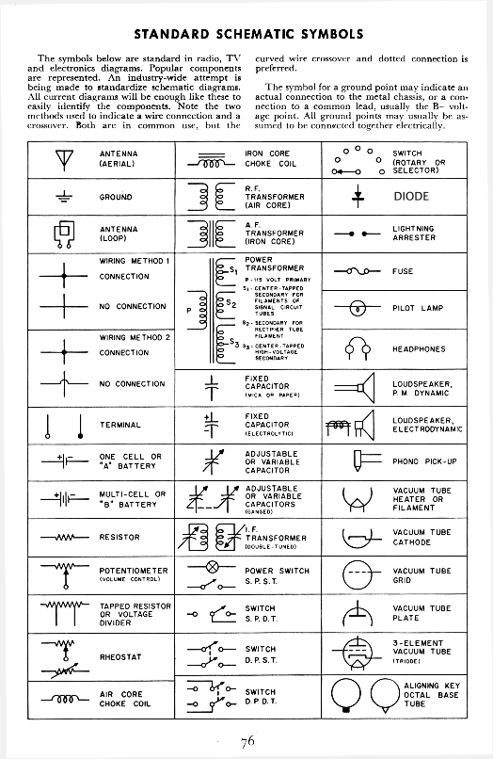
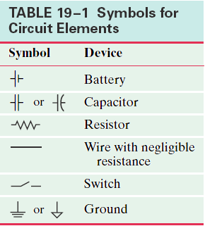
Schematic Diagrams
Diagrams that depict electrical circuits using special symbols to represent each component of the circuit.
Why? Standardized and easier to draw/interpret.
Know these:

Slide 3
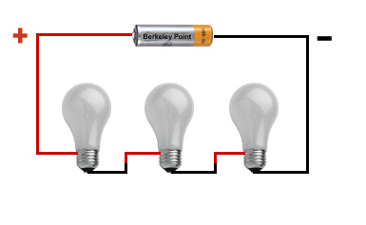
Series Circuits
Series: have only one pathway from the high to the low potential, so
I is same everywhere.
I_{total} = I₁ = I₂ = I₃ = …
R’s add together.
R_{eq} = R₁ + R₂ + R₃ + …
V’s add together.
V_{total} = V₁ + V₂ + V₃ + …
where V_{total} is the voltage “boost” of the battery
and V₁, V₂ etc are the voltage “drops” of the loads
following Conservation of NRG: ΔV_{loop} = 0
called Kirchhoff’s Loop Rule… coming up

Slide 4
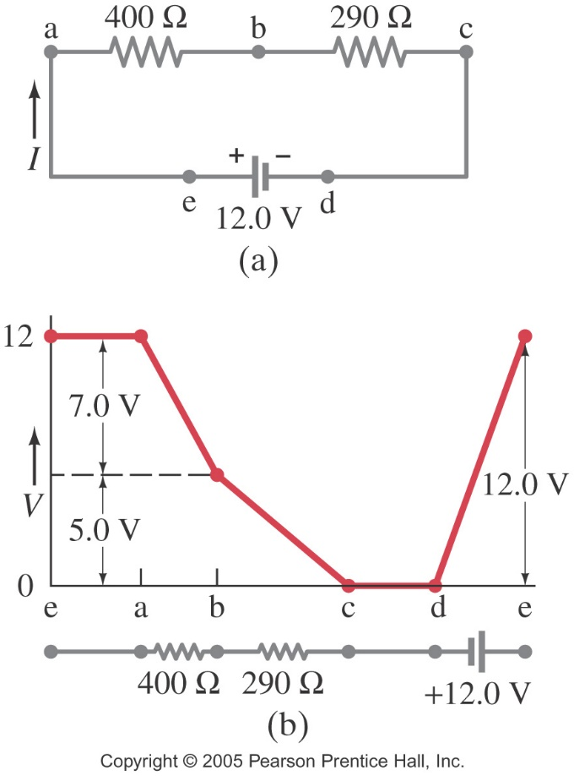
Kirchhoff’s Rules
Named after Gustav Kirchhoff when he published them in 1845. There are two:
Loop Rule: The sum of the changes in potential around a closed loop is zero.
Origin?
The Law of Conservation of Energy

Slide 5
Schematic Diagrams – Series Circuit
I is the same everywhere
R’s add to find total Req
V drops around loop add to = V boost of battery

Slide 6
Series Circuits
Applying Ohm’s Law
I_{total} = V_{total} /R_{eq} = I_{anywhere}
and
I_{anywhere} = V₁ / R₁ = V₂ / R₂ = V₃ / R₃ =…
Advantage?
Cheap – use much less wiring than parallel
Disadvantage?
If anything breaks, opens, etc, nothing works!
Ex: old strands of Christmas lights

Slide 7
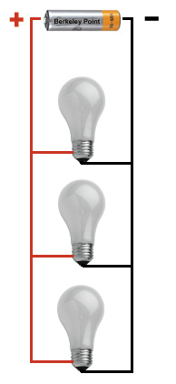
Parallel Circuits
Parallel have multiple branches from
the high to the low potential, so
I divides up among the branches
I_{total} = I₁ + I₂ + I₃ +…
Amt in each branch depends inversely
on the R that’s there
V’s are the same across each branch.
V_{total} = V₁ = V₂ = V₃ = …
R_{eq} decreases as more resistors are added,
Since we might be adding another R (stop light)
but we’ve also added a brand new path (road)…
1/R_{eq} = 1/R₁ + 1/R₂ + 1/R₃ + …

Slide 8
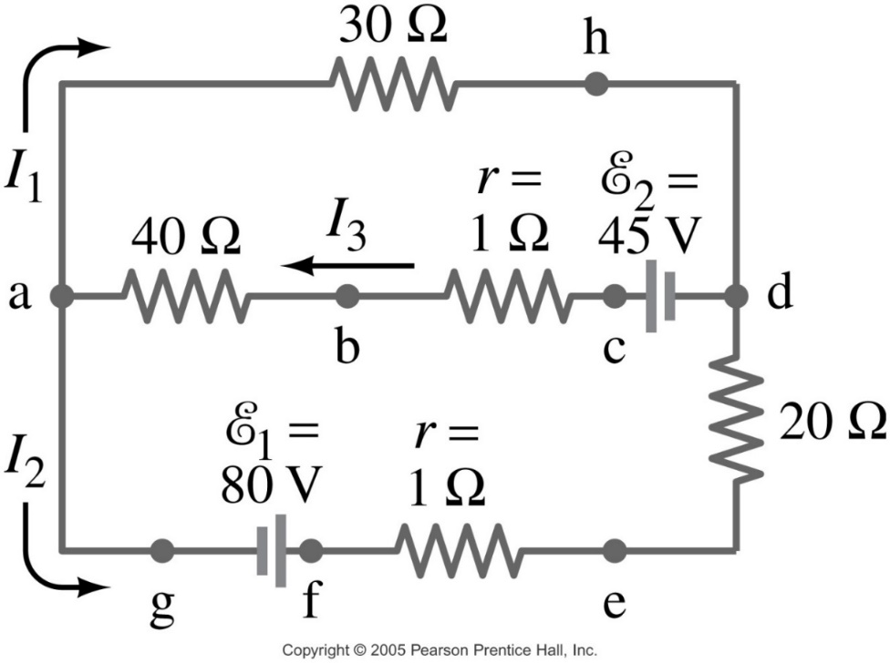
Kirchhoff’s Rules
Junction Rule: The sum of currents entering a junction equals the sum of the currents leaving it.
Origin?
The Law of Conservation of Charge

Slide 9
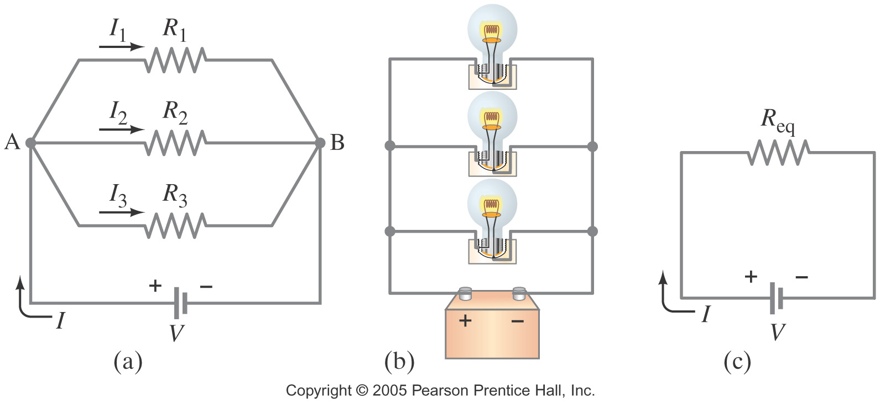
Schematic Diagrams – Parallel Circuit
In parallel, I is split
V in every branch = V of battery
R’s add by inverse equation
(Note if only 2 Rs, use… )

Slide 10
Parallel Circuits
Applying Ohm’s Law
V_{total} = I_{total}R_{eq} = V_{anybranch}
and
V_{anybranch} = I₁R₁ = I₂R₂ = I₃R₃ = …
Advantage?
Maintains a constant V drop across each parallel branch, so any number of loads can be plugged in and all will get current as if they’re alone – nothing affects anything else!
Disadvantage?
Must be connected to circuit breaker as more loads reduce R_{total} so I_{total} will increase – dangerous!
Ex: just about everything - everywhere!!!

Slide 11
Meters to Take Circuit Measurements
Ammeters measure current. They must be connected right into the path of the current to get a read of how much I is traveling through that branch of the circuit. So they must be connected in __________ with the branch of the circuit they’re to measure.
The construct of an ammeter has as _____ resistance as possible, so that it doesn’t alter the circuit you’re putting it in to measure.
Voltmeters measure voltage, or potential difference. They must be connected across the part of the circuit for which you want a read of potential difference. So they must be connected in __________ with the branch of the circuit they’re to measure.
The construct of a voltmeter has as ____ a resistance as possible, so that it, again, doesn’t alter the circuit you’re putting it in to measure… no I will go that way.

Slide 12
Meters to Take Circuit Measurements
Ohmmeters measure resistance and they’re construct is simply a combo of both that of a ammeter and voltmeter.
Multimeters are the most useful – they have a dial or switch that can be set to measure any of these quantities
Analog vs Digital Meters
Analog – reading from a needle pointer on a scale
uses a galvanometer – works on the principle of force between a magnetic field and a current-carrying wire… more on that in Ch 20
Digital – reading from a LCD
No galvanometer – instead “newer” electronic circuitry…
Much more precision… but not necessarily accurate…

Slide 13
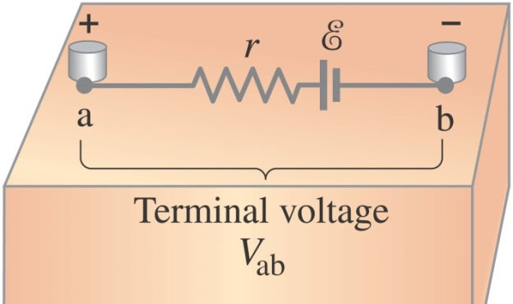
EMF and Terminal Voltage
Recall: An electric circuit needs a potential difference to make current flow. Sources of potential difference can be called different things:
power supply
source of emf (E ) – electromotive force
Ex: battery or generator are power supplies or have emf
A battery is a nearly constant voltage source, but it does have a small internal resistance (r), which reduces the actual, aka terminal voltage, V_{ab}, from the ideal emf,E.
This resistance behaves as if wired in series with the emf

Slide 14
EMF in Series vs Parallel
EMFs in series in the same direction add together to provide a greater potential to the circuit. (a)
EMFs in series in opposite directions subtract to provide a smaller potential to the circuit, but it can be used to charge the smaller of the two sources. (b)
Need to watch mixing of batteries… see reading…
a) b) c)
EMFs in parallel, don’t add, they equal, but there’s more charges in more batteries, so while current isn’t larger, it will last longer – more amp⋅hrs. (c)
Only make sense if voltages are the same. Otherwise the weakest voltage prevails, so it weakens stronger batteries.

Slide 15
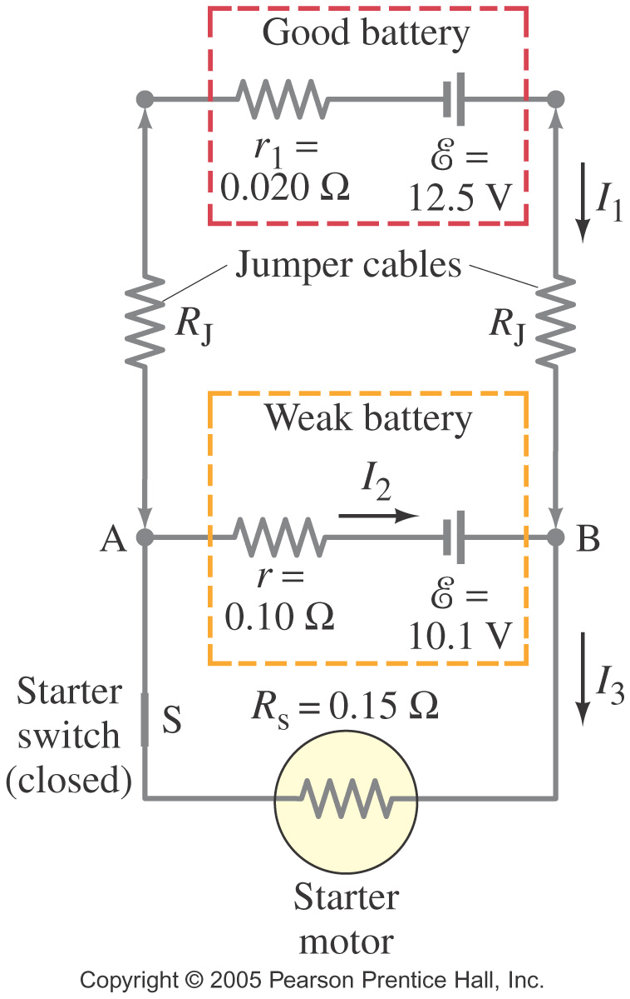
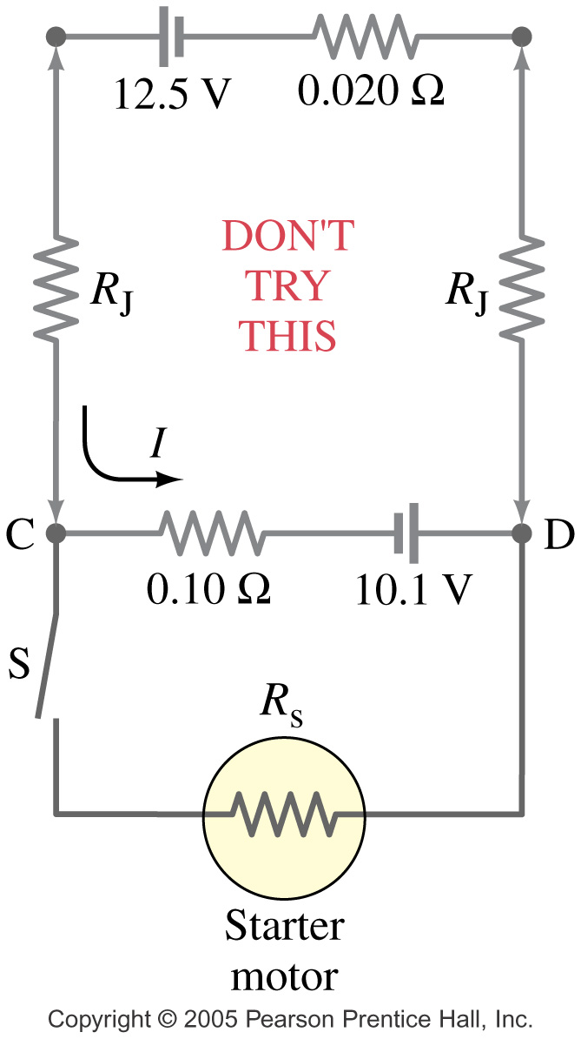
Jump starting a car Proper connections Improper connections

