Slide 1
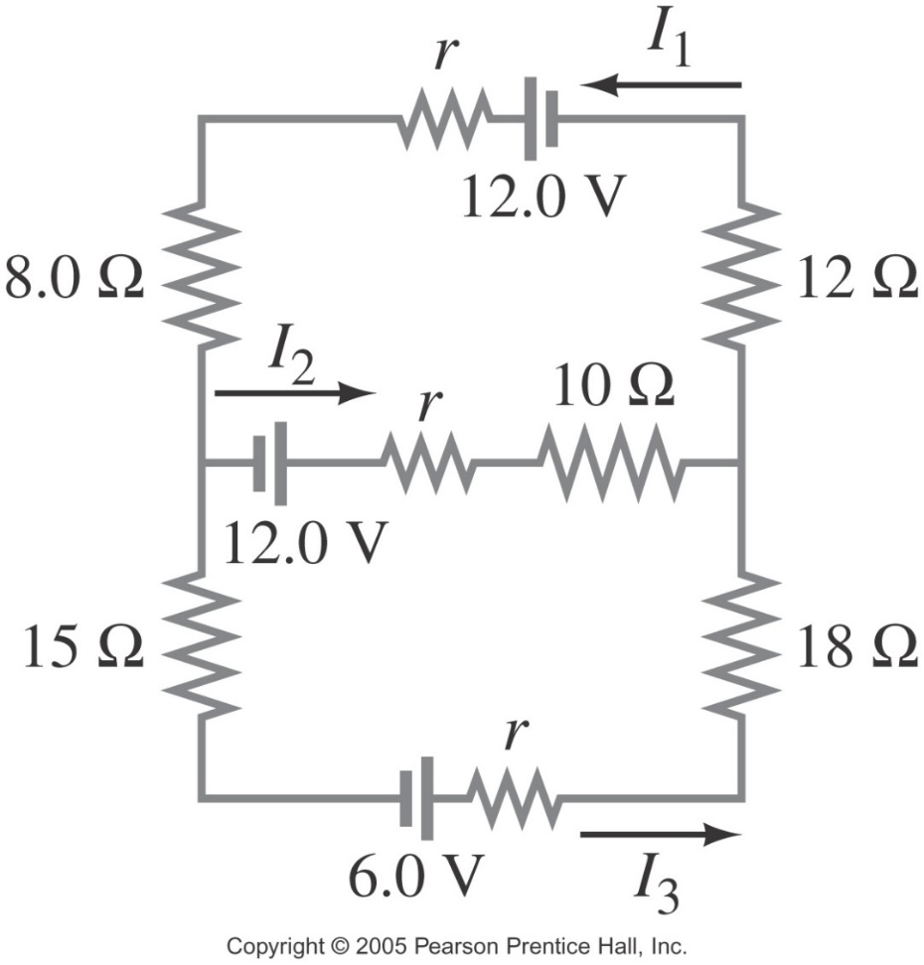
Kirchhoff’s Rules Revisited
Some circuits cannot be broken down into series and parallel connections, because they’re too complex to determine what’s going on just by looking at them.
For these circuits, we use Kirchhoff’s rules exclusively to set up a series of equations which can then be solved for common unknowns – currents and potential differences.

Slide 2
Complex Circuit Problem Solving
with Kirchhoff’s Rules
Label each current, using I’s with subscripts, then apply junction rule to one of the junctions of the circuit.
Apply loop rules to different loops of the circuit; you will need as many independent equations as there are unknowns. Be careful with signs:
Moving through a power supply in the opposite direction as conventional current is a loss, so use -.
Moving through a resistor in the opposite directions as your labelled current is a boost, so use +.
Solve the equations using substitution. You’ll goal is for a single equation with just 1 unknown.

Slide 3
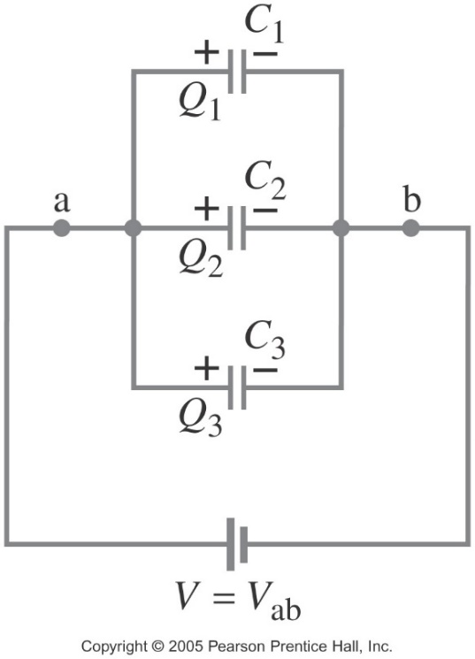
Capacitors in Circuits – the Reverse of Resistors!
In Parallel:
voltage drops across them are equal,
and recall Q = CV,
where the Q on each C had to have come from the battery,
so Q_{tot} = Q₁ + Q₂ + Q₃, etc,
so
then
So the net result of adding Cs in parallel is to increase the total capacitance, because you’re essentially increasing the area of the plates on which to store the charge.
Also, to find PE stored in the charged capacitors, use:
U_{C} = ½QV or U_{C} = ½CV² (see eq’n sheet)

Slide 4
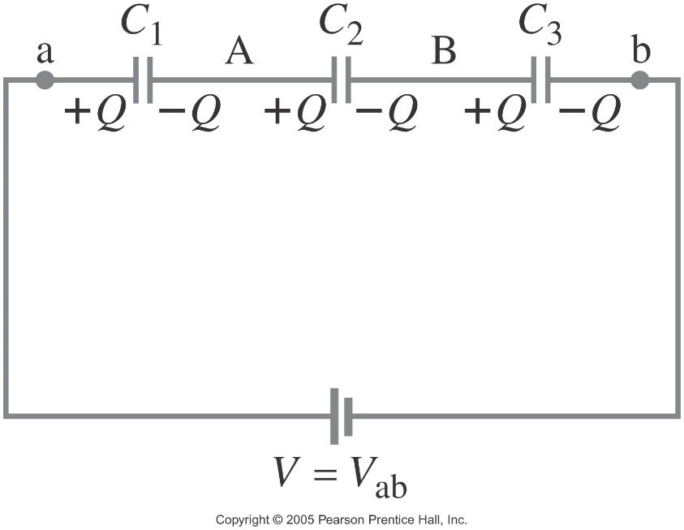
Capacitors in Circuits – the Reverse of Resistors!
In Series:
the charge on each must be equal,
while their voltage drops would add to equal the battery’s.
So with Q = C_{eq}V,
and V_{tot} = V₁ + V₂ + V₃,
then
and
So adding Cs in series decreases total capacitance, because you end up storing less Q_{tot} since V drops must add to = V_{term}, then each capactor’s V must be less.
Again, PE of capacitors from U_{C} = ½QV = ½CV²

Slide 5
RC Circuits – A Resistor & Capacitor in Series
Charging the Capacitor –
What happens when the switch is closed?
e-s flow from neg term of battery, thru R, to load up the upper plate of C.
This pushes e-s off the lower plate of C, so it’s oppositely but equally charged,
which increases the V drop across the C, and therefore the V drop across the R must drop since their sum = V_{tot},
until V_{c} = V_{tot}, then I stops flowing and V_{R} = 0.
This entire process takes a particular amount of time…

Slide 6
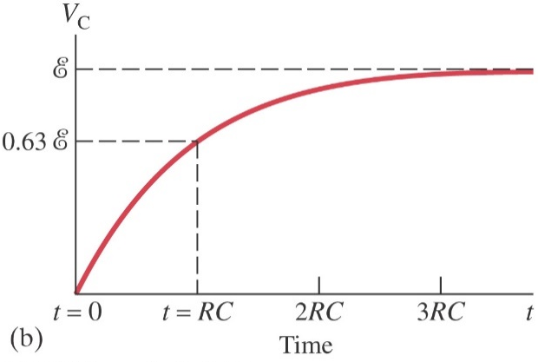
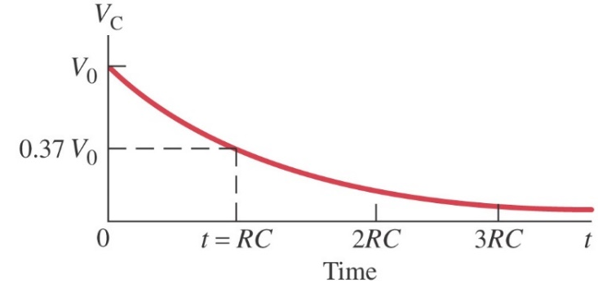
RC Circuits – Capacitor Charging & Discharging
The charging of the capacitor to it’s max potential, V_{c}, occurs as an exponential function of time:
where e = 2.718 and
it’s called “the base for natural log”
(which means it is LN’s inverse function)
& RC = τ, the circuit’s time constant.
Charge build up on the capacitor, Q, follows the same relationship: where Q₀ is max charge.
However, both V_{R} and I in the circuit are in exponential decay, and that’s also how a capacitor discharges:
$V_{C}= V_{0}e^{{−t}/{RC}}$ for discharging
$V_{R}= ℰe^{{−t}/{RC}}$ for charging
$I= \frac{ℰ}{R}e^{{−t}/{RC}}$ for charging

