Slide 1
Electric Potential Energy
Think of Electric PE like gravitational PE only due to electric forces, not gravitational forces.
Recall an object has more PE_{g}
if lifted higher off the surface of Earth,
since it’s always attracted to the surface by gravity
and more distance to fall, gaining speed/KE.
Likewise, a charge has more PE_{e} if
it’s pulled farther from an opposite charge
it’s pushed closer to a similar charge
since in there’s both attraction & repulsion in electricity
and in either case it will have more distance to move, gaining speed/KE.

Slide 2
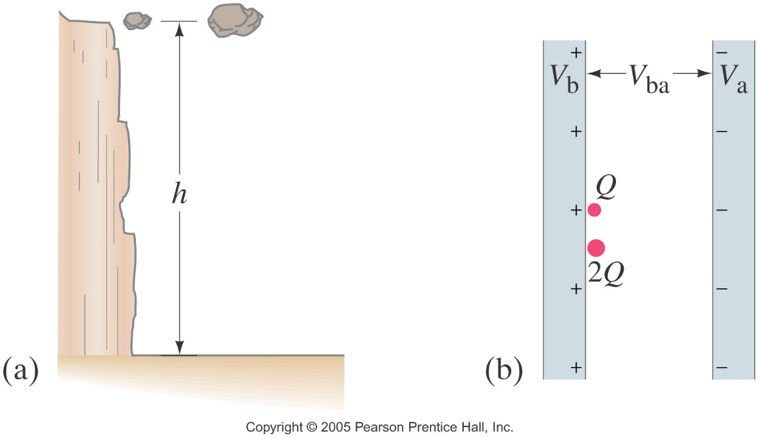
Diagram of Analogy between Gravitational and Electric Concepts
a) Two rocks are at the same location in a gravitational field. The larger rock has more gravitational potential energy.
b) Two charges are at the same location in an electric field. The larger charge has more electric potential energy.

Slide 3
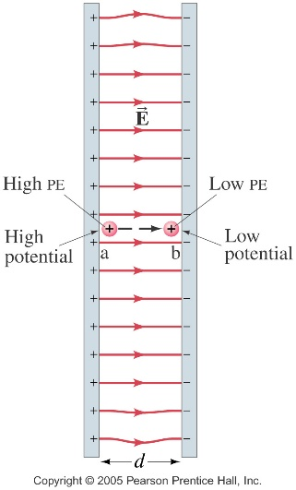
Math of Electric Potential Energy
Using what we understand about gravity:
Recall U_{g} = mgh,
Then what would make sense as the eq’n for U_{e}?
How about U_{e} = in a uniform E
This makes sense from the work equation as well:
Recall W = ΔE and W = FΔx
so then if F_{e} = qE, shouldn’t ΔU_{e} = - qEΔd ???
(That neg is because as W is done by E, q will naturally lose U_{e} while it gains KE.)
Units: Joules = Coulombs ⋅ Newton/Coulomb ⋅ meter
so J = N⋅m = kg m²/s²… exactly as we learned last year!
Note Joules is large for the energy on typical charges, so instead use the electron volt where 1 eV = 1.6 x 10⁻¹⁹ J
But after all that, this equation is rarely used… except as a step towards a much more important idea…

Slide 4
Introducing the Concept of Electric Potential
Again, let’s go back to an analogy from mechanics:
Recall U_{g} = mgh,
if we looked at the ratio of energy per unit of mass,
U_{g}/m, it would equal mgh/m
or just U_{g}/m = gh,
where the quantity of gh could have been know as “gravitational potential”
meaning all objects, regardless of mass, would have the same “gravitational potential” at the same height, h in the same gravitational field, g.
There wasn’t much use for that idea in our study of mechanics, so we never talked about that or defined the term “gravitational potential”
But that kind of an idea is much more useful than straight energy, in our study of electricity.

Slide 5
Electric Potential Energy vs Electric Potential
Instead of energy/mass for gravity,
let’s do energy/charge for electricity:
Then U_{e} = qEd
q q
or U_{e}/q = Ed
Where U_{e}/q is known as electric potential, defined as electric potential energy per unit of charge.
In other words, all objects, regardless of charge, would have the same “electric potential” at the same distance, d, in the same electric field, E.
And with that we introduce a new unit:
Joule/Coulomb, or J/C, has the nickname Volt, or V,
after Alexandro Volta, an Italian physicist and chemist doing work in the early 1800’s.

Slide 6
Diagram of Analogy between Gravitational and Electric Concepts
a) Two rocks are at the same location in a gravitational field. The larger rock has more gravitational potential energy, but both have the same gravitational potential.
b) Two charges are at the same location in an electric field. The larger charge has more electric potential energy, but both have the same electric potential.

Slide 7
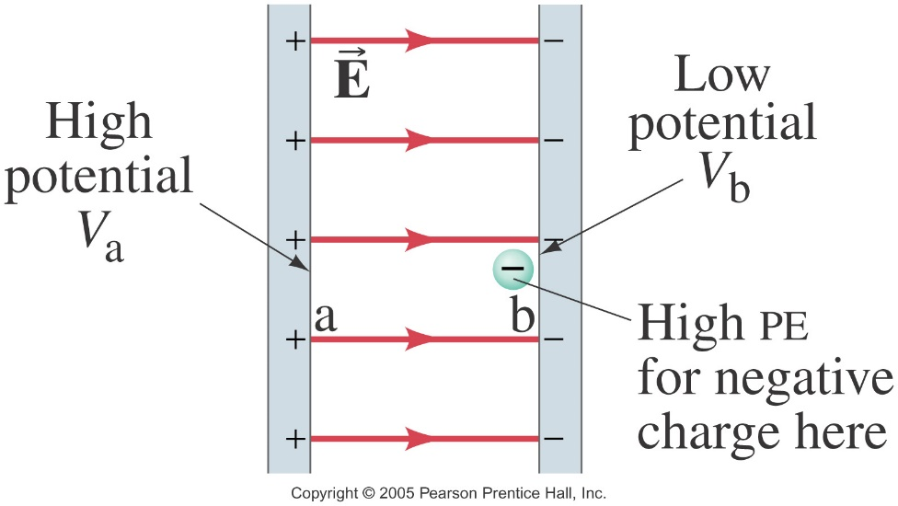
Finally, Electric Potential Difference
Still, the idea of electric potential is NOT very meaningful in the study of electricity, but it continues to get us closer to what is…
The fundamental quantity used in the study of electricity is electric potential difference…
where instead of being concerned with the electric potential at a particular location in an electric field,
we’re concerned with the difference in electric potential between two points in that field.
Consider
this diagram:

Slide 8
Electric Potential Difference Explained
One more time with our gravitational analogy…
The gravitational potential difference for a small pebble falling 100 m, 1000 km above the Earth’s surface is less than if it fell that 100 m at the Earth’s surface.
And it’s also less if it only fell 10 m, instead of 100 m.
But the gravitational potential difference for a boulder falling 100 m, 1000 km above the Earth’s surface is the same as that of the small rock…
because both fell the same h, thru the same g.
Then it’s the same for electric potential difference…
The electric potential difference for any particular charge is different for different changes in location in a varying field, and different for different changes of position,
but it doesn’t depend on the amount of charge in the field that’s doing all the moving around.

Slide 9
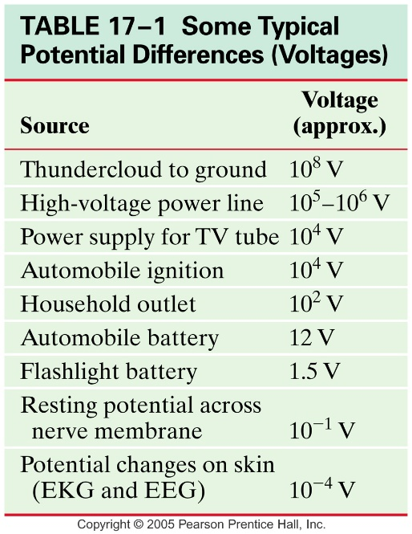
Electric Potential Difference = Voltage
NOTE:
Electric Potential Difference is aka Voltage
whose standard variable is V (in italics)…
measured in volts,
whose abbreviation is V…
a little confusing.
Anyway, what does all this mean?
Basically, that while electric potential difference is a fundamental quantity used in the study of electricity, you shouldn’t read more into it than is really there.
Looking at the chart, it’s easy to assume that more voltage means more danger, but that’s not necessarily true…
Our Van de Graaff generator creates up to 500,000 volts of electric potential difference, but without many free charges to push around, it’s not dangerous.
It’s like dropping feathers from 1 mile up… lots of gh, but hardly any mgh!

Slide 10
Math of (Electric) Potential Difference
If we expressed Electric Potential as
U_{e}/q = Ed
Then we can express (Electric) Potential Difference as
V = ΔU_{e} /q
or V = EΔd in a uniform field, E
And by V = kq/r²⋅Δd
or V = kq/r for a point charge, q
(where assumed V = 0 at r = ∞)
Units: Already covered this… J/C = Volts
& so does N⋅m/C = V
Recall in Ch 16: E = F/q so units of N/C,
and now E = V/d so units of V/m?
Right… if N⋅m/C = V, then N/C = V/m.

Slide 11
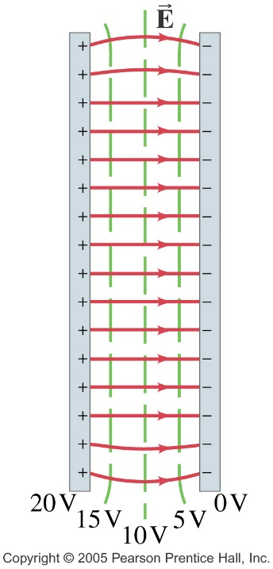
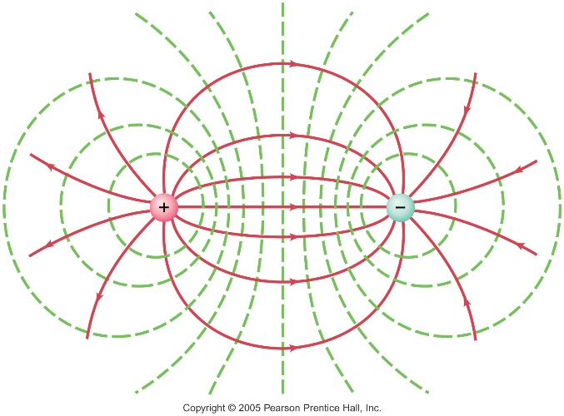
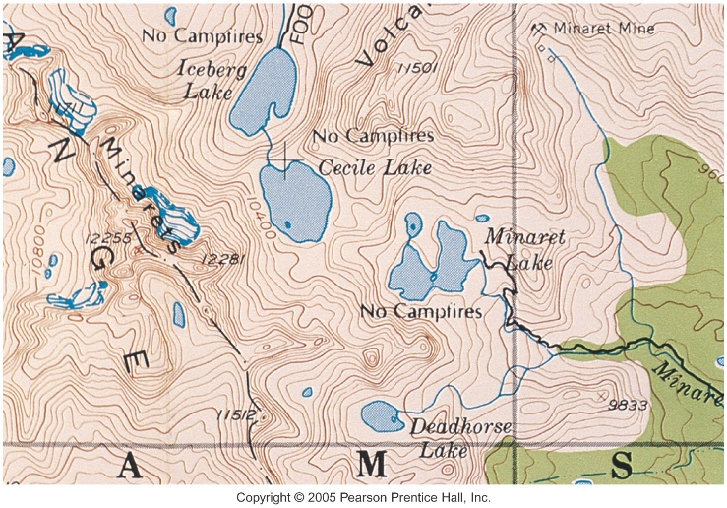
Equipotential Lines/Surfaces
An equipotential surface is one on which all points are at the same electric potential.
Or in the case of a typical 2D E diagram,
we’d be looking at equipotential lines.
Electric fields (lines) run perpendicular to
the equipotentials (lines).
The surface of any
conductor is an
equipotential surface.
We are familiar with an analogous version of these in map making…
Contour lines on topographic maps convey equal altitudes along them, but varying altitudes between them.

Slide 12
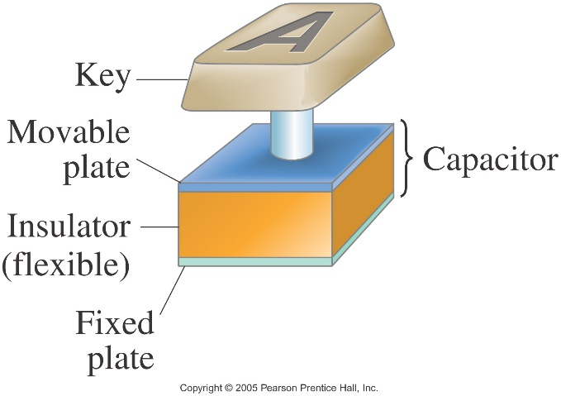
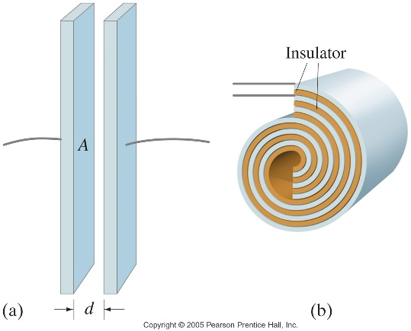
Capacitors
Constructed of two conducting parallel plates or sheets, near but not touching each other, then often rolled* into a cylinder to save space.
Device that stores electric charge for
a quick burst, to be used at a later time. Ex: _________
energy back up if there’s a short power failure. Ex: ___
blocking surges to protect components in a circuit
memory for binary code in computers
in the keypads on keyboard – depressing the key, reduces the spacing between the plates, which increases capacitance, which gets detected as an electronic signal - cool!!

Slide 13
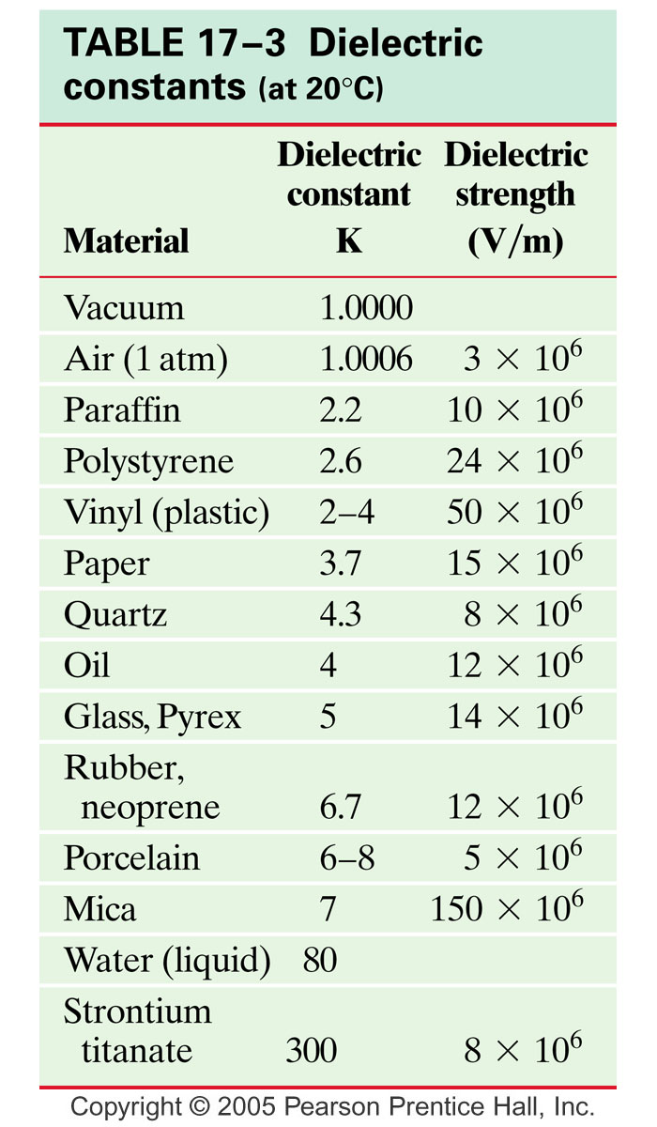
Dielectrics
* If the capacitor is rolled, then it needs an insulator – called a dielectric - between the plates.
Keeps plates from touching, so that a charge can in fact be stored up.
Increases the amount of charge that can be stored if the insulating strength – called dielectric constant – is better than air.

Slide 14
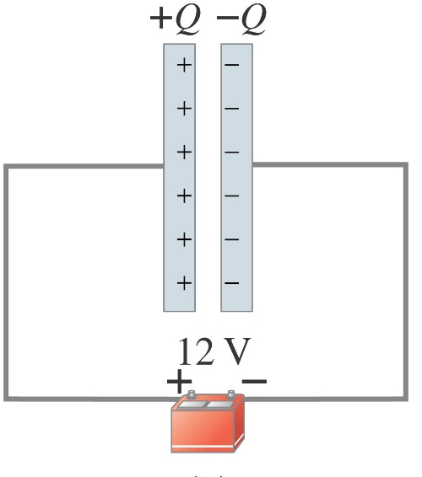
Math of Capacitance
When a voltage is applied across a capacitor,
by connecting each plate to the terminals of
a battery, the plates become equally, but
oppositely charged.
For a given capacitor, the amount of charge
acquired by each plate is directly proportional
to the potential difference between them,
or q α V
Where the constant of proportionality that makes this expression an equation is called capacitance, C (in italics)
so q = CV
in units of Farads, F so 1 F = 1C / 1V
The max capacitance of a capacitor can independently be determined by the area of, and distance between, the parallel plates: $C=Kε_{0 }\frac{A}{d}$, where K is the dielectric constant

