Slide 1
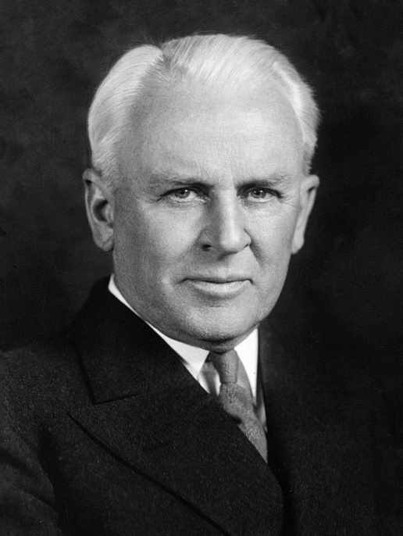
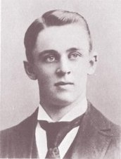
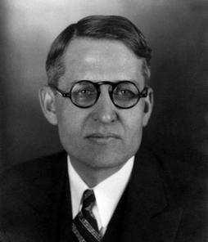
The Millikan Oil Drop Experiment
Robert Millikan (1868 -1953)
while a Professor at the University of Chicago, worked on the size of the elementary charge in 1908-1910 along with his grad student, Harvey Fletcher (1884-1981).
(young) (old)
Harvey Fletcher

Slide 2
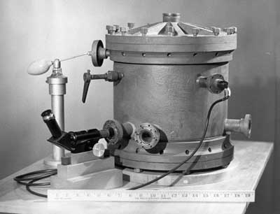
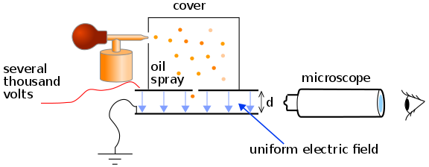
The Millikan Oil Drop Experiment
They sprayed tiny oil drops from an atomizer, which charged them, before they dropped through a hole into the electric field of a set of horizontal parallel plates.
There, with the plates off, they focused on a single charge falling at a constant speed, and determined its terminal velocity.
This allowed them to find its radius and then its mass.
Then with the plates on, they got that charge to hold still between the plates, which enabled them to be able to find the total charge on the drops.

Slide 3
The Math used in Millikan’s Experiment
1851 George Stokes – Stoke’s Law computed the drag (frictional) force on smooth, spherical object in viscous fluids: $F_{d}$ = $6πrην_{term}$
where r is radius & $η$ is viscosity of fluid
Then using F_{g} = mg where the mass = density ⋅ volume,
so $F_{g}$ = $(ρ_{oil}− ρ_{air})(4/3πr^{3})(g)$
Now if the drops hit terminal velocity, then F_{g} = F_{d},
and then r can be found: $r= \sqrt{\frac{9η_{air}ν_{term}}{2g(ρ_{oil}−ρ_{air})}}$
Once we know r, m can easily be found from density again:
$m$= ($ρ_{oil})(4/3πr^{3})$

Slide 4
The Math Used in Millikan’s Experiment
With the mass of the drop known, they could now turn the parallel plates on to make the new balancing act be between electric force and gravitational force:
F_{g} = F_{e}
mg = qE where E = V(oltage) /d(btwn plates) (from Ch 17) so mg = qV/d
then q = dmg/V
When they plotted the values of q, he noticed they were quantized, or whole number multiples of a base value…
They got the elementary charge, q_{e-} = 1.5924 x 10⁻¹⁹ C
Turns out it was off because they were using an incorrect value for the viscosity of air… oops! Still, he (only Millikan) got the Nobel Prize in Physics in 1923 for this, as well as other work.

