Slide 1
Electric Fields
Force fields – the space around an object where it is able to apply a force to something without touching it
Idea came from Michael Faraday in mid 1800’s
Used to explain the phenomenon of “force-at-a- distance” that started all the way back with Newton’s UL of G in mid 1700’s.
Other force fields: gravitational & magnetic
This space reaches out infinitely far in theory,
but in practice, its strength falls off by the ISL.
All force fields are vector quantities.

Slide 2
Understanding Electric Fields
The electric field is defined as the electric force per unit of charge, so E = F_{e}/q Units: newtons / coulomb
Interestingly enough, E doesn’t depend on the mag of q, because however you change q,
F_{e} will change proportional… by Coulomb’s Law…
Actually, you’ve seen this before, with gravity:
recall F_{g} = mg for weight, right?
If you doubled m, would that change g??
NO! Because F_{g} would change proportionately, so
g is the constant,
and can be called “gravitational field strength/const”
(instead of acceleration due to gravity) where:
gravitational field is defined as gravitational force per unit of mass, so g = F_{g} /m Units: newtons/kg (not m/s²)

Slide 3
Direction of Electric Fields
Unlike gravitational fields, that only apply a force in the direction “into the mass” that created them,
electric fields can apply both “into” and “out of” forces on charges, depending on if the charge is + or -.
So scientists needed a convention to define the direction of E: did it in terms of a test charge…
which refers to a small amount – relative to the charge creating the field – of positive charge.
That is to say the direction of E is defined to always point where the test charge would go if released at that point in the field. So in a field created by
a negative charge, that’s into the charge,
a positive charge, that’s away from the charge.

Slide 4
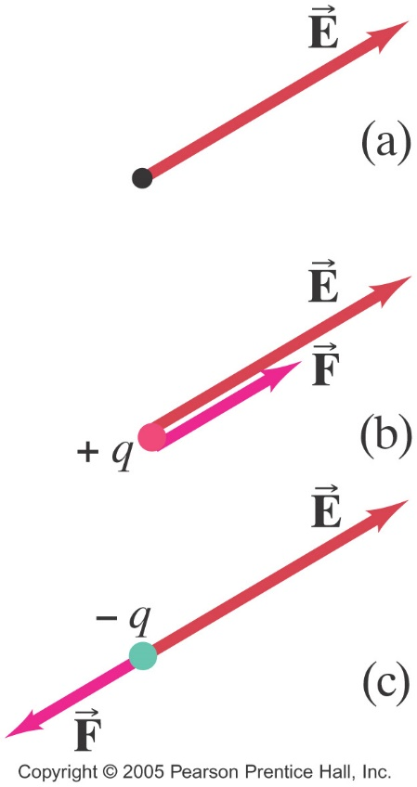
Direction of Electric Fields
Based on E = F_{e}/q:
if q is positive,
E & F are in the same direction,
if q is negative,
E & F are in opposite directions.
Note, this q is the charge in the field, not creating the field. We can tell that because E points in the same direction regardless of if q is + or -.

Slide 5
Back to Understanding Electric Fields
If the q in E = F_{e}/q doesn’t cause E to change, what does determine the strength of E, the electric field?
To answer that, let’s go back to Universal Gravitation:
Remember how F_{g} = F_{G} on the surface of a planet
and m?g = Gm₁m₂/r²
so g = Gm₍₁₎/r² ??
This means m₂ doesn’t affect the value of g, but m₁ does!
It’s the same for the two charges in Coulomb’s Law:
F_{e} = F_{e} (just for continuity with above)
and q?E = kq₁q₂/r² near a point charge
so E = kq₍₁₎/r² !!
So E is a measure of the effect of the charge creating the field at location r, unaffected by the charge placed at location r.

Slide 6
Math of Electric Fields
So now we have two equations that deal with E…
1st, the definition of all electric fields, no matter the shape of the charge creating them:
E = F_{e}/q (comparable to g = F_{g}/m)
where this q is the one in the field, (q₂)
and since this is a vector equation, include the sign on q, to find direction of E.
2nd, the equation for E created by a point charge:
E = kq/r² (comparable to g = Gm/r² ) – mag only
where this q is the one creating the field, (q₁), but since it’s derived from Coulomb’s law, it’s not a vector equation either, so don’t include the sign on q - instead figure out direction of E “manually”.
Note: Must remember which q is which in each equation!!
Both of them find E in units of newtons/coulomb or N/C.

Slide 7
Electric Fields Lines
Recall vectors can be represented by arrows of a particular length, pointing in a particular direction.
That has worked great up until now, but physicists came up with a more practical and useful way to indicate the strength of fields around an object that has one:
Concentration of lines, meaning the number of them in a given area, instead of length, to show strength of field. Their length, then, can be left as infinitely long to remind us of the size of the field.
Direction: as we already learned, points to where the test charge would go if released at that point in the field. So in a field created by
a negative charge, that’s into the charge,
a positive charge, that’s away from the charge.

Slide 8
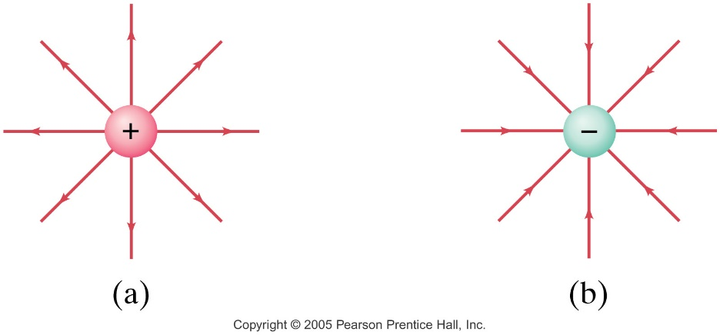
Electric Field Lines about a Point Charge
The lines are infinite
Arrows placed on them show the direction of the test charge if placed in the field at that point.
Fewer lines in the same amount of space indicate less field strength than space with a greater concentration of lines, but usually just within same diagram. If comparable, then different numbers of lines represent a particular amount of charge.
There’s still field between the lines - empty space is just to represent relative strength.
They’re also 3D! But that’s hard to draw on flat paper.

Slide 9
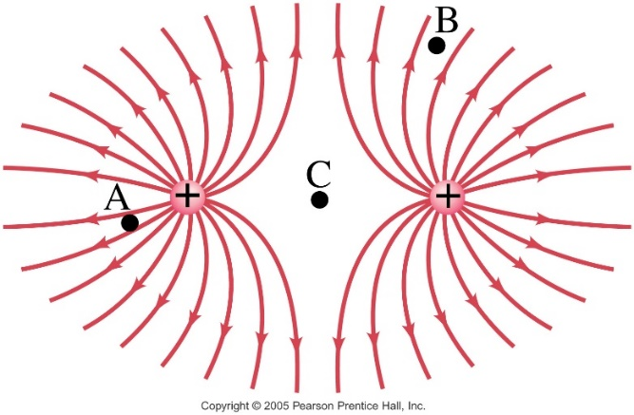
Superposition of Electric Fields
More than 1 E acting at the same location means vector addition… but with field lines, it simply creates diagrams where the “lines” curve.
(FYI: Fig (a) is an electric dipole.)
This means E at any particular spot acts tangent to the curved field lines.
If one of these charges disappeared, the lines around the other would be straight again.
These curves still map out the path of a test charge if placed in this field.
They will never cross: E can only have 1 direction at any particular spot, and crossing, would indicate 2 directions.

Slide 10
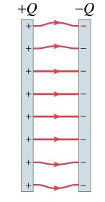
Electric Field between Parallel Plates
There are actually many uses for oppositely
charged parallel plates in everyday life –
The most common of which is in a
capacitor, which we’ll learn more about
in Ch 17.
Note, as long as the size of the plates is large compared to the separation distance between them, then the value of the E is a constant, as shown by the parallel, evenly- spaced electric field lines.
The equation to determine it is: E = 4πkq/A
A is area of one plate
q is the magnitude of charge on each plate

Slide 11
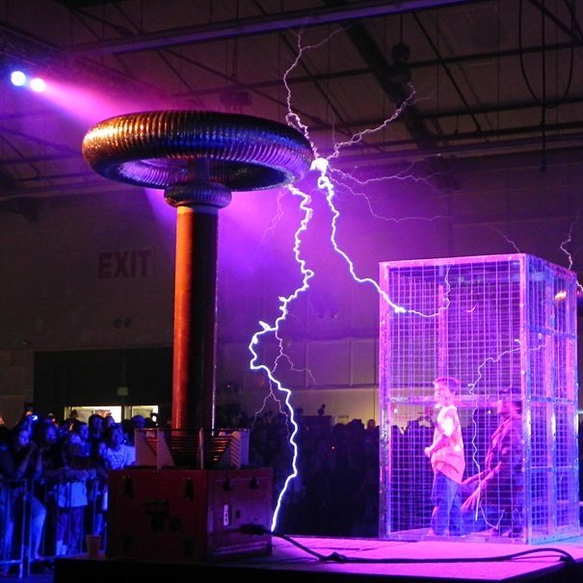
Electric Shielding
Using an encasement (box, cage, cover wrap) made of a conductor (metal) to protect (shield) anything (delicate electronics, you…) from the effects of charge.
Because charges will spread
themselves out over the surface
of a conductor in such a way as
to cancel each other’s field
inside the conductor.
The electric field inside an electric
shielding device is always zero –
naturally – the charges don’t come to rest until it is.
Often referred to as a Faraday’s Cage…

Slide 12
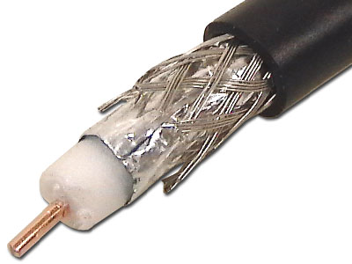
Electric Shielding
Ex: coaxial cable
electronic device cases (DVD)
electric guitars
your car in an electrical storm
an airplane too
To obtain this zero field strength, charges congregate on points and corners of various shapes.

Slide 13
A different, more fundamental constant than k…
The proportionality constant, k, can also be written in terms of ϵ₀, called the permittivity of free space,
where $ε_{0}= \frac{1}{4πk}=8.85 x {10}^{−12}$ C²/N∙m²
so for Coulomb’s Law: $F= \frac{1}{4πε_{0}}$ $\frac{q_{1}q_{2}}{r^{2}}$
This form of the equation looks more complicated, but in other fundamental equations that we haven’t learned yet, using ϵ₀ makes the equations simpler than using k.
ϵ₀ can also be used in the electric field eq’ns:
Pt chges: $E= \frac{1}{4πε_{0}}\frac{q}{r^{2}}$ Parallel plates: $E= q/{Aε_{0}}$

Slide 14
A Glimpse to the Future… _________________
When/If you study E&M in college, you’ll get right into Maxwell’s equations, named after James Clark Maxwell, who published them in 1861. He is also credited with 1st suggesting that light is an electromagnetic phenomenon.
They are a set of partial differential (calculus) equations that, together with the Lorenz Force law, form the foundation of classical electrodynamics, classical optics, and electrical circuits.
These areas of physics are the basis for all electric, optical and radio technologies like power generation, electric motors, wireless communication, cameras, televisions, computers etc.
Maxwell's equations describe how electric and magnetic fields are generated by moving charges, and changes of each other.
One important consequence of the equations is that fluctuating electric and magnetic fields can propagate at the speed of light, and this electromagnet radiation manifests itself in many ways from radio waves to light and X- or γ-rays.

Slide 15
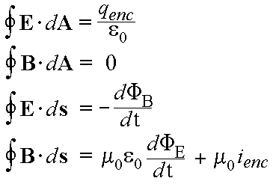
A Glimpse to the Future… Maxwell’s Equations
Coulomb’s Law
(Gauss figured out form)
Gauss’s Law
Karl, early 1800’s
Faraday’s Law
Ampere’s Law, with
Maxwell’s addition
Andre’-Marie, early 1800’s
Where E is electric field, B is magnetic field;
is flux – refers to the amount of something passing thru an area;
μ₀ is permeability of free space;
ε₀ is permittivity of free space;
Note: μ₀ε₀ ₌ (c²)⁻¹ All 3 “fundamental constants”… see front of text.

Slide 16
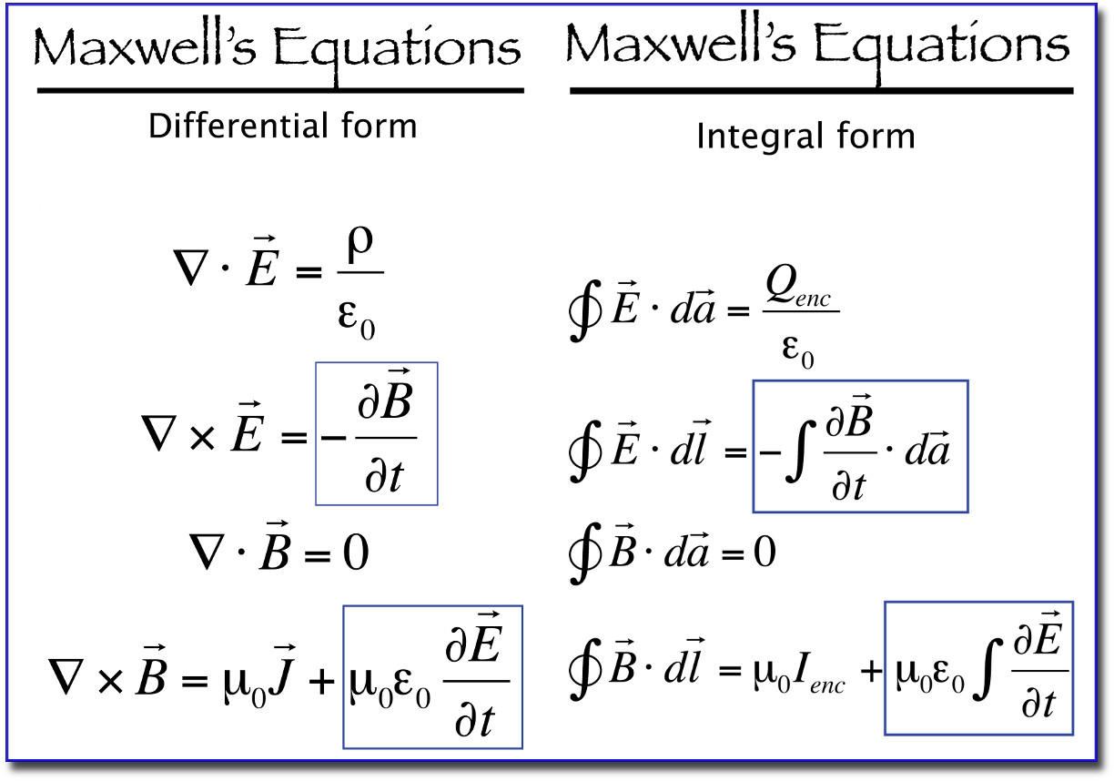
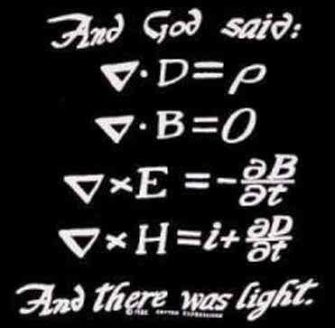
A Glimpse to the Future… Maxwell’s Equations
The equations have many “standard” forms…
and even…
Where ∇ is called the Del operator and
refers to a gradient or a change in space

