Slide 1
A Review of Basic Atomic Structure & Terms
Atom – smallest piece of any element that still has the properties of that element
electrically neutral: # of protons = # of electrons
Atomic number - # of protons in an atom
Determines what element it is.
Atomic weight (aka relative atomic mass) essentially tells how many protons & neutrons an atom has, but it’s never a whole number because natural elements have isotopes
Isotope – versions of the same element containing different numbers of neutrons in the nucleus
Ions – a charged atom
Positive ion – more p+ than e-, so lost electrons
Negative ion – more e- than p+, so gained electrons

Slide 2
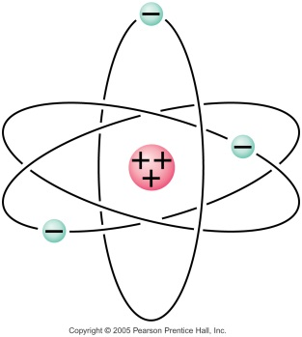
A Review of Basic Atomic Structure & Terms
Basic atomic structure :
YUCK!!
Almost beyond comprehension, the nucleus is incredibly small & dense, while the electrons are incredibly rare & far out! Stadium analogy…
The protons are tightly held in the nucleus by the Strong Nuclear force (one of the 4 fundamental forces) and so it takes a nuclear change (aka nuclear reaction – examples: fission or fusion) to change the number of protons in an atom!
But the electrons are WAY out there… often easily swiped away by even just the brush of a hand…
particle | symbol | location | mass (kg) | Charge (C)
proton | p⁺ | nucleus | 1.673 x 10⁻²⁷ | e = +1.602 x 10⁻¹⁹
electron | e⁻ | electron cloud | 9.11 x 10⁻³¹ | e = - 1.602 x 10⁻¹⁹
neutron | n⁰ | nucleus | 1.675 x 10⁻²⁷ | 0

Slide 3
Electrostatics and Basic Behavior
Electrostatics is the study of static electricity
electro refers to electric charge
the charge subatomic particles have… (e-, p⁺)
static means ‘at rest’
as opposed to moving,
which is called current electricity (Ch 18…)
Like charges repel; opposite charges attract…
with a force determined by Coulomb’s Law.
Law of Conservation of Electric Charge:
While charge can be moved from one place/object to another, the total amount of electric charge will remain the same… charge can’t be created or destroyed.

Slide 4
Insulators vs Conductors
Conductors:
electrons flows freely
due to low electron affinity
Ex: metals, water
Insulators:
almost no electrons flow
due to high electron affinity
Ex: plastics, glass, wood

Slide 5
3 Ways to Charge an Object
1. by Friction: rub 2 neutral objects together.
If they’re different electron affinities, one will give up e’s becoming positive and the other will grab the extra e’s becoming negative.
Ex: static cling in laundry or with clothes/hair
plastic slides at a park playground
water particles/clouds in a thunderstorm
2. by Conduction: touch charged object to a neutral one.
The excess charge will be looking to repel farther away and so the neutral one’s surface becomes a great place to do that – it ends up charged as well, with the same charge as the originally charged object.
Ex: metal leaves on an electroscope
if you’re charged (by friction typically), then you touch (shock) something

Slide 6
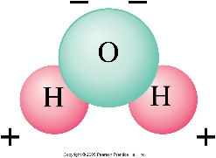
Before 3rd way, first need to know:
Induced Charge Separation: bring a charged object near, but don’t touch it, to a neutral one and the charges on the neutral one will separate. The “like” charges move away from the originally charged object, leaving the neutral object with a positive side and a negative side.
Ex: electroscope again, but don’t touch
it this time
rod sways stream of water due
polar H₂O molecules
in thunderstorms… the set up for
lightning to strike the ground

Slide 7
1 Way to Discharge an Object
Grounding: Connect it, either directly, or by means of a conducting material, to a much larger object, like the Earth, which is capable of accepting a lot of excess charge, but not becoming charged itself.
Ex: lightning rod
a shock from a anything (doorknob, person, etc) on a dry day
dangling wire from car/wheelchair
3rd prong or polarized plugs

Slide 8
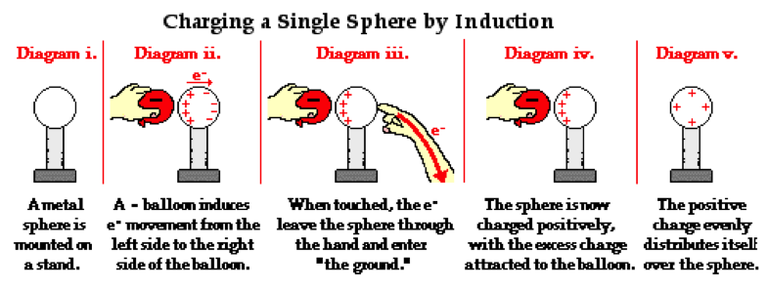
3 Ways to Charge an Object
3. by Induction: ground the neutral object while the charged rod is near, so electrons will move on/off the object because of the charge on the rod, leaving the object with the opposite charge as the rod.
If the rod is neg, electrons will drain from the object when grounded, so it ends up positively charged.
If the rod is pos, electrons will move onto the object when grounded, so it ends up negatively charged.

Slide 9
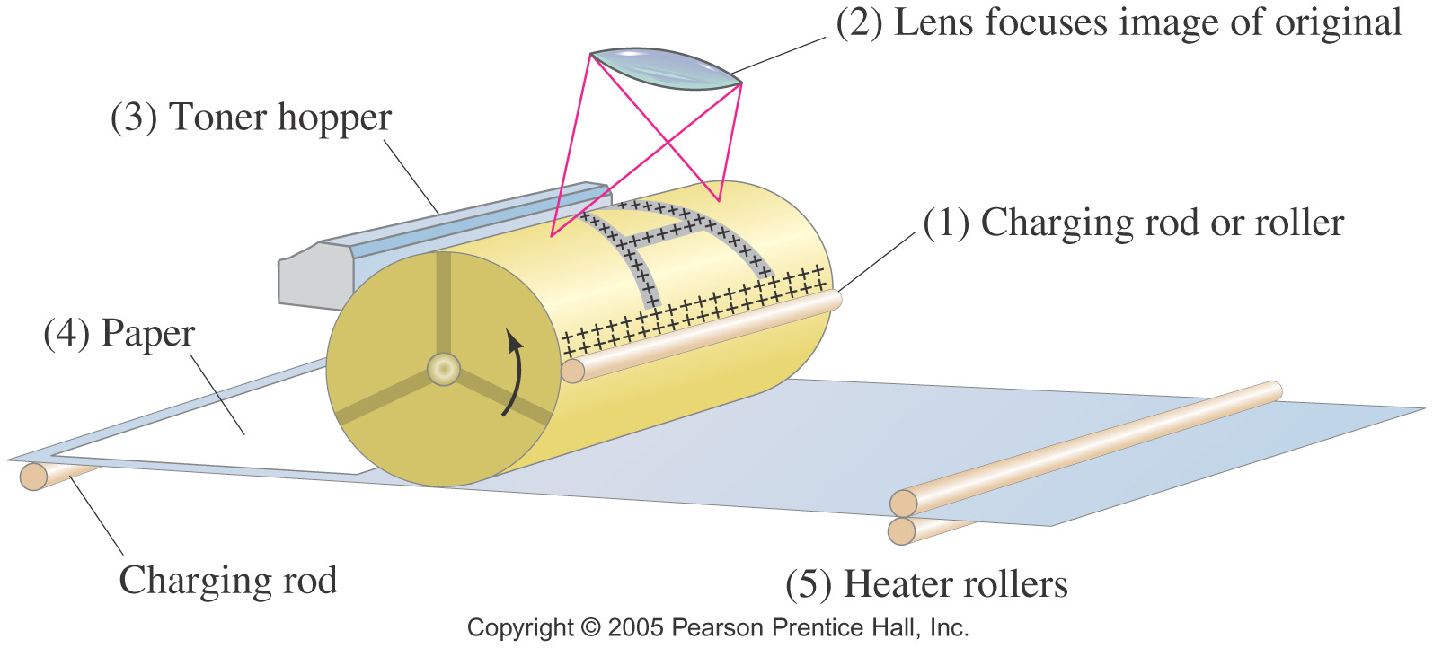
Examples of Electrostatics: Photocopy Machines
Photocopy machine:
drum is charged positively
image is focused on drum
only black areas stay charged and therefore attract toner particles
image is transferred to paper and sealed by heat

Slide 10
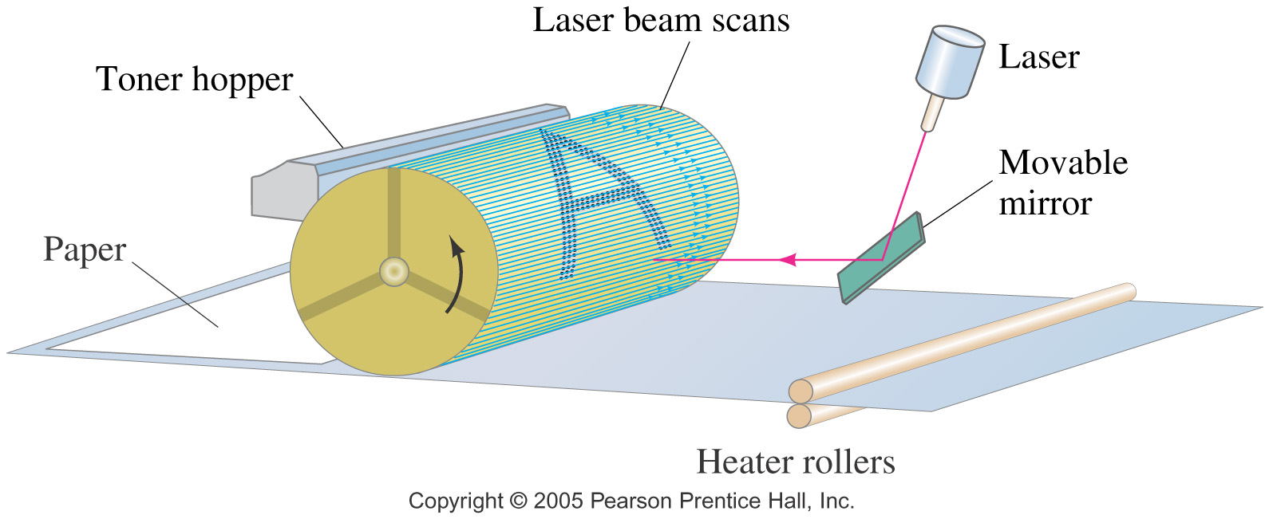
Example of Electrostatics: Computer Printers
Laser printer is similar, except a computer controls the laser intensity to form the image on the drum

Slide 11
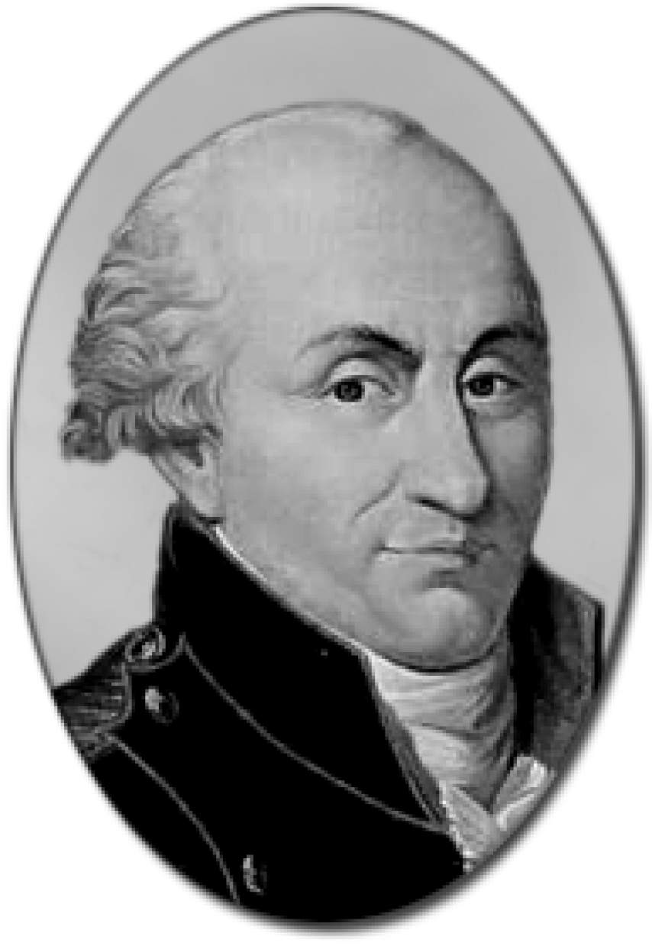
Some History of Coulomb’s Law Experiment
Joseph Priestley*, in 1767, is 1st to believe that electric force strength follows inverse square law. Recall: ISL first thought of by Newton in 1680’s and/or Robert Hooke, Newton’s arch nemesis :)
Charles-Augustin de Coulomb invented the torsion balance in 1777 and in 1785 publishes what is now known as Coulomb’s Law.
Aside: John Michell came up with his own torsion balance around 1782, then died suddenly in 1793. It got passed to Henry Cavendish, and by 1795, Cavendish used the idea to figured out the proportionality constant, G, in Newton’s Universal Law of Gravitation.
* Priestly also founded Unitarianism & supported the French Revolution… fled to USA in 1791 – lived in Northumberland County PA til death.

Slide 12
Coulomb’s Law
Name after French Charles Coulomb; published in 1785:
Coulomb’s Law is the mathematical relationship that is used to determine the strength of the electric force (F_{e}) between 2 charged particles (q) or objects.
Extremely similar to Newton’s Universal Law of G! (p507)
NUL of G
Any 2 masses attract
F_{G} = Gm₁m₂/r²
Remember inverse square?
G = 6.67 x 10⁻¹¹ Nm²/kg²
CL for Electric Charges
Any 2 charges attract
or repel!
F_{e} = k q₁q₂/r²
So inverse square as well
k = 9.0 x 10⁹ Nm²/C²
That’s a huge difference between constant values!! k ≈ 10²⁰ bigger than G

Slide 13
That’s why…
hair can stick up with balloon or sweater
socks hang onto each other out of the dryer
we can get pith balls to “dance”
Correct interpretation of these phenomena:
The F_{g} of the entire Earth is weaker than the F_{e} of the tiny charged particles (p’s & e’s) on these objects!
We don’t hear much about F_{e}, even though it’s so much stronger than F_{g}, because most objects are electrically neutral, so F_{e} = 0, but objects always have mass, so there’s always F_{g}.
But at the atomic/molecular level, it’s responsible for all the forces we’ve studied so far, except gravity!
all contact forces (pushes & pulls)
like: friction, tension, applied, elastic & normal force!

Slide 14
A few additional notes on F_{e} = kq₁q₂/r²
charges (q’s) must be small relative to the distance between them – called point charges
q is the quantity of charge present on an object
units are Coulombs (C)
Charge is quantized – smallest amt possible called elementary charge – the amt of a single e- or p+:
q_{e} = -1.6 x 10⁻¹⁹ C & q_{p} = +1.6 x 10⁻¹⁹ C
So then 1 Coulomb of charge has 6.25 x 10¹⁸ individual charges in it!
If q’s are the oppositely charged,
then F_{e} is an attractive force
If q’s are similarly charged,
then F_{e} is a repulsive force

Slide 15
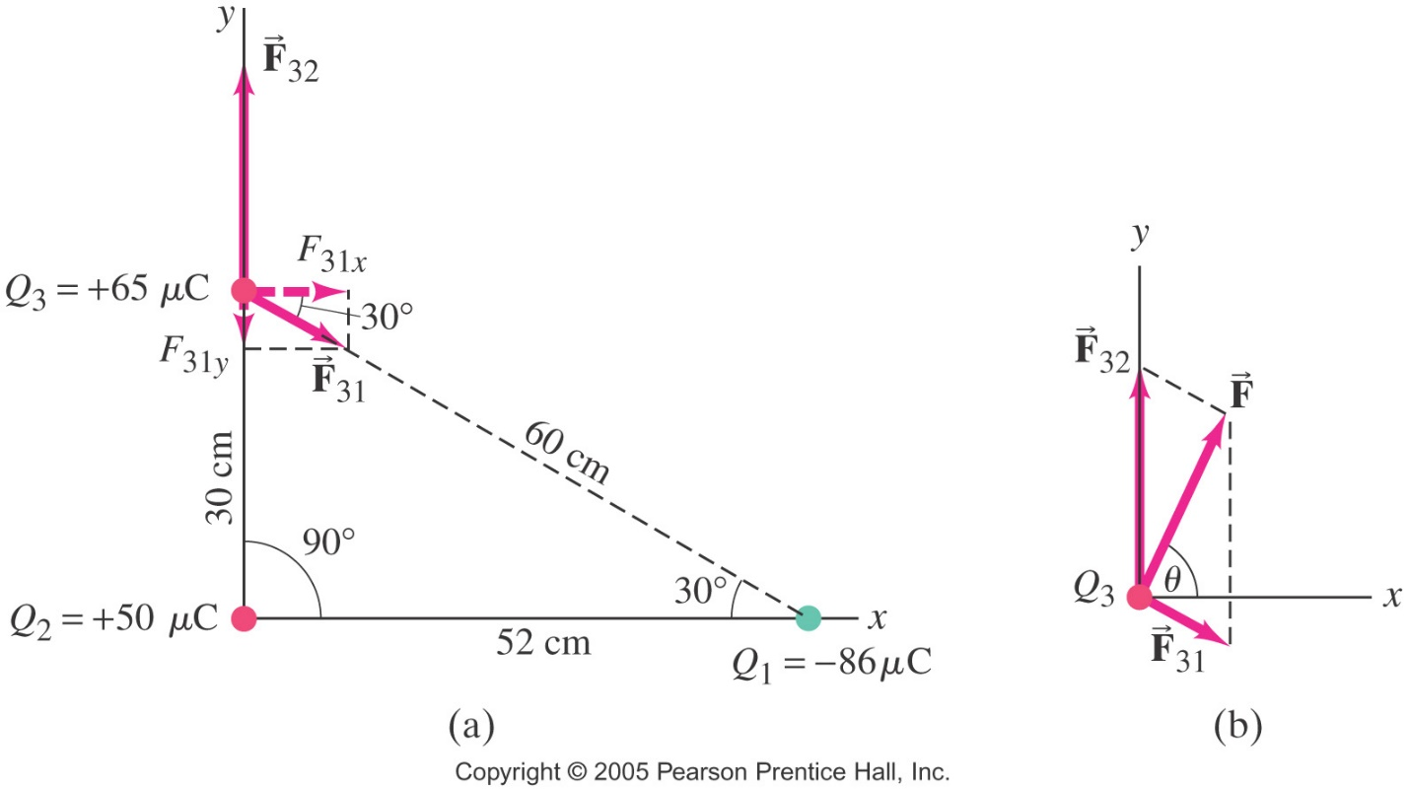
Superposition for Electric Charges
Principle of Superposition: for multiple point charges, the forces on each charge, from every other charge, can be calculated and then added as vectors.
The net force on a charge is the vector sum of all the forces acting on it. ΣF_{on q} = ₁F_{q} + ₂F_{q} +₃F_{q} + …
1st: find F between each set of charges, using Coulomb’s law.
2nd: add up those F’s using vector addition techniques.

Slide 16
Review of Vector Addition
original vectors to be added
adding them tip to tail
(c) adding them by parallelogram
(d) adding them by components

